Slide 1
MICHAEL ZUREN, PhD
Lake County Treasurer
Joey Tomsick
President, Lake County Council on Aging

Slide 2

FINANCIAL TIPS FOR SENIORS CITIZENS

Slide 3
Objectives:
Guard against identity theft
Manage your money
How to identify & report financial exploitation
Resources & information on protecting your assets

Slide 4
Why are older adults at risk of financial exploitation?

Slide 5
Some older adults may:
Have regular income and accumulated assets.
Be trusting and polite.
Be lonely and socially isolated.
Be vulnerable due to grief from the loss of a spouse, family member, friend, or pet.

Slide 6

Exploitation by Caregivers and
In-Home Helpers – Tips to Defend Yourself at Home

Slide 7
Secure your private financial documents.
Require receipts for purchases made by helpers.
Monitor bank accounts and telephone bills.
Do not let hired caregivers or helpers open your mail, pay your bills, or manage your finances.

Slide 8
Never let caregivers use your credit/debit card to run errands or make purchases.
Check your free credit reports at annualcreditreport.com

Slide 9
Budget Closely and Track Expenses
Never Stop Learning About Finances
Automate Your Finances

Slide 10
How do I check the credentials of my financial adviser?
You can check a broker’s background via the Financial Industry Regulatory Authority (FINRA) BrokerCheck at finra.org or by calling 1-800-289-9999

Slide 11
Scam where debt collectors try to trick their victims into paying a debt that doesn’t exist, and demand the debt is paid immediately!

Slide 12
Planning ahead:
* Gives you control and options for your situation
* Allows time for gathering information, comparing options, and determining how to handle it

Slide 13

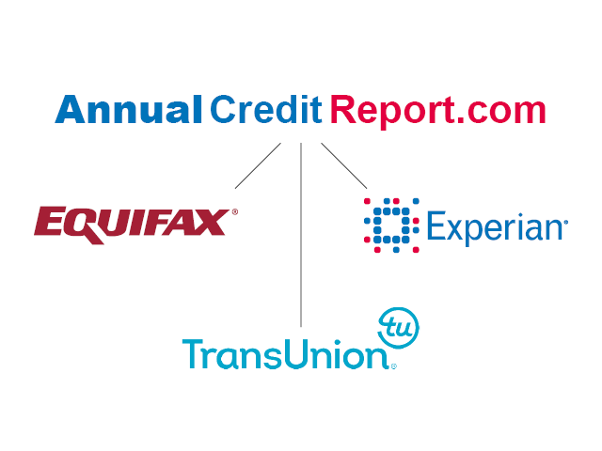
KEEP A CLOSE EYE ON CREDIT

Slide 14
Your Personal Monthly Budget

Slide 15
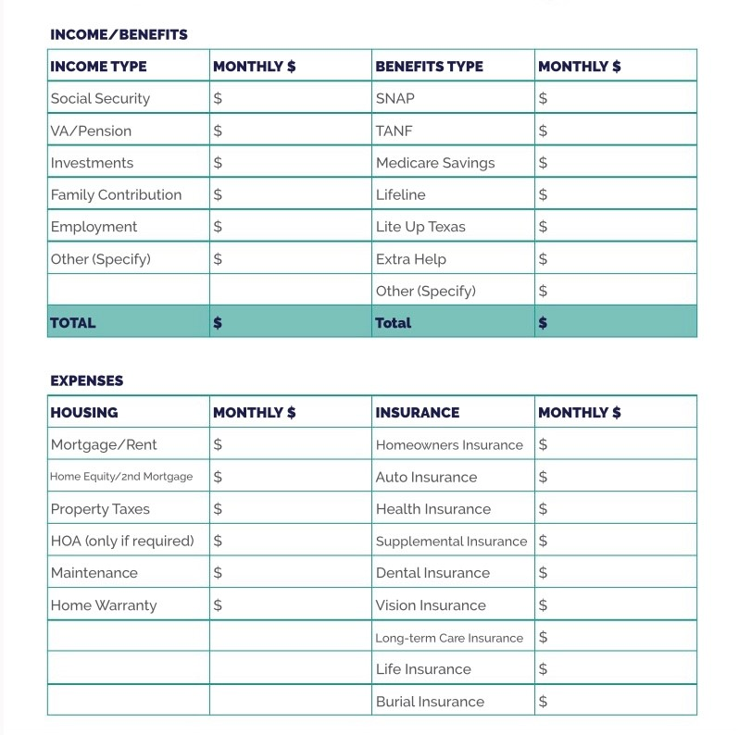

Slide 16
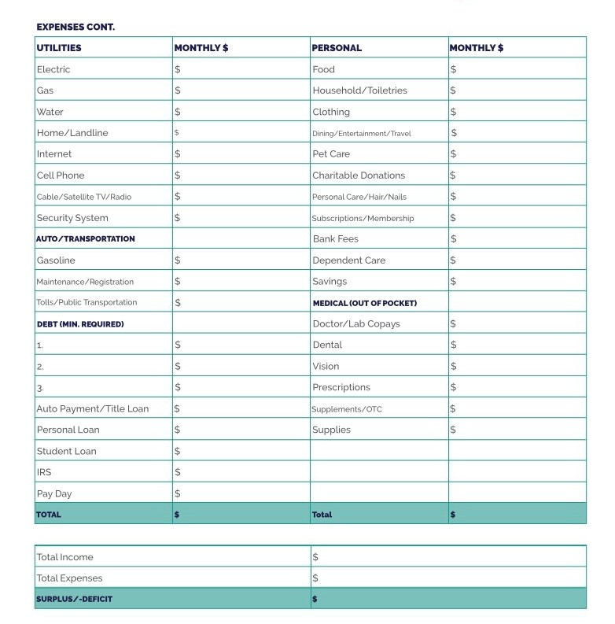

Slide 17
Programs for Seniors
Homestead Exemption Qualifications
Must be 65 or older or totally disabled
You must own your home on January 1st in the year you are applying for the homestead exemption
If house is in a Trust or Life Estate, copy of trust is required
Must be your primary Residence
Income limitations $38,600 (2024) to qualify based on the Modified Adjusted Gross Income (located on line 3 of the State Income Tax Return plus line 11 of the Ohio Schedule A)
If you do not file a State Tax Return, proof of age is required with completed exemption application
If qualified, Law Exempts the first $25,000 of value

Slide 18
Programs for Veterans
Disabled Veterans and Surviving Spouses Program
Must be 100% disabled for the year applying for exemption
VA disabled Veterans do not have any income requirements
If qualified, Law Exempts the first $50,000 of value
Notes:
18

Slide 19
How to obtain an application
Christopher Galloway
Lake County Auditor
105 E. Main Street
Painesville, Ohio 44077
Attn: Homestead Dept
440-350-2532
Form available online at Auditor’s website
www.lakecountyohio.gov/auditor

Slide 20
In an effort to assist low-income senior citizens with utility costs, the Board of Lake County Commissioners and the Department of Utilities established a program to provide a 30% discount on LAKE COUNTY water and sewer bills
must be 65 years of age or older
own and occupy the property
meet the income qualifier established by the Ohio Homestead Exemption
Residents must contact the utilities office 440-350-2070 or visit lakecountyohio.gov/utilities and print Senior Citizen Discount Application

Slide 21
Your bank will never send you an email asking you to verify your account number or any other identifying information.
True
False

Slide 22
Where can you check a financial adviser’s background?
FINRA BrokerCheck
Social Security Administration
State Securities Regulator
Federal Trade Commission

Slide 23
What can you do to prepare financially for a disaster? a. Set up automatic bill payments b. Know where to find important documentation in an emergency. c. Review insurance information regularly to ensure you have adequate coverage. d. All of the above.

Slide 24
Which forms of identification should you have readily available in case of emergency?
Driver’s License
Insurance Card
Social Security Card
Passport
Birth Certificate

Slide 25
Who of the following may be perpetrators of elder financial exploitation? Select all that apply. a. Family members and caregivers b. Friends or neighbors c. Telephone and mail scammers d. Financial advisers

Slide 26
If you receive a call or an email from someone claiming to be in trouble and in need of emergency funds, what should you do? Select all that apply. a. Call the individual at a known phone number to verify that the need is legitimate. b. Immediately wire funds to the account number provided. c. Hang up immediately. d. If the call is from a hospital or law enforcement agency, look up the number to verify who it is.

Slide 27
What is TRUE of a durable power of attorney (POA)?
a. It remains in place if you become incapacitated.
b. It allows the person you select to make financial decisions on your behalf.
It can be changed or revoked.
No one else can monitor the actions of your designated POA.

Slide 28
What practices should you AVOID in selecting someone to repair your roof?
Getting three bids in writing from local established contractors.
Using contractors who come to your door and tell you they are working for a neighbor.
Asking if the contractor has the required licenses and getting his/her license numbers.
Paying in advance.

Slide 29
Questions and Answers

