Slide 1
FINANCIAL LITERACY
PRESENTED BY LAKE COUNTY TREASURER, MICHAEL ZUREN

Slide 2
BUILD YOUR FINANCIAL WELL-BEING
Spend less than you earn
Save for future spending
Only borrow what you can afford
Grow your earning capacity
Protect what you have

Slide 3
COURSE TOPICS
Planning and goals
Career preparation
Spending and credit
Consumer protection
Income
Money management
Saving and investing
Risk management

Slide 4
WHY IS FINANCIAL EDUCATION IMPORTANT?
STUDENTS EXPOSED TO AN ECONOMIC WAY OF THINKING AND TO PERSONAL FINANCIAL CONCEPTS AT AGE APPROPRIATE LEVELS CAN MORE EASILY APPLY SOUND DECISION-MAKING SKILLS, DEVELOP STABLE SAVING AND SPENDING HABITS, AND LINK EDUCATION SUCCESS TO CAREER AND LIFE SUCCESS

Slide 6
EXAMPLE
Gross Pay 500.00
Federal 33.27
FICA 31.00
Medicare 7.25
State 5.20
Net Pay 423.28

Slide 7
SMART goals are: Specific Measurable Attainable Realistic Time Bound
An example of a clearly written financial goal would be:
“To pay off credit card bills by 2024.”
“To save money for college for the next five years.”
“To establish an emergency fund of $2,000 in 18 months.”
All of the above
An example of a long-term goal would be:
A family vacation
Buying a used car
Purchasing a cell phone
Saving for retirement

Slide 8
Nicole set a goal to buy a car in the next few months. She plans to make a $2,500 down payment and has already saved $1,300. If she can save $150 each month, how long will it take her to save the entire $2,500: A . 6 months B. 8 months C. 10 months D. 12 months

Slide 9
28
Values, peers, family,
feelings, and habits can influence:
Education
Relationships
Financial Decisions
All of the above

Slide 10
Financial Tips for Young Adults
Learn Self-Control
If you’re lucky, your parents taught you this skill when you were a kid. If not, keep in mind that the sooner you learn the fine art of delaying gratification, the sooner you’ll find it easy to keep your personal finances in order. Although you can effortlessly buy an item on credit the minute you want it, it’s better to wait until you’ve actually saved up the money for the purchase. Do you really want to pay interest on a pair of jeans or a box of cereal?

Slide 11
If you make a habit of putting all your purchases on credit cards despite not being able to pay your bill in full at the end of the month, then you might still be paying for those items in 10 years.

Slide 12
Credit cards are convenient, and paying them off on time helps you build a good credit score. And some offer appealing rewards.
Except in rare emergencies, though, make sure to always pay your balance in full when the bill arrives. Also, don’t carry more cards than you can keep track of. This financial tip is crucial for creating a healthy credit history.

Slide 13
A debit card is equally handy and takes the money from your checking account at once, keeping you from racking up an interest-bearing balance.
A debit card is equally handy and takes the money from your checking account at once, keeping you from racking up an interest-bearing balance.

Slide 14
“Pay yourself first.” No matter how much you owe in student loans or credit card debt, and no matter how low your salary may seem, it’s wise to find some amount—any amount—of money in your budget to sock away in an emergency fund every month.

Slide 16
EDUCATOR
SALARY: $4,000
NET PAY: $3,200
FIXED EXPENSES:
RENT $800
UTILITIES $200
STUDENT LOAN $300
INSURANCE $100
VARIABLE EXPENSES:
SAVINGS
GROCERIES
DINING OUT
ENTERTAINMENT
CLOTHING
DOG / CAT
CAR PAYMENT
CHARITY

Slide 17
MANUFACTURER
SALARY: $3,000
NET PAY: $2,400
FIXED EXPENSES:
RENT $800
UTILITIES $200
INSURANCE $100
VARIABLE EXPENSES:
SAVINGS
GROCERIES
DINING OUT
ENTERTAINMENT
CLOTHING
DOG / CAT
CAR PAYMENT
CHARITY

Slide 18
RETAILER
SALARY: $2,500
NET PAY: $2,000
FIXED EXPENSES:
RENT $800
UTILITIES $200
INSURANCE $100
VARIABLE EXPENSES:
SAVINGS
GROCERIES
DINING OUT
ENTERTAINMENT
CLOTHING
DOG / CAT
CAR PAYMENT
CHARITY

Slide 19
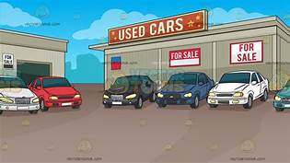
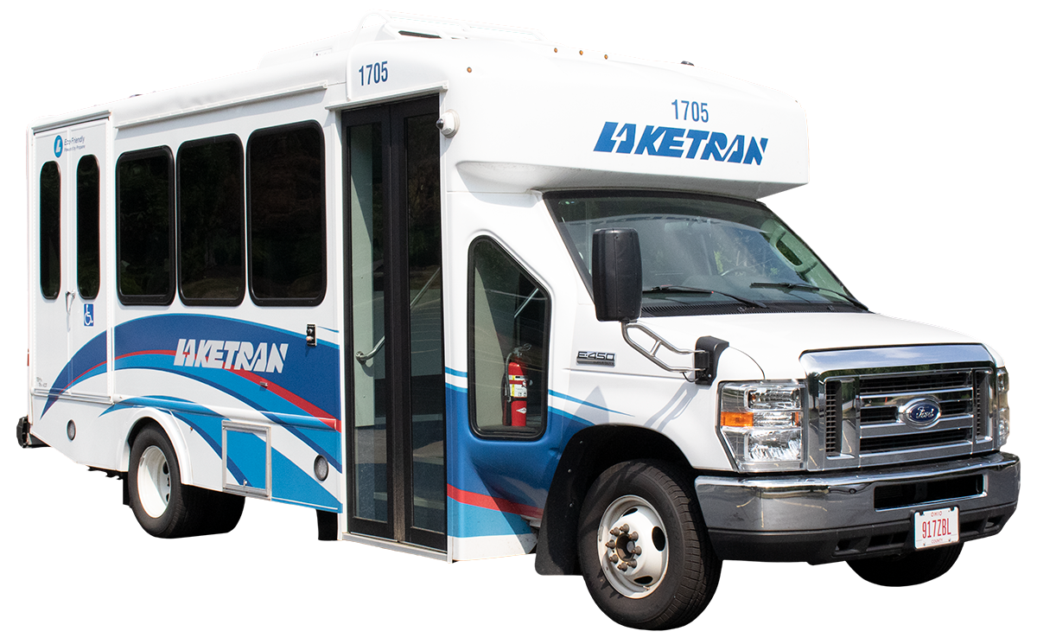
MONTHLY FIXED EXPENSES:
RENT $800
UTILITIES $200
INSURANCE $100
CELL PHONE $100
MONTHLY VARIABLE EXPENSES:
SAVINGS $0 or $50 or $100
GROCERIES $300
DINING OUT $25 PER MEAL
FAST FOOD $10 PER MEAL
ENTERTAINMENT $0 or $50 or $100
CLOTHING $0 or $50 or $100
DOG / CAT $0 or $100
CAR PAYMENT $250 used / $400 new
GASOLINE $100
CAR REPAIRS $100
LAKETRAN $0 or $100
CHARITY $0 or $50 or $100

Slide 20
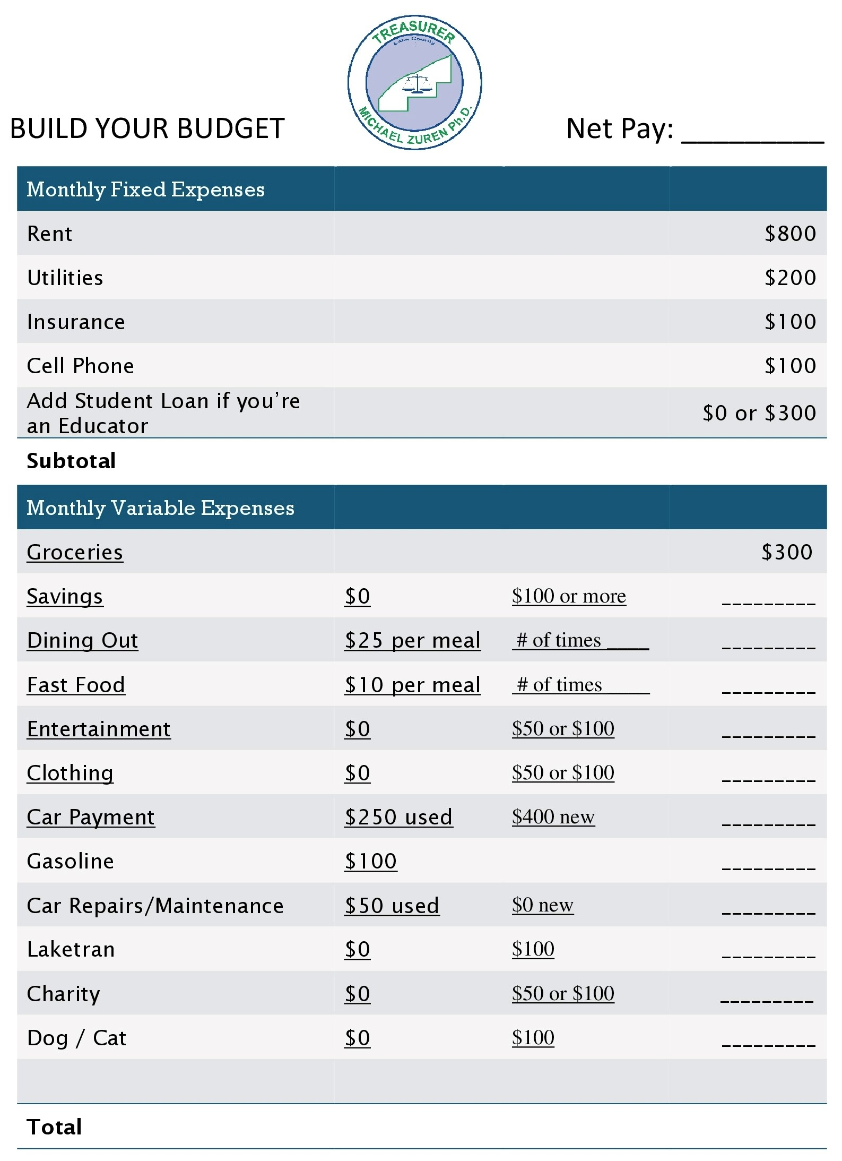

Slide 21
WINDFALL OR EXPENSE

Slide 22
setting up and maintaining a budget
income | budget | actual | difference
Job #1 | $ | $ | $
Job #1 | $ | $ | $
Other | $ | $ | $
total monthly income | $ | $ | $
expenses | budget | actual | difference
fixed regular expenses
Rent | $ | $ | $
Car insurance | $ | $ | $
Car payment | $ | $ | $
Credit card | $ | $ | $
fixed irregular expenses
Savings | $ | $ | $
Food | $ | $ | $
Utilities | $ | $ | $

Slide 23
setting up and maintaining a budget (continued)
expenses | budget | actual | difference
transportation
Bus fare | $ | $ | $
Gas and oil | $ | $ | $
Parking and tolls | $ | $ | $
Repairs | $ | $ | $
other
Medical expenses | $ | $ | $
Clothing | $ | $ | $
Entertainment | $ | $ | $
Household items | $ | $ | $
Personal items | $ | $ | $
Tuition | $ | $ | $
School expenses | $ | $ | $
total monthly expenses | $ | $ | $

Slide 24
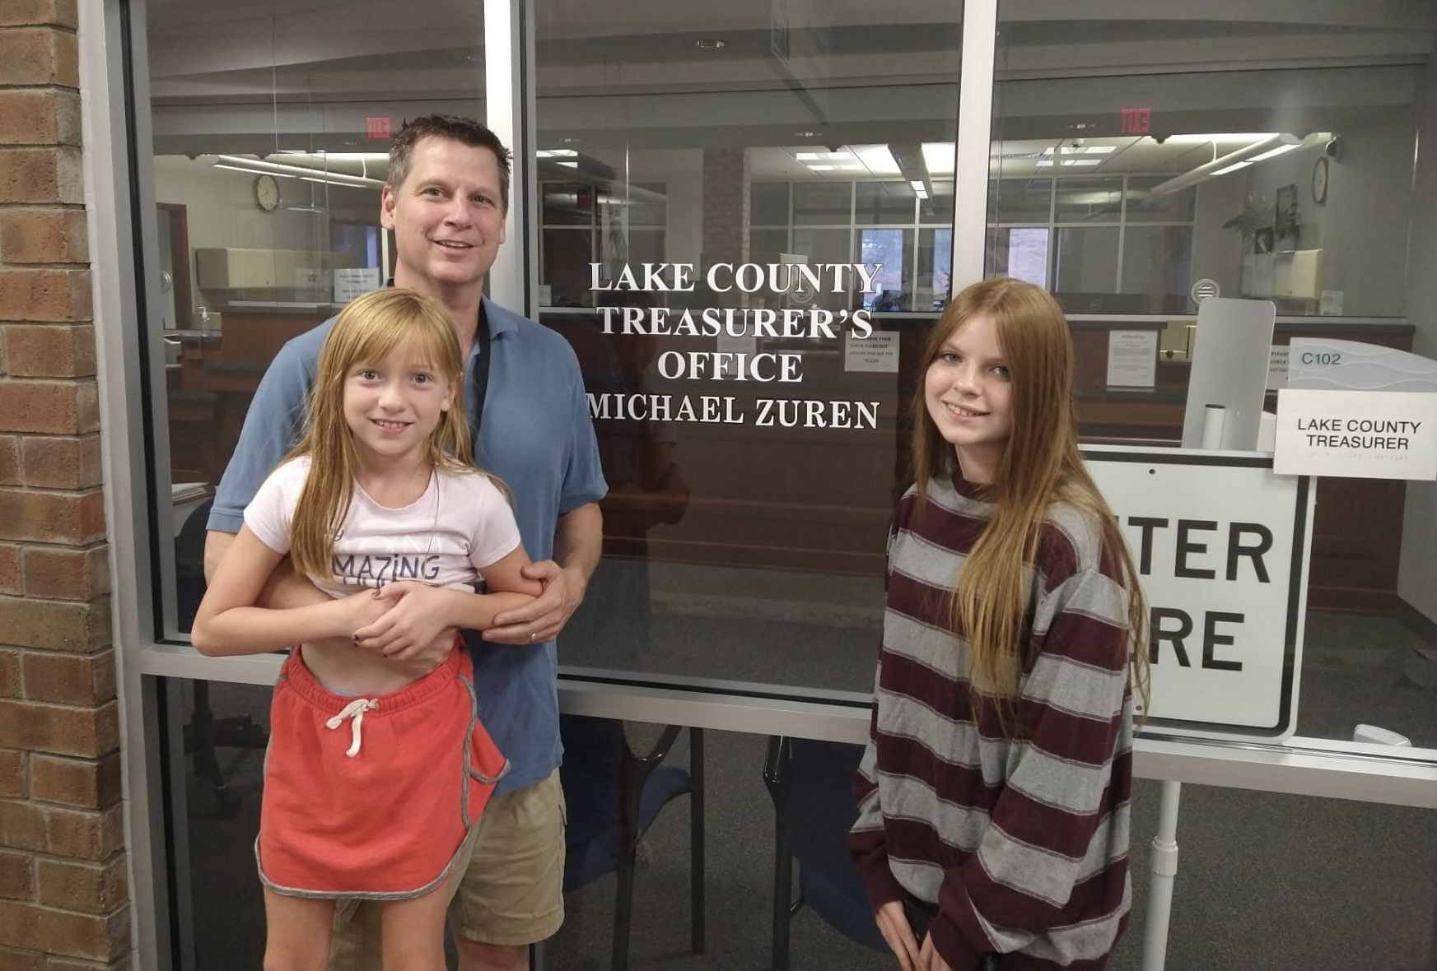
Which of the following is affected by one’s values in life?
Decisions
Goals
Personal life
All of the above

Slide 25
CREDIT is the ability to borrow money or access goods or services with the understanding that you’ll pay later.

Slide 26
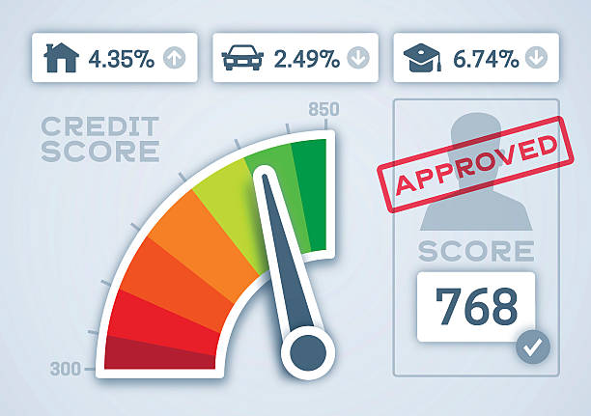
What Makes up a Credit Score?
Do credit scores matter when applying for credit (credit cards, installment loans, or mortgages), insurance, or even a new job? The answer is simple. Banks, lenders, insurance companies, and employers all use credit scores to determine if you will be granted the credit applied for and what the interest rate will be, if you are hired, or the risk of insuring you. This system used by banks and lenders is often referred to as “risk-based pricing”. Credit scores are the lender’s indicator of risk or the likelihood a borrower could default on a debt. Consumer credit agencies such as Transunion, Equifax, and Experian have created algorithms or a statistical calculation, which use an individual’s past credit history and use of credit to measure the likelihood they would become late or default on their debt.

Slide 27
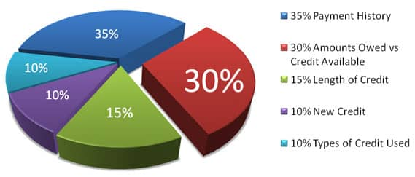
How Credit Scores are Calculated:
The Fair Isaac Corporation developed the “FICO” scoring system. Under this system, credit scores range between 300 and 850.

Slide 28
What is sales tax?
1. tax paid on income
tax earned on savings
tax paid on purchases
tax paid on all expenses
What is interest?
1. money paid on purchases
money earned on an account
money paid for expenses
money paid on taxes

Slide 29
MANY PROFESSIONAL ATHLETES AND CELEBRITIES – PEOPLE WHO CAN AFFORD TO LIVE DESIRED LIFESTYLES – HAVE GOALS FOR THEIR PROFESSIONAL AND PERSONAL ACHIEVEMENTS. WHY DO SUCCESSFUL PEOPLE SET GOALS?
A. Goal-setting allows them to measure progress toward accomplishments or lifestyle changes they desire
B. Setting goals provides them with direction
C. Goal-setting gives them an opportunity to show off to others
D. Both “a” and “b”

