Slide 1
New 12 month payment plan | Homestead & VA tax credits
Financial Literacy | Identity Theft
CHRISTOPHER GALLOWAY,
Lake County Auditor

Slide 2
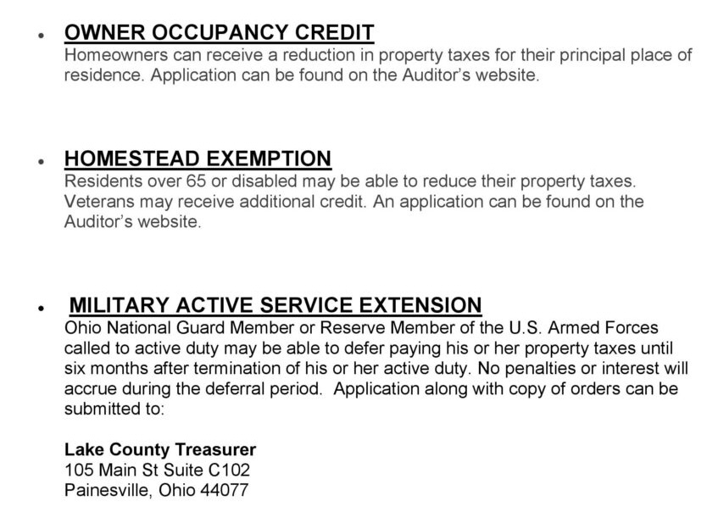
Tax
Savings

Slide 3
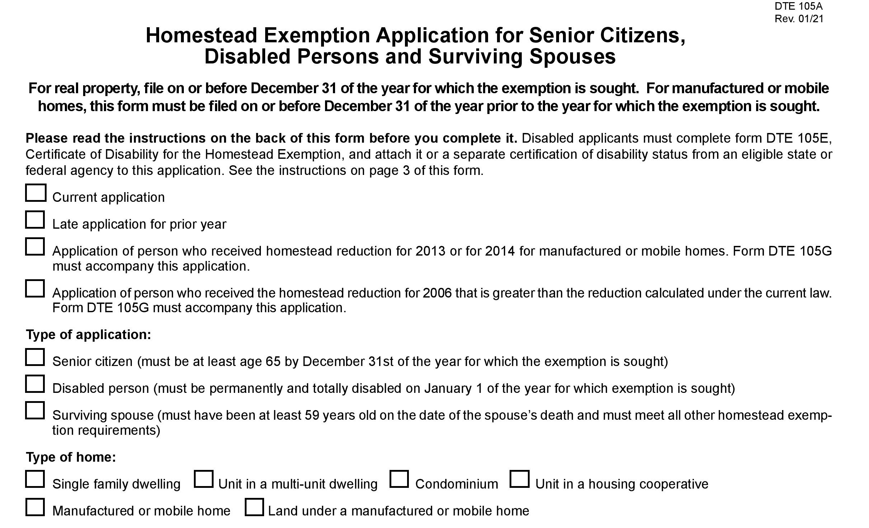

Slide 9
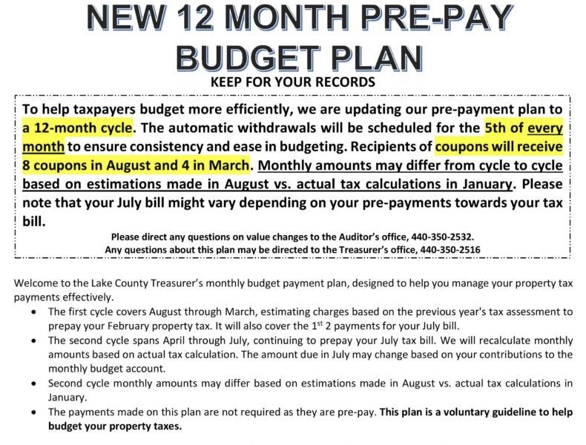
CHRISTOPHER GALLOWAY,
Lake County Auditor

Slide 10
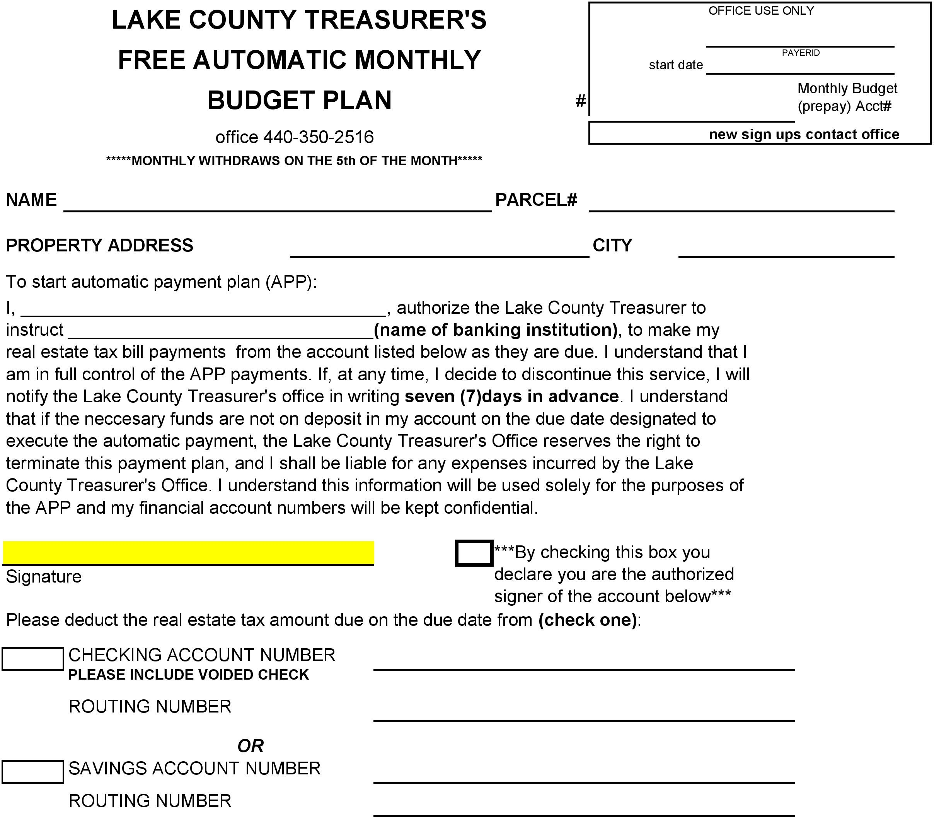

Slide 17
Identity Theft Explained
Identity theft occurs when a criminal steals your personal information and uses it without your permission, looking to steal your money, data and other personal assets.

Slide 18
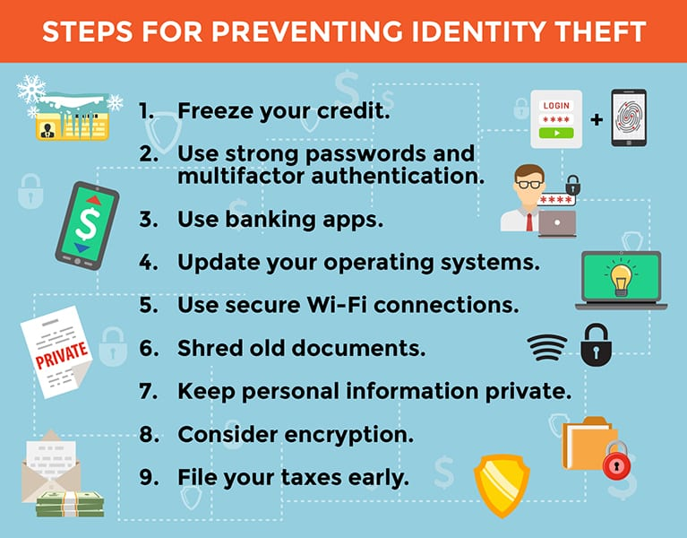

Slide 19
If you’re a victim: Contact Federal Trade Commission IdentityTheft.gov

Slide 24
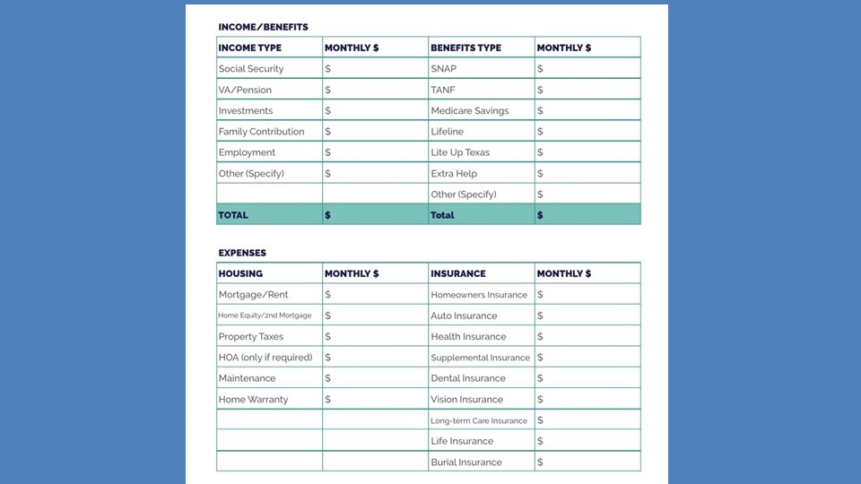

Slide 25
