Slide 1
FINANCIAL LITERACY
PRESENTED BY LAKE COUNTY TREASURER, MICHAEL ZUREN
and LAKE COUNTY AUDITOR, CHRISTOPHER GALLOWAY

Slide 2
BUILD YOUR FINANCIAL WELL-BEING
Spend less than you earn
Save for future spending
Only borrow what you can afford
Grow your earning capacity
Protect what you have

Slide 3
The Auditor oversees many critical functions of Lake County government.
The Auditor serves as the county’s chief fiscal officer, chief assessor, and sealer of weights and measures. As fiscal officer, the auditor is responsible for maintaining county financial records and issuing warrants for payment of county obligations.

Slide 4
As assessor, the auditor is charged with determining property values for taxing purposes and transferring real property deeds. As sealer of weights and measures, the auditor tests and certifies the accuracy of various commercial measuring devices, like gas pumps and commercial scales.

Slide 5
In addition to these formal roles, the Auditor serves as administrator of the county’s data processing center and secretary to the Data Processing Board, secretary and chairman to both the Board of Revision and the Budget Commission, and Chairman of the GIS Board. Other duties include issuing dog and vendor licenses, certifying tax rates, administering various tax reduction programs such as the Homestead Exemption.

Slide 6
COURSE TOPICS
Planning and goals
Career preparation
Spending and credit
Consumer protection
Income
Money management
Saving and investing
Risk management

Slide 7
WHY IS FINANCIAL EDUCATION IMPORTANT?
STUDENTS EXPOSED TO AN ECONOMIC WAY OF THINKING AND TO PERSONAL FINANCIAL CONCEPTS AT AGE APPROPRIATE LEVELS CAN MORE EASILY APPLY SOUND DECISION-MAKING SKILLS, DEVELOP STABLE SAVING AND SPENDING HABITS, AND LINK EDUCATION SUCCESS TO CAREER AND LIFE SUCCESS

Slide 9
EXAMPLE
Gross Pay 500.00
Federal 33.27
FICA 31.00
Medicare 7.25
State 5.20
Net Pay 423.28

Slide 10
SMART goals are: Specific Measurable Attainable Realistic Time Bound
An example of a clearly written financial goal would be:
“To pay off credit card bills by 2024.”
“To save money for college for the next five years.”
“To establish an emergency fund of $2,000 in 18 months.”
All of the above
An example of a long-term goal would be:
A family vacation
Buying a used car
Purchasing a cell phone
Saving for retirement

Slide 11
Nicole set a goal to buy a car in the next few months. She plans to make a $2,500 down payment and has already saved $1,300. If she can save $150 each month, how long will it take her to save the entire $2,500: A . 6 months B. 8 months C. 10 months D. 12 months

Slide 12
28
Values, peers, family,
feelings, and habits can influence:
Education
Relationships
Financial Decisions
All of the above

Slide 13
Financial Tips for Young Adults
Learn Self-Control
If you’re lucky, your parents taught you this skill when you were a kid. If not, keep in mind that the sooner you learn the fine art of delaying gratification, the sooner you’ll find it easy to keep your personal finances in order. Although you can effortlessly buy an item on credit the minute you want it, it’s better to wait until you’ve actually saved up the money for the purchase. Do you really want to pay interest on a pair of jeans or a box of cereal?

Slide 14
If you make a habit of putting all your purchases on credit cards despite not being able to pay your bill in full at the end of the month, then you might still be paying for those items in 10 years.

Slide 15
Credit cards are convenient, and paying them off on time helps you build a good credit score. And some offer appealing rewards.
Except in rare emergencies, though, make sure to always pay your balance in full when the bill arrives. Also, don’t carry more cards than you can keep track of. This financial tip is crucial for creating a healthy credit history.

Slide 16
A debit card is equally handy and takes the money from your checking account at once, keeping you from racking up an interest-bearing balance.
A debit card is equally handy and takes the money from your checking account at once, keeping you from racking up an interest-bearing balance.

Slide 17
“Pay yourself first.” No matter how much you owe in student loans or credit card debt, and no matter how low your salary may seem, it’s wise to find some amount—any amount—of money in your budget to sock away in an emergency fund every month.

Slide 19
EDUCATOR
SALARY: $4,000
NET PAY: $3,200
FIXED EXPENSES:
RENT $800
UTILITIES $200
STUDENT LOAN $300
INSURANCE $100
VARIABLE EXPENSES:
SAVINGS
GROCERIES
DINING OUT
ENTERTAINMENT
CLOTHING
DOG / CAT
CAR PAYMENT
CHARITY

Slide 20
MANUFACTURER
SALARY: $3,000
NET PAY: $2,400
FIXED EXPENSES:
RENT $800
UTILITIES $200
INSURANCE $100
VARIABLE EXPENSES:
SAVINGS
GROCERIES
DINING OUT
ENTERTAINMENT
CLOTHING
DOG / CAT
CAR PAYMENT
CHARITY

Slide 21
RETAILER
SALARY: $2,500
NET PAY: $2,000
FIXED EXPENSES:
RENT $800
UTILITIES $200
INSURANCE $100
VARIABLE EXPENSES:
SAVINGS
GROCERIES
DINING OUT
ENTERTAINMENT
CLOTHING
DOG / CAT
CAR PAYMENT
CHARITY

Slide 22
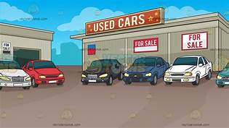
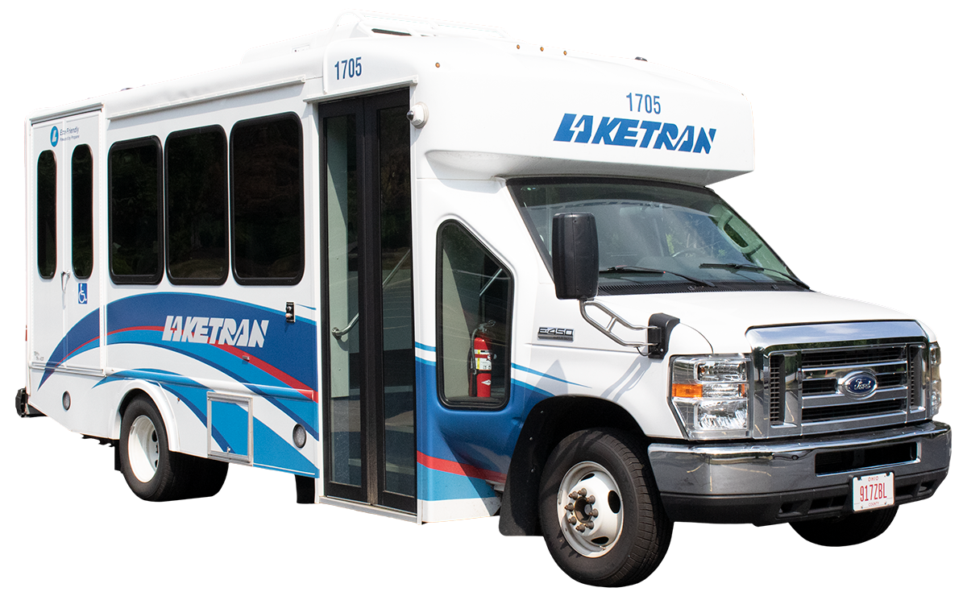
MONTHLY FIXED EXPENSES:
RENT $800
UTILITIES $200
INSURANCE $100
CELL PHONE $100
MONTHLY VARIABLE EXPENSES:
SAVINGS $0 or $50 or $100
GROCERIES $300
DINING OUT $25 PER MEAL
FAST FOOD $10 PER MEAL
ENTERTAINMENT $0 or $50 or $100
CLOTHING $0 or $50 or $100
DOG / CAT $0 or $100
CAR PAYMENT $250 used / $400 new
GASOLINE $100
CAR REPAIRS $100
LAKETRAN $0 or $100
CHARITY $0 or $50 or $100

Slide 23
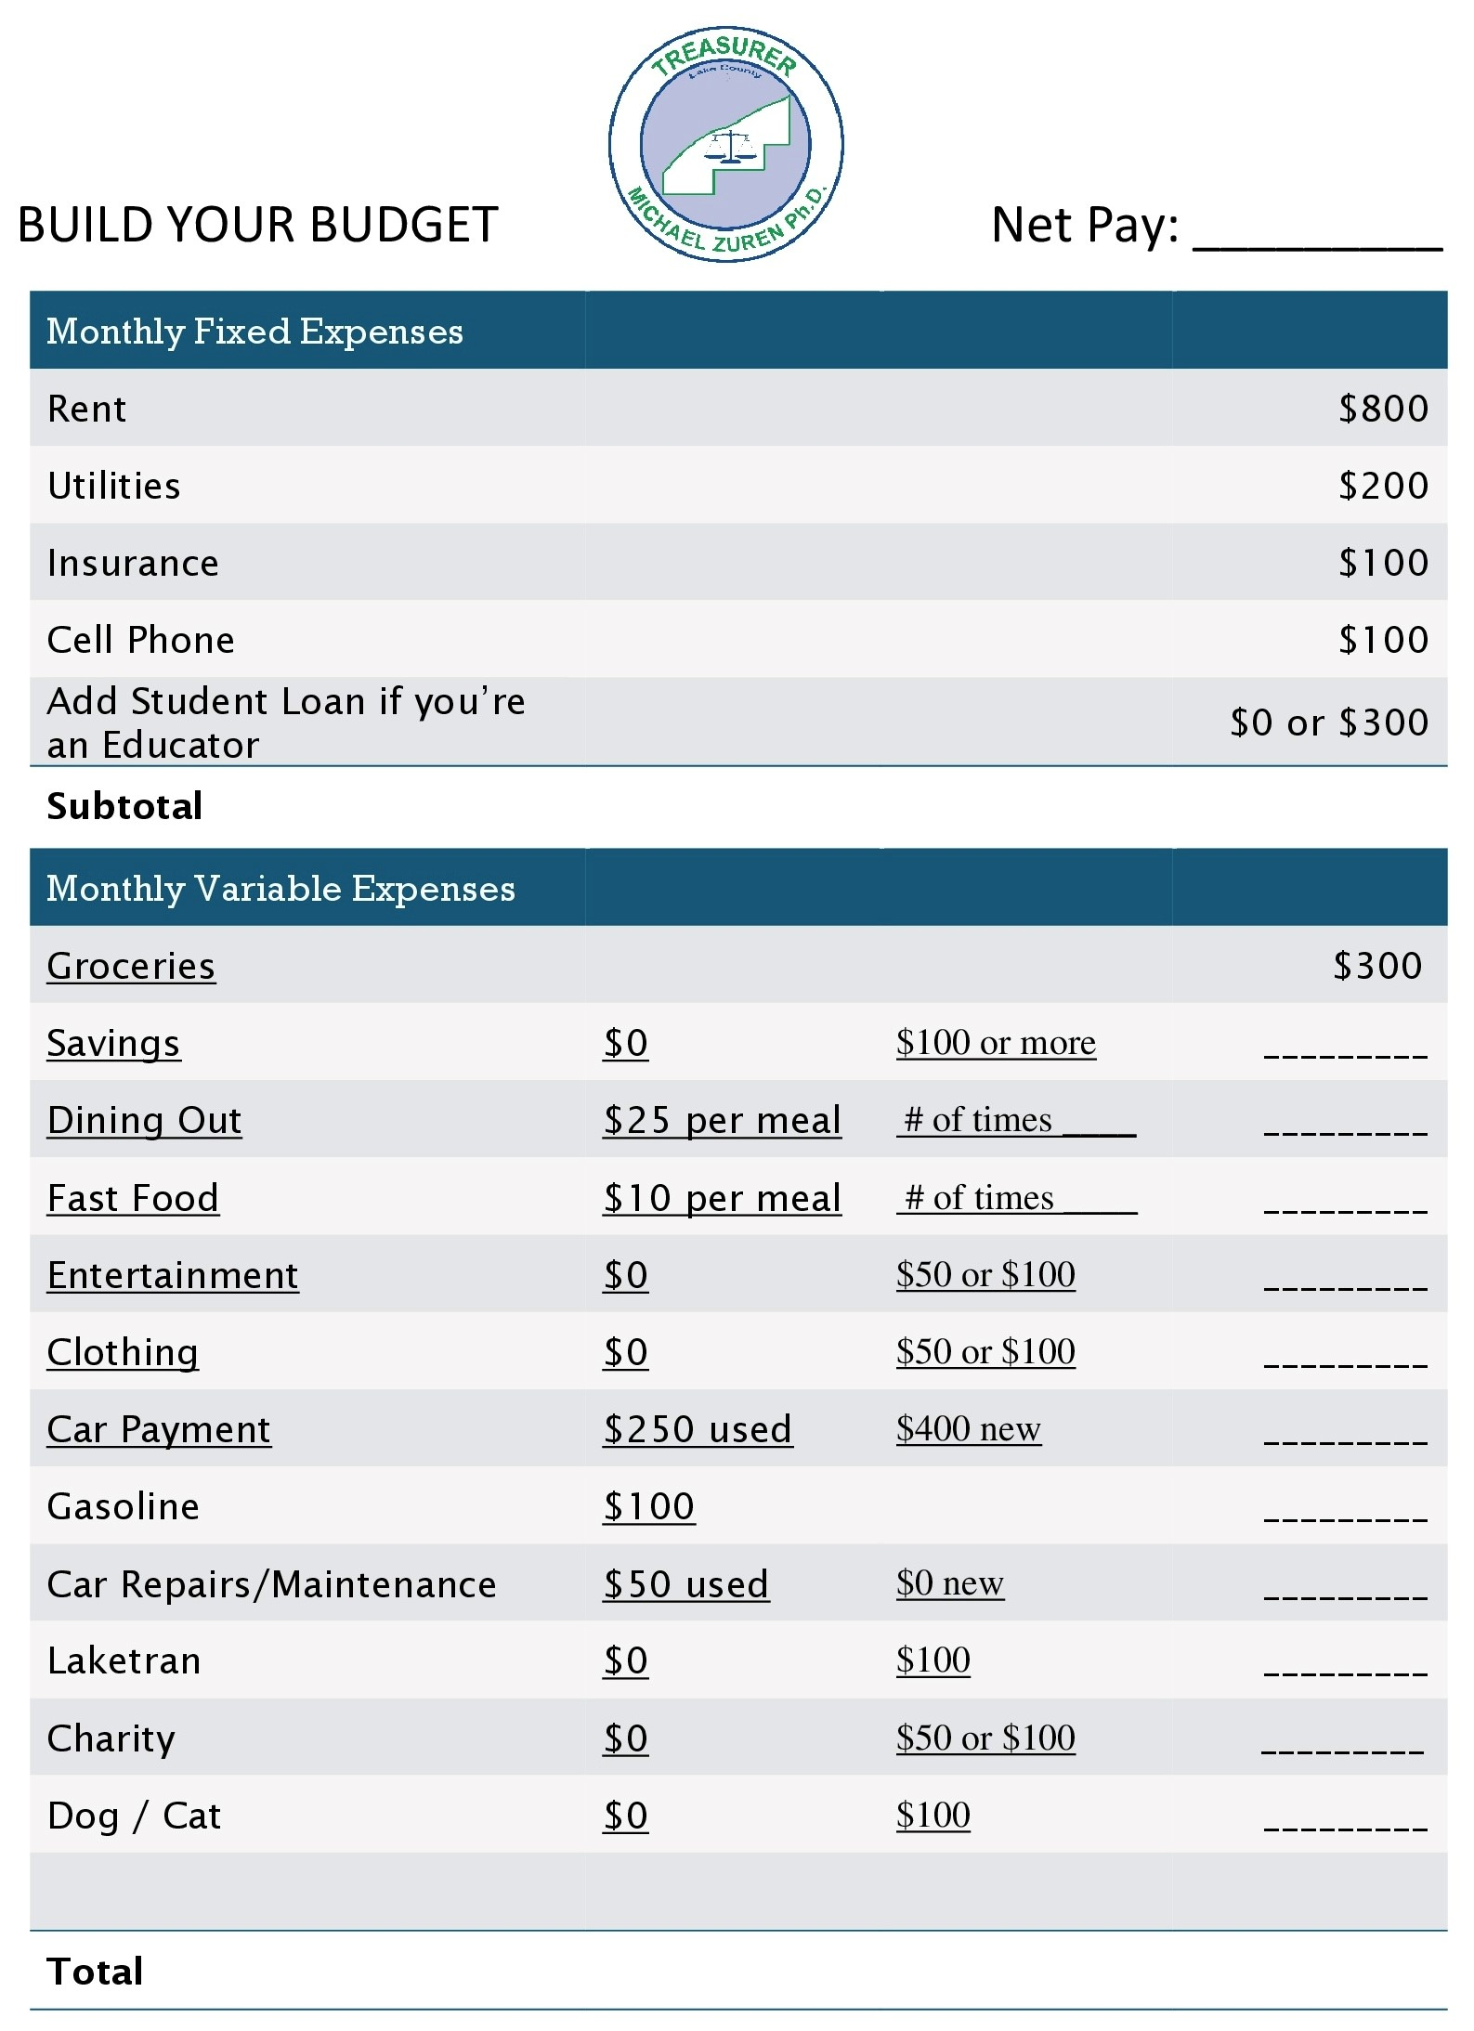

Slide 24
WINDFALL OR EXPENSE

Slide 25
setting up and maintaining a budget
income | budget | actual | difference
Job #1 | $ | $ | $
Job #1 | $ | $ | $
Other | $ | $ | $
total monthly income | $ | $ | $
expenses | budget | actual | difference
fixed regular expenses
Rent | $ | $ | $
Car insurance | $ | $ | $
Car payment | $ | $ | $
Credit card | $ | $ | $
fixed irregular expenses
Savings | $ | $ | $
Food | $ | $ | $
Utilities | $ | $ | $

Slide 26
setting up and maintaining a budget (continued)
expenses | budget | actual | difference
transportation
Bus fare | $ | $ | $
Gas and oil | $ | $ | $
Parking and tolls | $ | $ | $
Repairs | $ | $ | $
other
Medical expenses | $ | $ | $
Clothing | $ | $ | $
Entertainment | $ | $ | $
Household items | $ | $ | $
Personal items | $ | $ | $
Tuition | $ | $ | $
School expenses | $ | $ | $
total monthly expenses | $ | $ | $

Slide 27
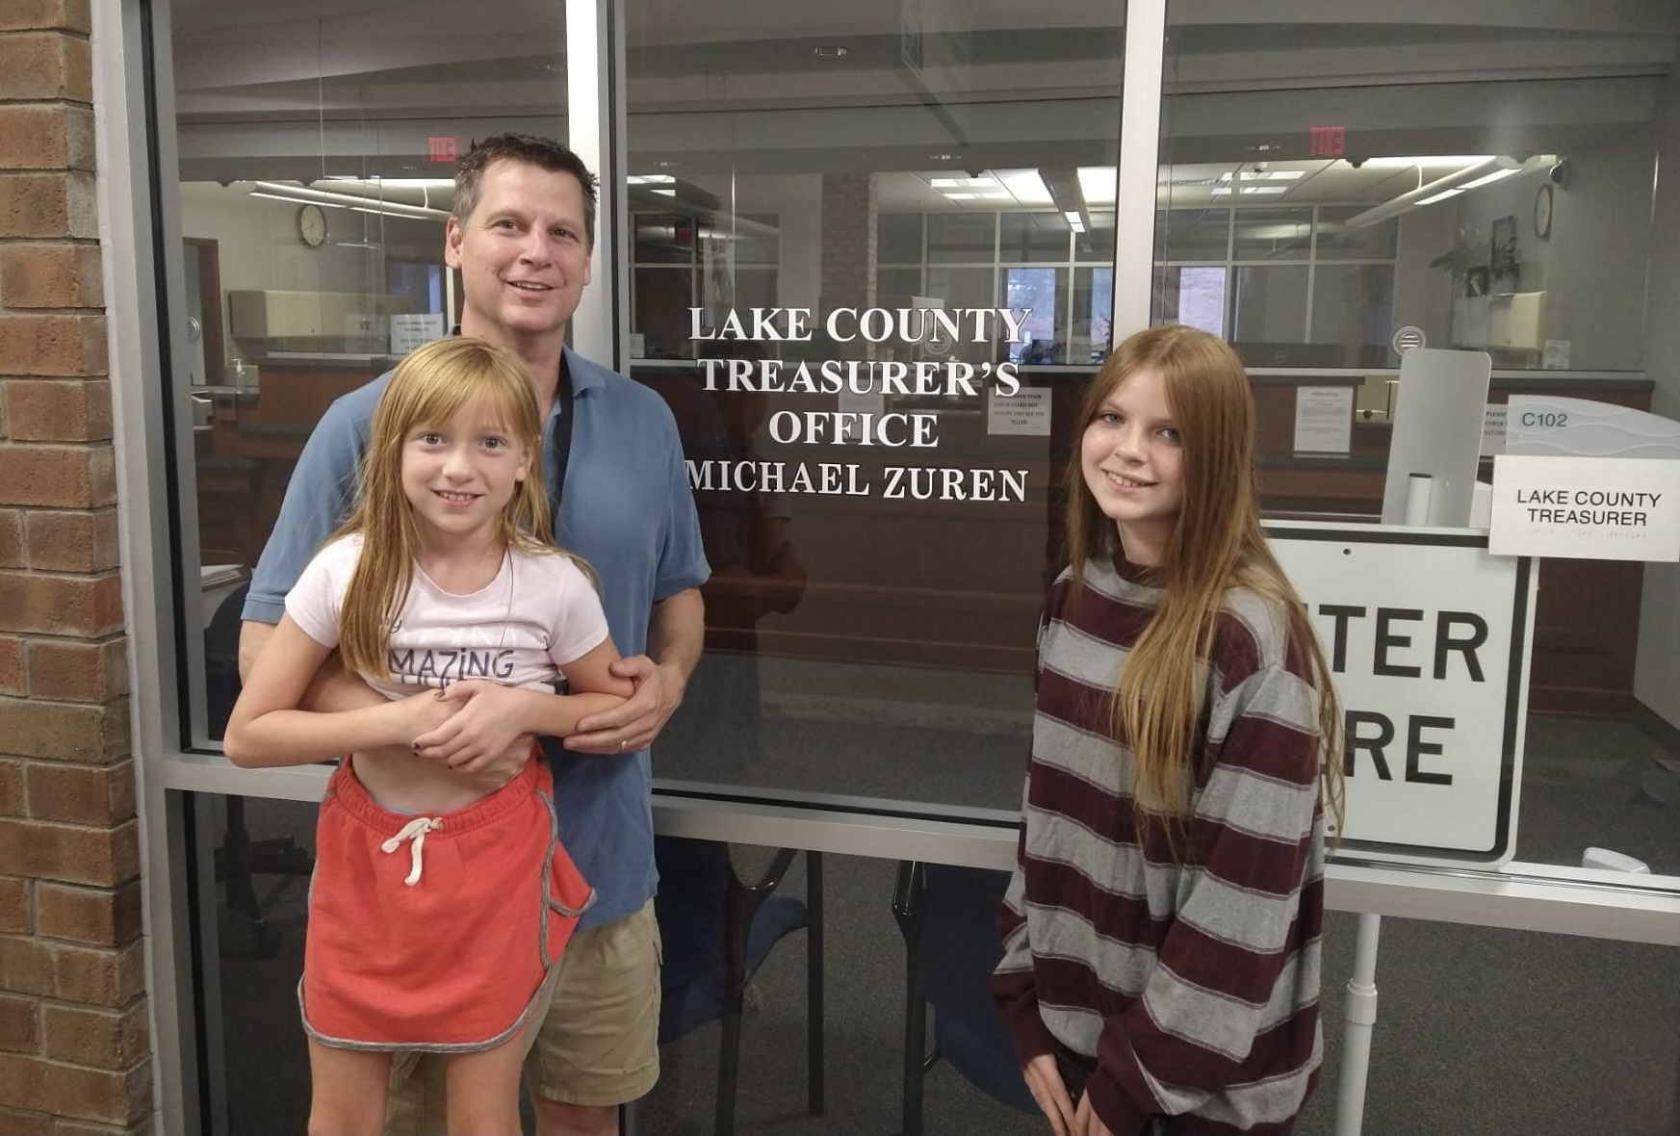
Which of the following is affected by one’s values in life?
Decisions
Goals
Personal life
All of the above

Slide 28
CREDIT is the ability to borrow money or access goods or services with the understanding that you’ll pay later.

Slide 29
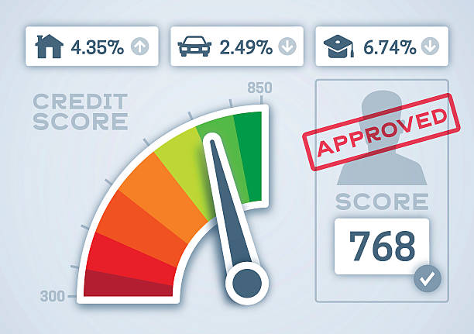
What Makes up a Credit Score?
Do credit scores matter when applying for credit (credit cards, installment loans, or mortgages), insurance, or even a new job? The answer is simple. Banks, lenders, insurance companies, and employers all use credit scores to determine if you will be granted the credit applied for and what the interest rate will be, if you are hired, or the risk of insuring you. This system used by banks and lenders is often referred to as “risk-based pricing”. Credit scores are the lender’s indicator of risk or the likelihood a borrower could default on a debt. Consumer credit agencies such as Transunion, Equifax, and Experian have created algorithms or a statistical calculation, which use an individual’s past credit history and use of credit to measure the likelihood they would become late or default on their debt.

Slide 30
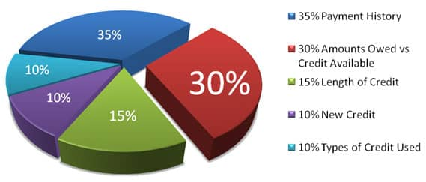
How Credit Scores are Calculated:
The Fair Isaac Corporation developed the “FICO” scoring system. Under this system, credit scores range between 300 and 850.

Slide 31
What is sales tax?
1. tax paid on income
tax earned on savings
tax paid on purchases
tax paid on all expenses
What is interest?
1. money paid on purchases
money earned on an account
money paid for expenses
money paid on taxes

Slide 32
MANY PROFESSIONAL ATHLETES AND CELEBRITIES – PEOPLE WHO CAN AFFORD TO LIVE DESIRED LIFESTYLES – HAVE GOALS FOR THEIR PROFESSIONAL AND PERSONAL ACHIEVEMENTS. WHY DO SUCCESSFUL PEOPLE SET GOALS?
A. Goal-setting allows them to measure progress toward accomplishments or lifestyle changes they desire
B. Setting goals provides them with direction
C. Goal-setting gives them an opportunity to show off to others
D. Both “a” and “b”

Slide 33
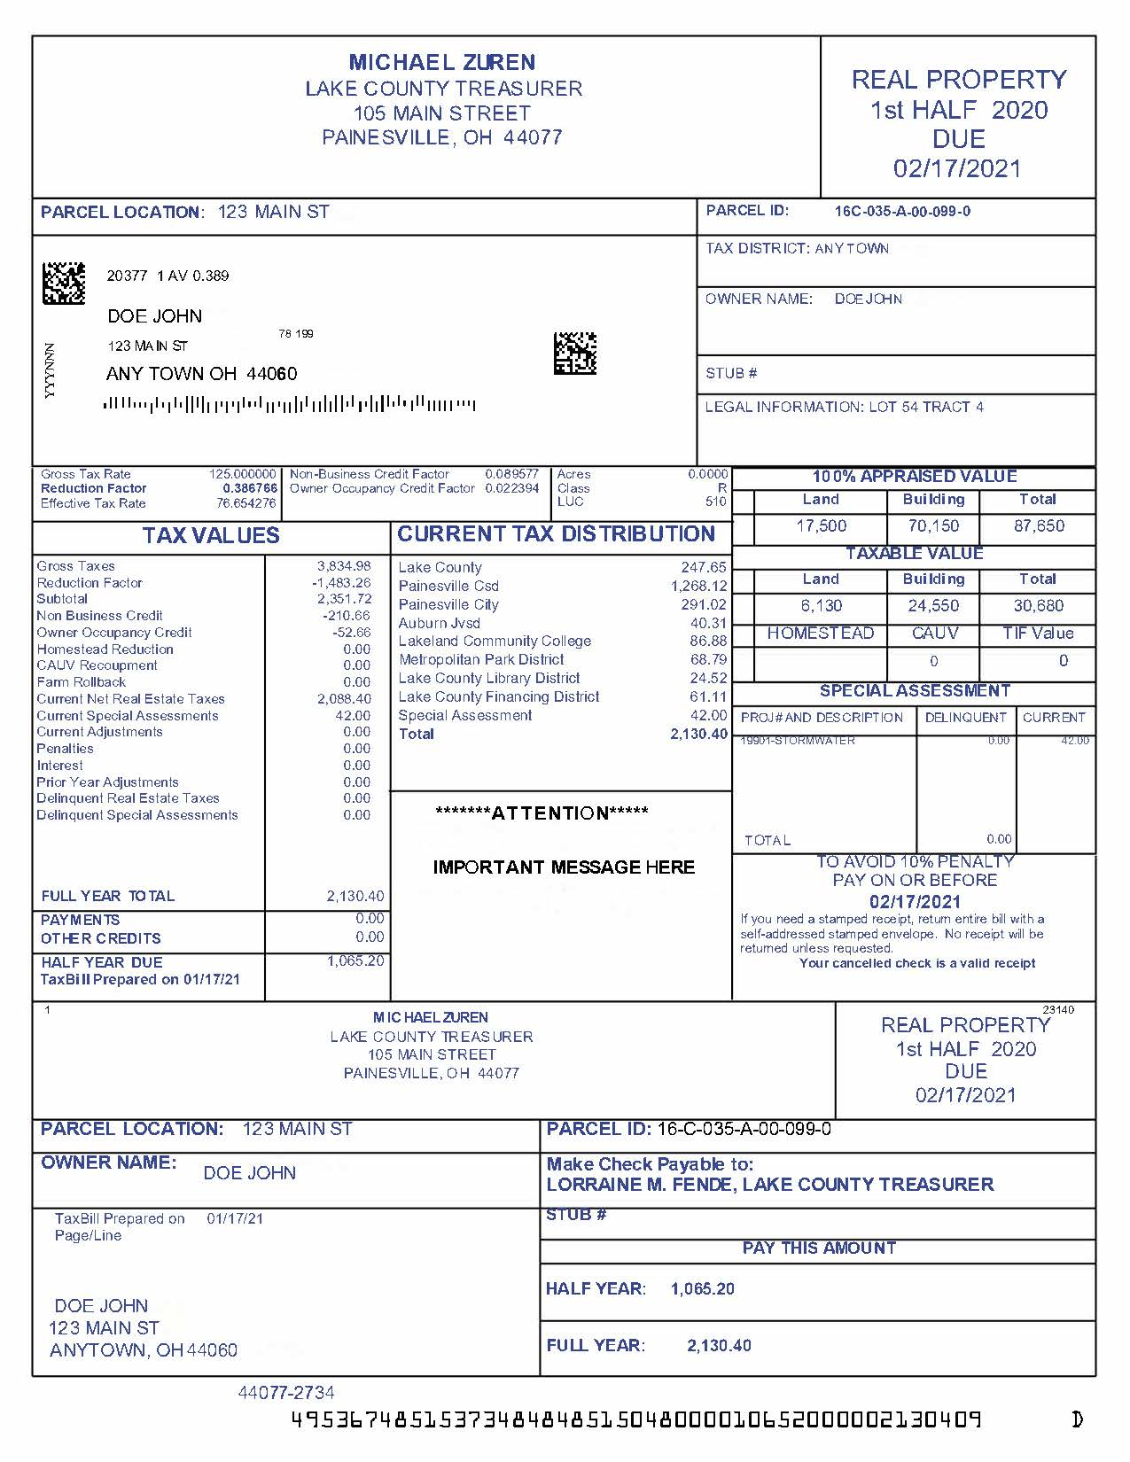

Slide 35
FINANCIAL TIPS FOR SENIOR CITIZENS

Slide 36
1) Budget Closely and Track Expenses 2) Never Stop Learning About Finances 3) Automate Your Finances

Slide 37
REIN IN THE GENEROSITY Prioritize on protecting your own financial well-being first and then look at how you can help family members

Slide 38
KEEP A CLOSE EYE ON CREDIT

Slide 39
Avoid Keeping Large Amounts of Cash At Home

Slide 40
Set Up a Power of Attorney
This allows a family member to manage all of your financial affairs on your behalf if you’re unable to do so yourself.

Slide 41
Consider a Medical Plan Medicare improvement plans tailored for seniors can bring out of pocket costs down

Slide 42
Make a Will

Slide 43
IMPORTANT QUESTIONS & DOCUMENTS
Have you created a will? Did you use an attorney? Who is named as executor? Where can someone find a copy of the will?
Do you have other important documents in place, including a living will and power of attorney? If so, where are copies of the documents stored?

Slide 44
SAFE DEPOSIT BOX
3. Do you have a safe deposit box? Which bank is it at and where do you keep the key? Do you have a list of what you store in it?

Slide 45
IMPORTANT QUESTIONS & DOCUMENTS
4. Where do you store your Medicare or Medicare replacement insurance card? Do you have gap insurance or a secondary insurance policy?
Where do you keep your social security card?
Do you have a life insurance or long-term care insurance policy? Where are those documents?

Slide 46
Veterans, Birth Certificate, Banking
7. If you’re a veteran, where are your important military documents (e.g., discharge papers)?
8. Does your loved one have a copy of your original birth certificate? Where is it?
9. Where do you do your banking? Do you use any brokerage firms or other financial institutions?

Slide 47
10. Do you have a mortgage on your home or do you own it outright?
If it is paid off, where is the deed stored? What agency do you use for homeowner’s insurance?

Slide 48
11. If you still drive, do you have a car?
Do you have a car payment? If not, where is the title stored?
Who is your insurance provider?

Slide 49
12. What bills do you have each month? Are you set up on autopay, or will someone need access to your checkbook to write checks?
13. Do you have a list of all your financial holdings including stocks, bonds, and other assets? Where is it kept?

