Slide 1
MICHAEL ZUREN, PhD Lake County Treasurer
CHRISTOPHER GALLOWAY,
Lake County Auditor

Slide 2
Treasurer’s Office Functions
Responsible for safeguarding all County funds
Cash Manager for all funds received and deposited
Serves as County’s Chief Investment Officer
Administrator of sophisticated delinquent tax collection programs
Maintains tax escrow and prepay accounts

Slide 3
Programs for Seniors
Homestead Exemption Qualifications
Must be 65 or older or totally disabled
You must own your home on January 1st in the year you are applying for the homestead exemption
If house is in a Trust or Life Estate, copy of trust is required
Must be your primary Residence
Income limitations $34,200 (2020) to qualify based on the Modified Adjusted Gross Income (located on line 3 of the State Income Tax Return plus line 11 of the Ohio Schedule A)
If you do not file a State Tax Return, proof of age is required with completed exemption application
If qualified, Law Exempts the first $25,000 of value

Slide 4
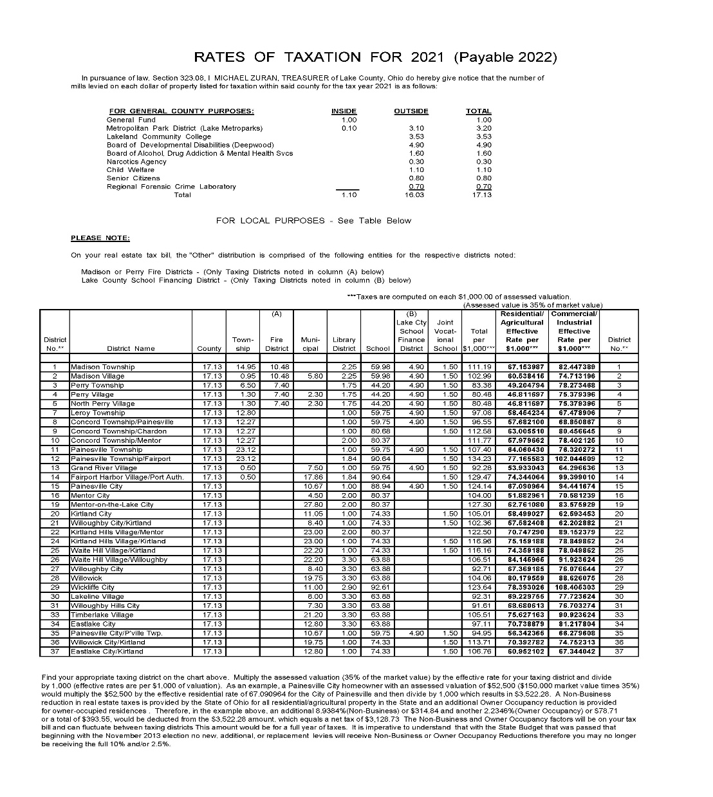
Homestead discount at current rates

Slide 5
Programs for Veterans
Disabled Veterans and Surviving Spouses Program
Must be 100% disabled for the year applying for exemption
VA disabled Veterans do not have any income requirements
If qualified, Law Exempts the first $50,000 of value
Notes:
5

Slide 6
How to obtain an application
Christopher Galloway
Lake County Auditor
105 E. Main Street
Painesville, Ohio 44077
Attn: Homestead Dept
440-918-2532 Ext. 2536 (Western Lake County)
440-350-2536 (Painesville)
440-428-4348 Ext. 2536 Madison
Form available online at Auditor’s website
https://www.lake.iviewauditor.com/

Slide 7
In an effort to assist low-income senior citizens with utility costs, the Board of Lake County Commissioners and the Department of Utilities established a program to provide a 25% discount on LAKE COUNTY water and sewer bills
must be 65 years of age or older
own and occupy the property
meet the income qualifier established by the Ohio Homestead Exemption
Residents must contact the utilities office 440-350-2070 or visit lakecountyohio.gov/utilities and print Senior Citizen Discount Application

Slide 12
Star Program : Fair Housing Resource Center
Star, is designed to provide financial assistance and services to prevent individuals from becoming homeless.
FHRC assists clients who have some form of income with 1st months rent and utility deposits to move into a new home.
FHRC also has a senior / disabled subsidy which can provide up to 6 months of subsidized rental payments.

Slide 13
Other Programs of Interest
Spouses of Public Service Officers Killed in the Line of Duty
Applicant must be the surviving spouse and will be entitled to a reduction in property taxes under this exemption for the tax year in which the public service officer dies through the tax year in which the surviving spouse dies or remarries

Slide 14
Did you move or refinance in the last year?
If you do not receive a real estate tax bill by FEBRUARY 1ST and JULY 1ST of each year, please contact the Treasurer’s office

Slide 15
UPDATE OR CHANGE YOUR ADDRESS
Please send letter or E-mail, to update mailing address
Michael Zuren, PhD
Lake County Treasurer
105 Main St PO Box 490
Painesville, OH 44077
Treasurer@lakecountyohio.gov

Slide 16
PAYMENT OPTIONS
Drive Thru
FIRST HALF COLLECTION JANUARY 2023-FEBRUARY 16, 2023
SECOND HALF COLLECTION JUNE 2023- JULY 16, 2023
Auto Pay (form located on Lake County Ohio Treasurer’s website)
Credit Card (fees apply)
E-Check ($1.50 fee applies if under $10,000)
Mail (postmark accepted)
Drop Box (no cash please)
In Person

Slide 17
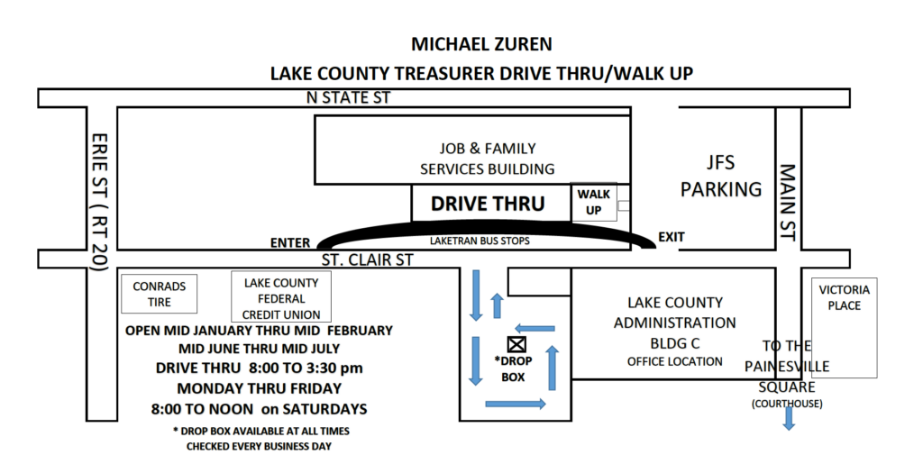

Slide 18
If you have any questions concerning the Treasurer’s Office please do not hesitate to call
from Painesville (440) 350-2516,
from Madison (440) 428-4348,
from West End and Cleveland (216) 918-2516;
FAX (440) 350-2623, send E-mail or visit us personally at the County Administration Building (105 Main St, Painesville, Ohio 44077)
Hours: Open Monday – Friday 8:00 AM – 4:30 PM
Extended hours during tax collection season (Open Saturdays)

Slide 19
FINANCIAL TIPS FOR SENIOR CITIZENS

Slide 20
Budget Closely and Track Expenses Never Stop Learning About Finances Automate Your Finances

Slide 21
REIN IN THE GENEROSITY Prioritize on protecting your own financial well-being first and then look at how you can help family members

Slide 22
KEEP A CLOSE EYE ON CREDIT

Slide 23
Avoid Keeping Large Amounts of Cash At Home

Slide 24
Set Up a Power of Attorney
This allows a family member to manage all of your financial affairs on your behalf if you’re unable to do so yourself.

Slide 25
Consider a Medical Plan Medicare improvement plans tailored for seniors can bring out of pocket costs down

Slide 26
Make a Will

Slide 27
IMPORTANT QUESTIONS & DOCUMENTS
Do you have other important documents in place, including a living will and power of attorney? If so, where are copies of the documents stored?

Slide 28
IMPORTANT QUESTIONS & DOCUMENTS
2. Have you created a will? Did you use an attorney? Who is named as executor? Where can someone find a copy of the will?

Slide 29
SAFE DEPOSIT BOX
3. Do you have a safe deposit box? Which bank is it at and where do you keep the key? Do you have a list of what you store in it?

Slide 30
IMPORTANT QUESTIONS & DOCUMENTS
4. Where do you store your Medicare or Medicare replacement insurance card? Do you have gap insurance or a secondary insurance policy?

Slide 31
IMPORTANT QUESTIONS & DOCUMENTS
Where do you keep your social security card?
Do you have a life insurance or long-term care insurance policy? Where are those documents?

Slide 32
What is the average cost of long term care (without) insurance?
The median annual cost of a nursing home depends on where you live. In the U.S. the cost ranges from $85,800 per year to as high as $150,000 or more per year in some states.
Average cost of nursing home is around $105,850/year.
This translates to monthly costs of $8,820.

Slide 33
TRUSTS
If you have enough assets, you may want to speak to an attorney about a trust
Trusts are often used in nursing home planning as well
Trusts are highly versatile instruments, which can be used for a wide variety of purposes to achieve specific goals

Slide 34
10. Do you have a mortgage on your home or do you own it outright?
If it is paid off, where is the deed stored? What agency do you use for homeowner’s insurance?

Slide 35
11. If you still drive, do you have a car?
Do you have a car payment? If not, where is the title stored?
Who is your insurance provider?

Slide 36
12. What bills do you have each month? Are you set up on autopay, or will someone need access to your checkbook to write checks?
13. Do you have a list of all your financial holdings including stocks, bonds, and other assets? Where is it kept?

Slide 37
THE SECURE ACT
The SECURE Act of 2019 changed the age at which RMDs begin from 70½ to 72. Secure 2.0 increases the age at which RMDs begin to age 73 for those individuals who turn 72 on or after January 1, 2023. Notably, an individual who attains age 72 in 2023 is not required to take an RMD for 2023.
RMD CHANGES
(RMDs) Required Minimum Distributions

Slide 38
Inheritance and RMD’s

Slide 39
Your Personal Monthly Budget

Slide 40
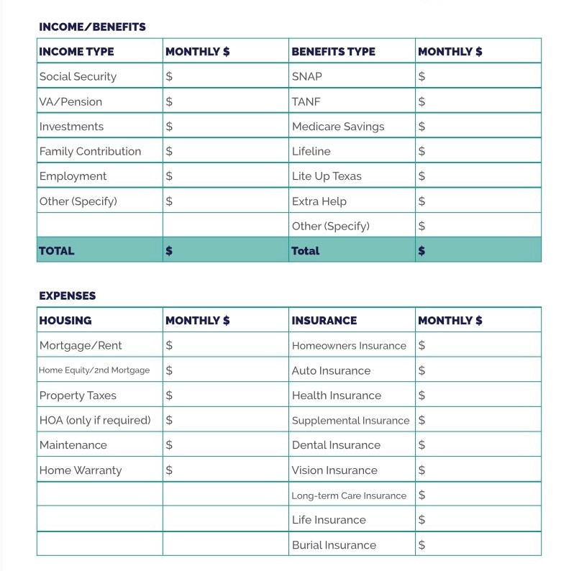

Slide 41
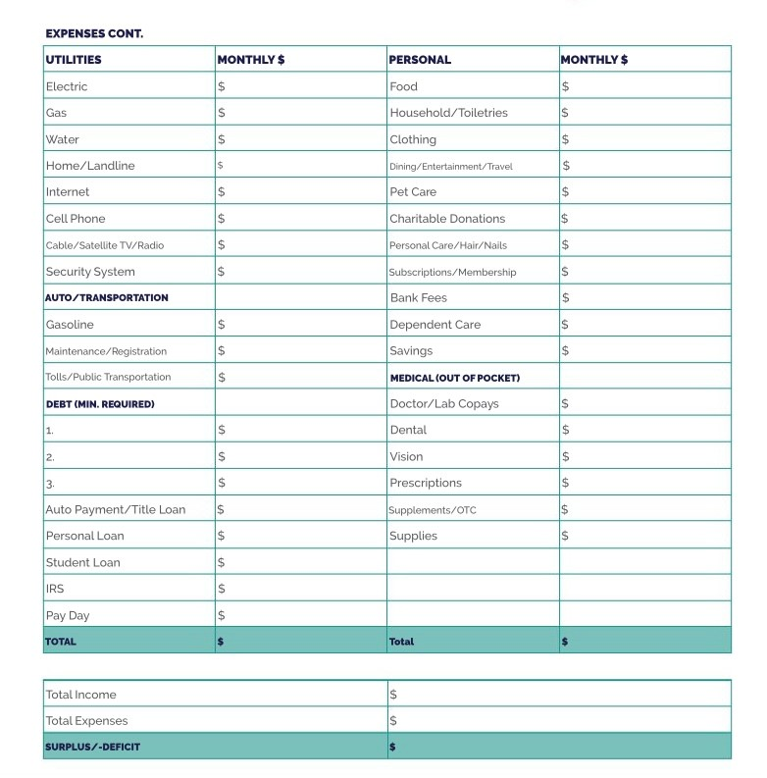

Slide 42
Questions and Answers

