Slide 1

CAREER DAY PRESENTATION
Lake County Treasurer
Presented by Michael Zuren, PhD.

Slide 2
TABLE OF CONTENTS
01
About Me
02
Responsibilities of a Treasurer
03
Treasurer’s Bucks
04
Future career opportunities
Education, Career History, and Community Outreach
Tax collector for the county
Show and explain how taxes work
For Students

Slide 3
Career History

Slide 4
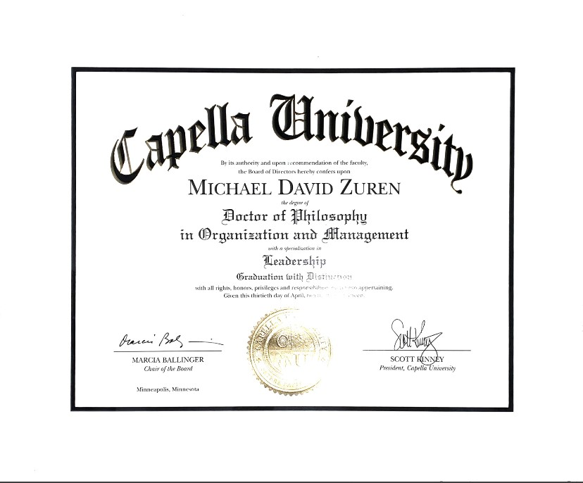

Slide 5
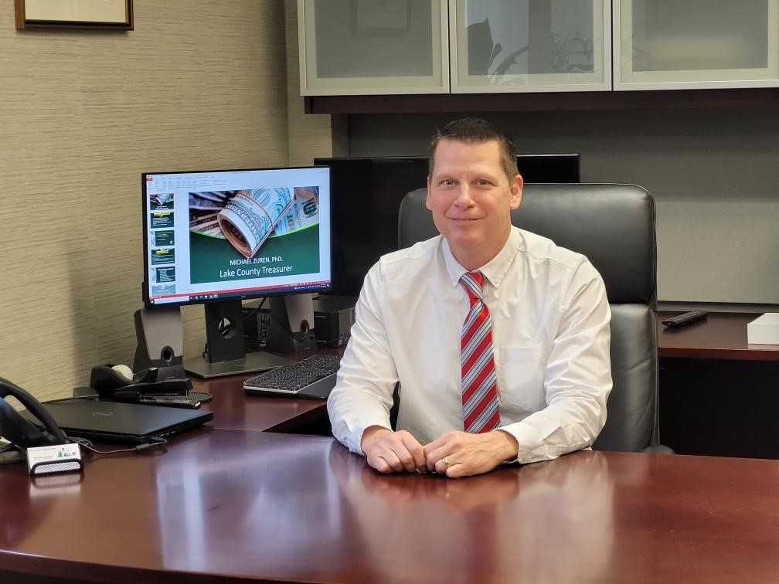
MORTGAGE BANKING
BROKERAGE
BANKING / INVESTMENT
LAKE ERIE COLLEGE MBA

Slide 6
CITY OF EASTLAKE
COUNCILMAN
FINANCE COMMITTEE
ECDC COMMITTEE CHAIR

Slide 7








Local
Author
of 8
Books

Slide 8
Duties of Treasurer’s Office
Investments
Collect Taxes
Cash Manager
The Treasurer’s office collects property taxes on approximately 110,000 parcels
in Lake County
The Treasurer
is the cash manager
functioning in a
manner similar to
a banker
Chief Investment
Officer
Manages Property Tax Escrow Accounts
Administers Delinquent Tax Collection Programs

Slide 9
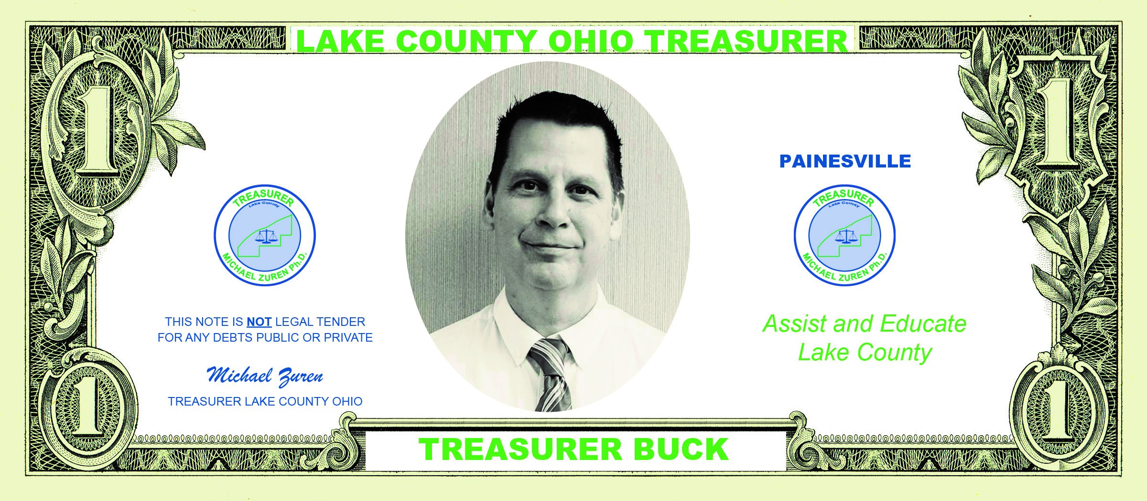
Treasurer’s Bucks

Slide 10
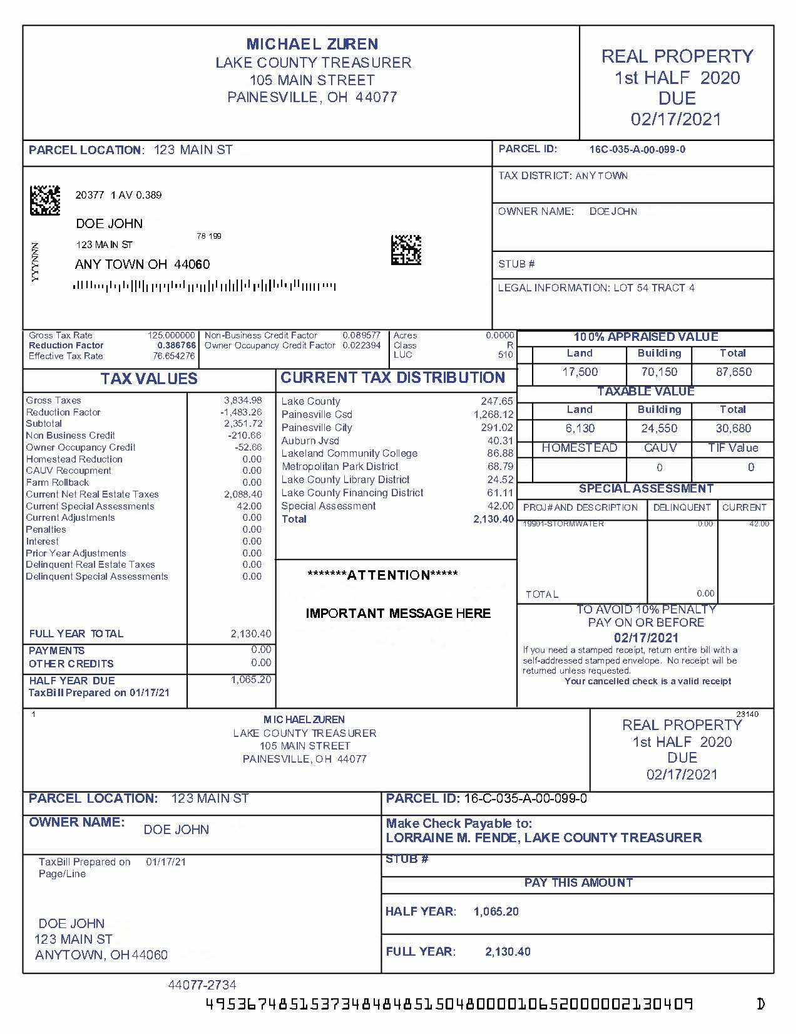
SAMPLE PROPERTY TAX BILL
The money collected from taxes funds local schools, pays for police and fire protection, maintains roads, and supports community services such as libraries and parks

Slide 11
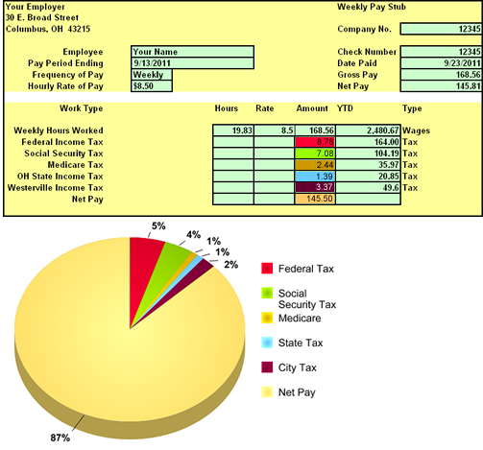
After you begin your first job, you will receive your first hard-earned paycheck. Your paycheck may be much less than what you were expecting. Where did the rest of your money go?
The answer, of course, is income taxes. Several types of taxes are withheld from each paycheck you receive. Some of these taxes include federal taxes (IRS), state taxes (ODT), and local taxes such as cities or school districts.
Let's take a look at a sample pay stub.

Slide 12
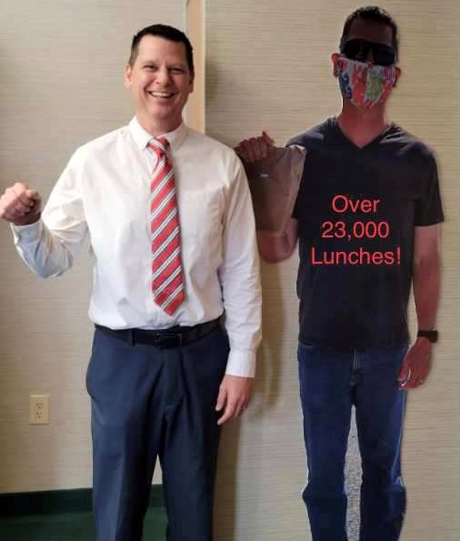
Volunteer opportunities
Call or Text Michael Zuren 440-251-5381
Service hours available to meet your high school graduation requirements

Slide 13
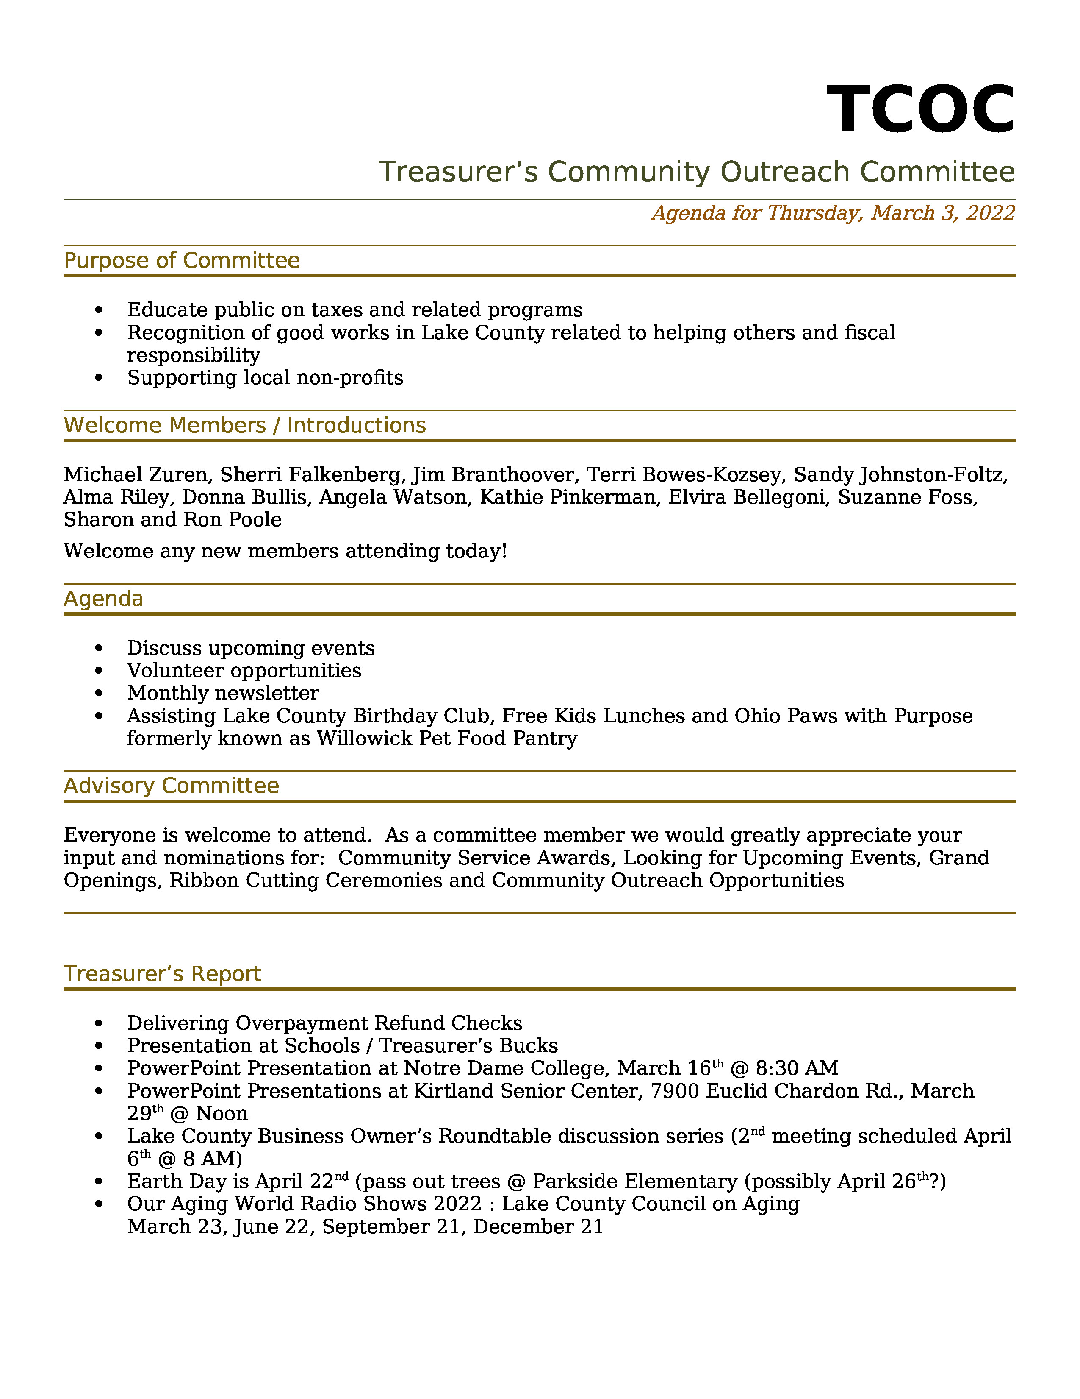
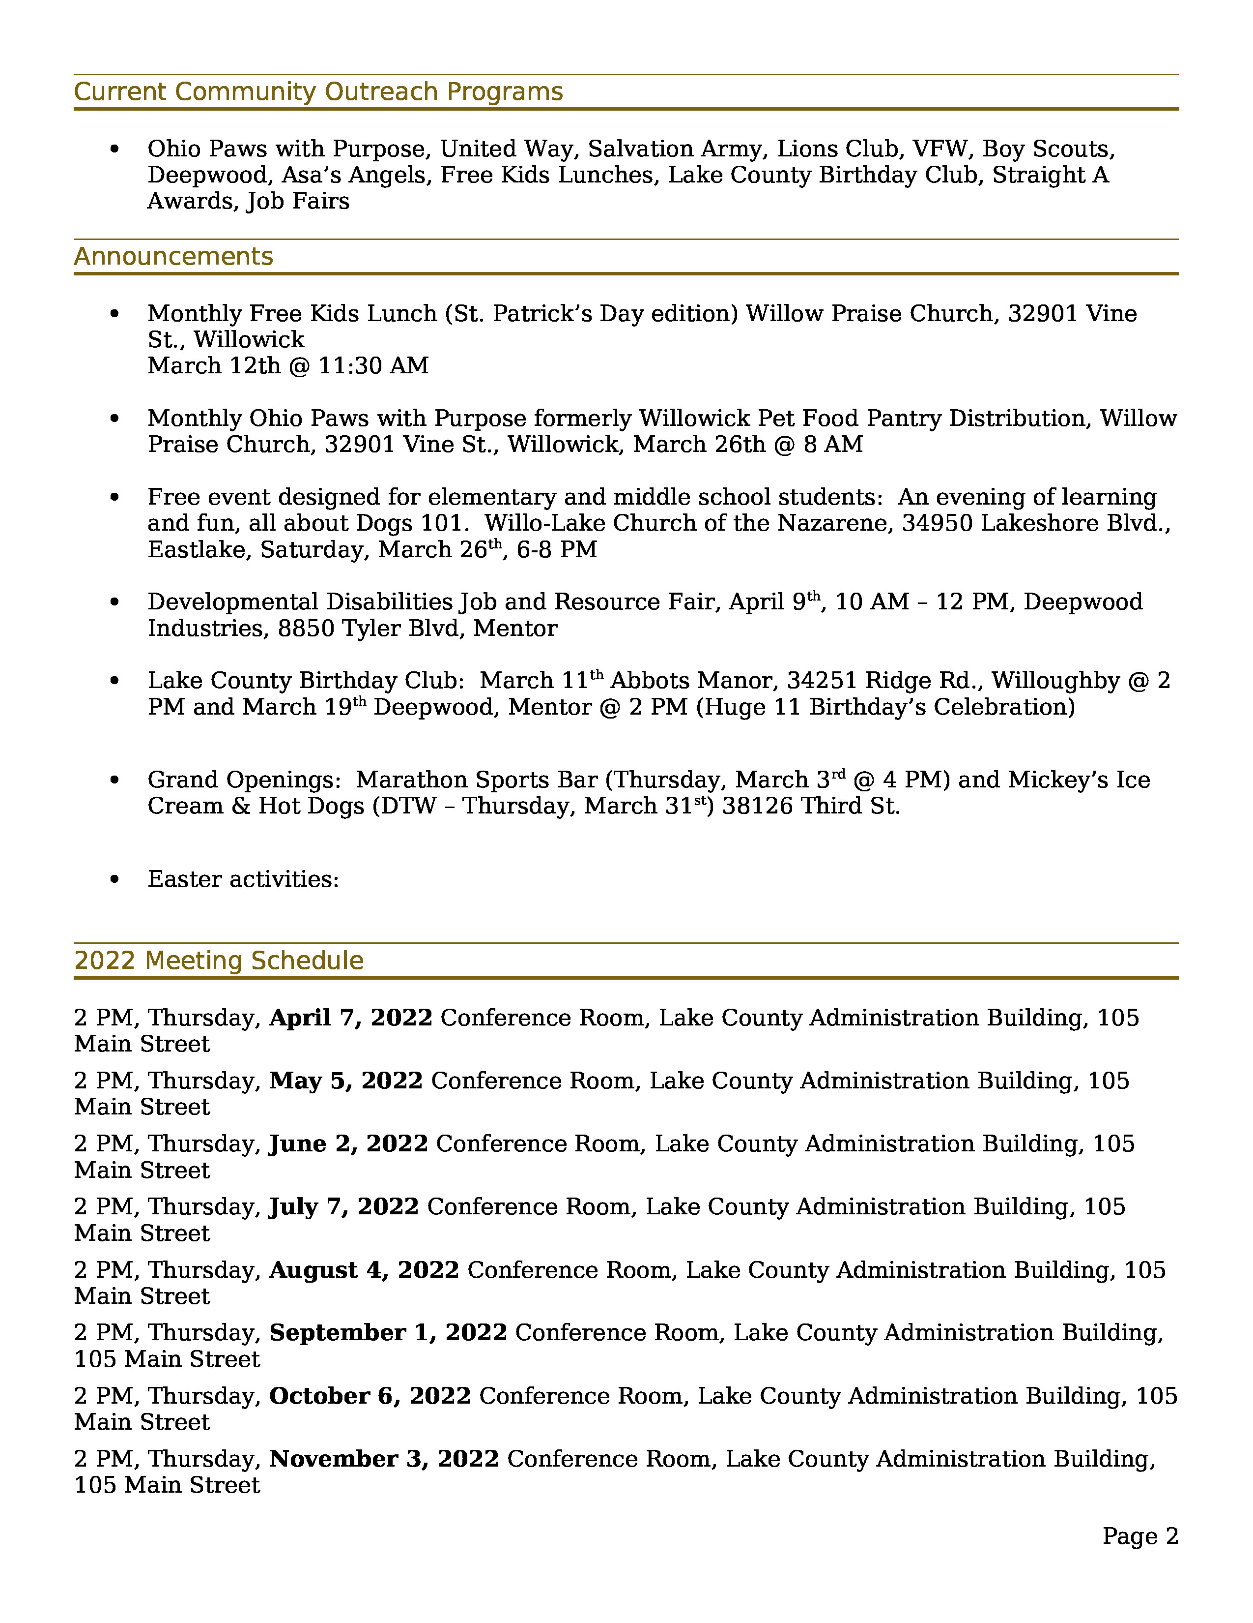

Slide 14
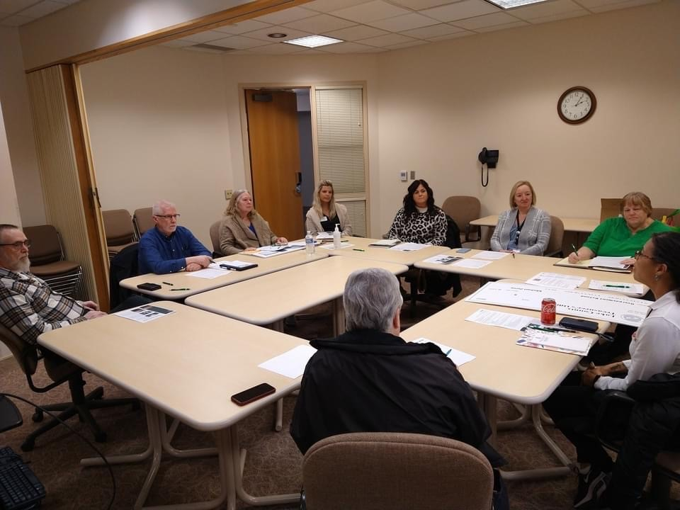
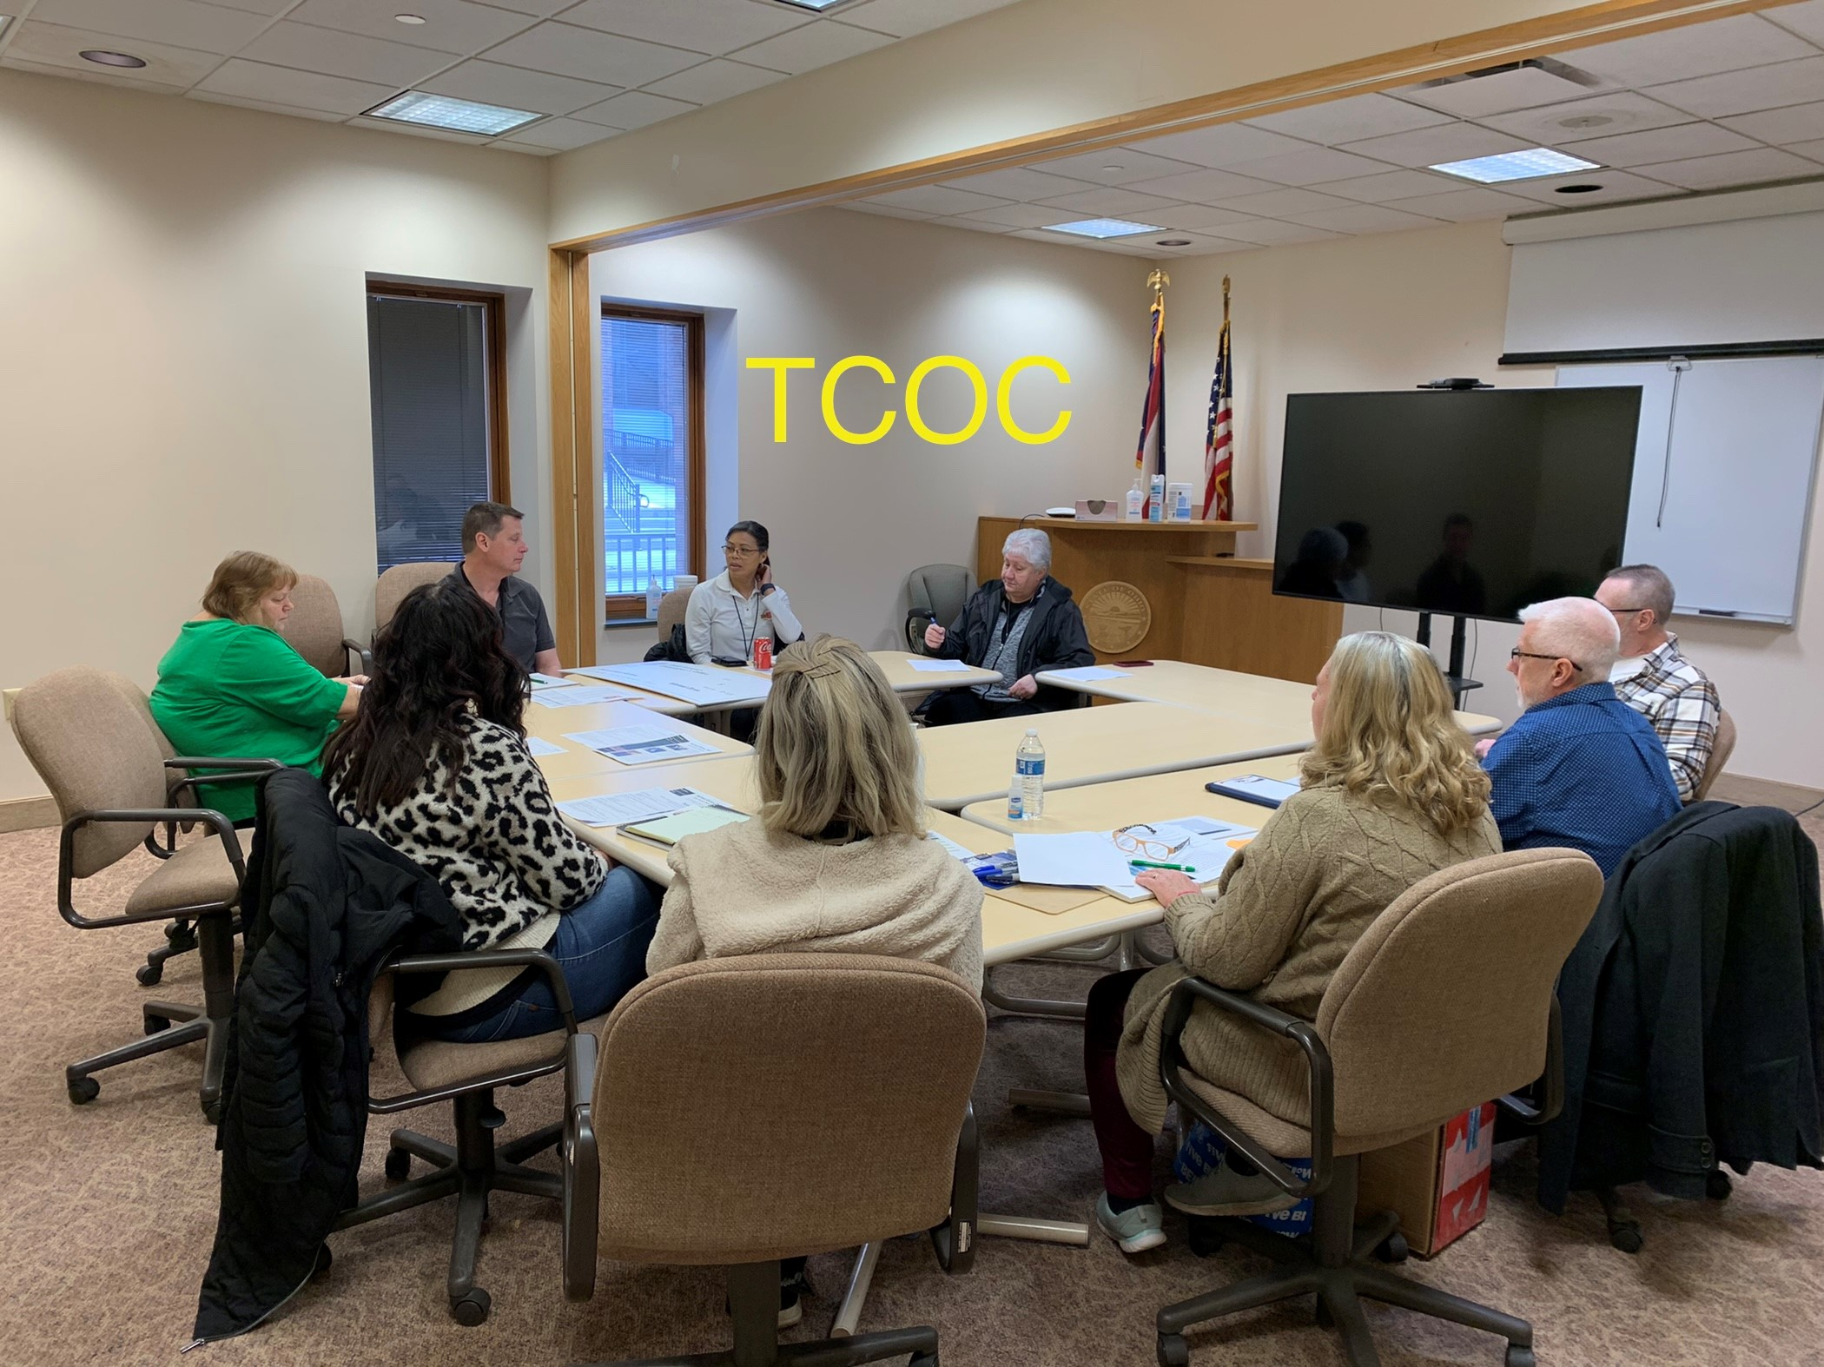
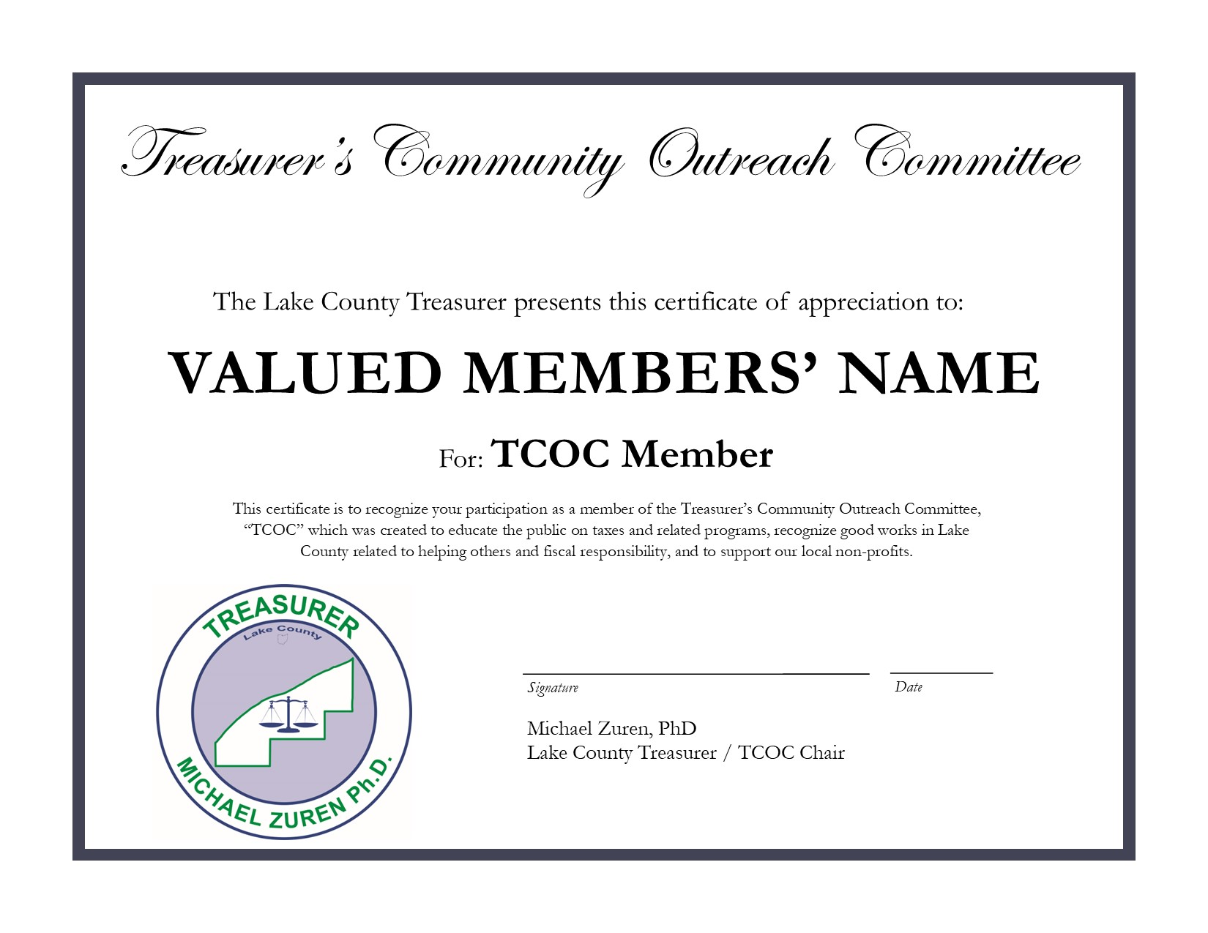

Slide 15
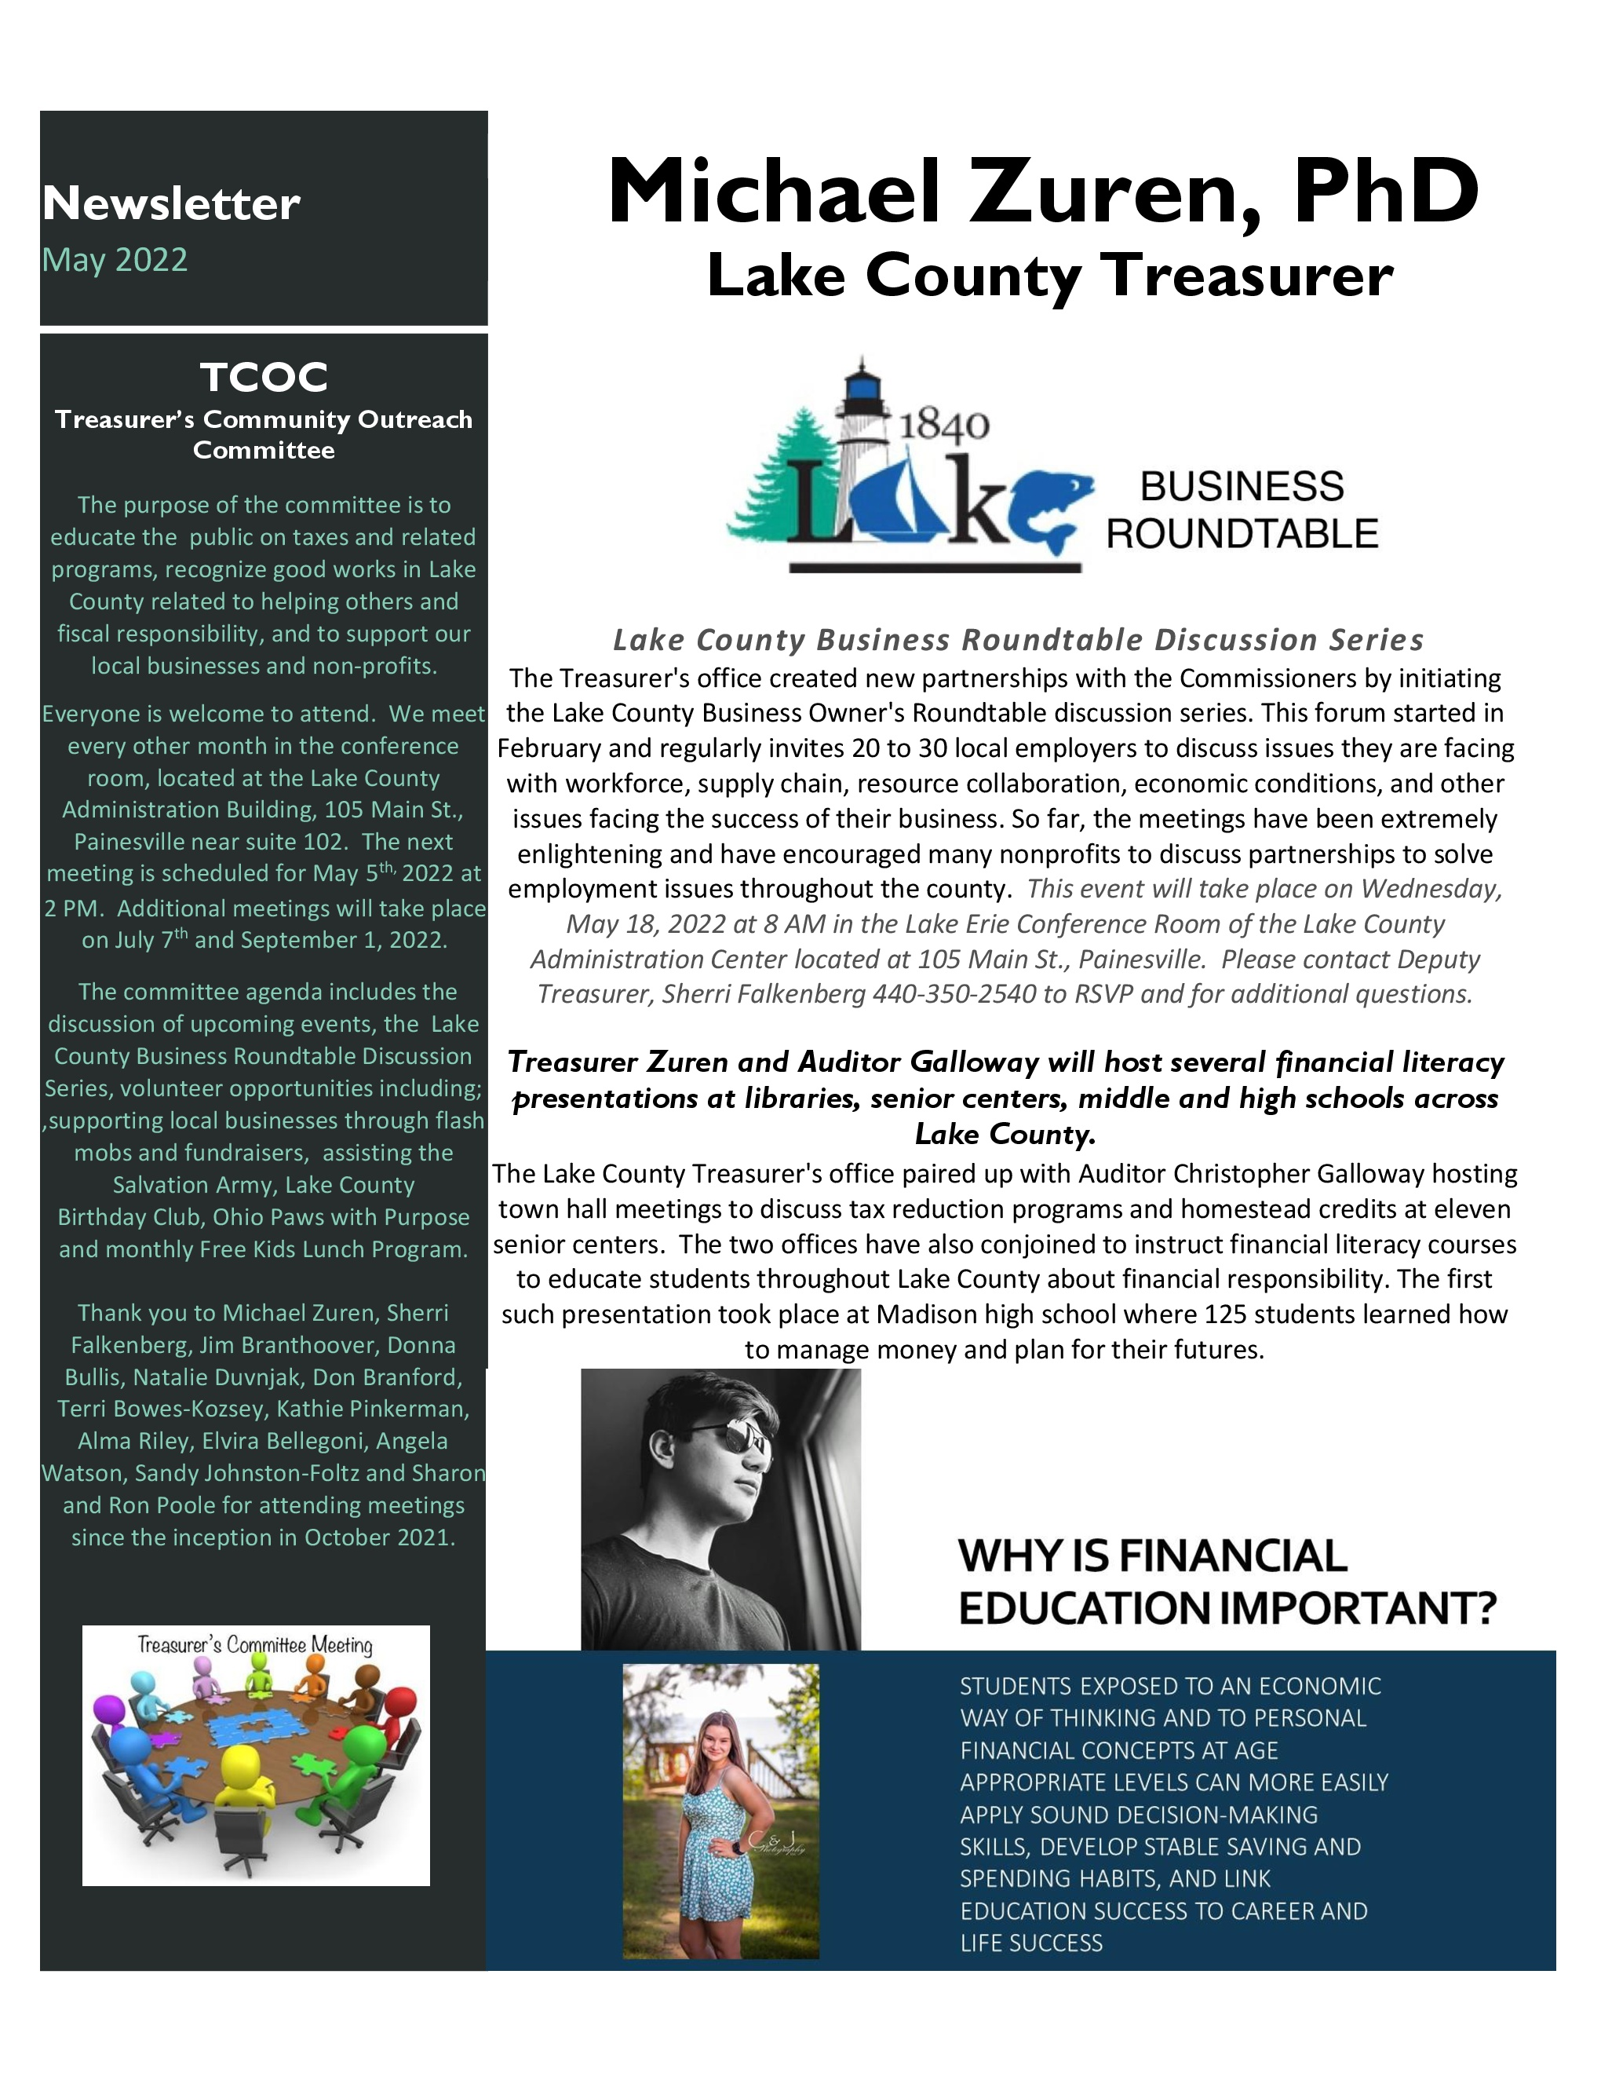
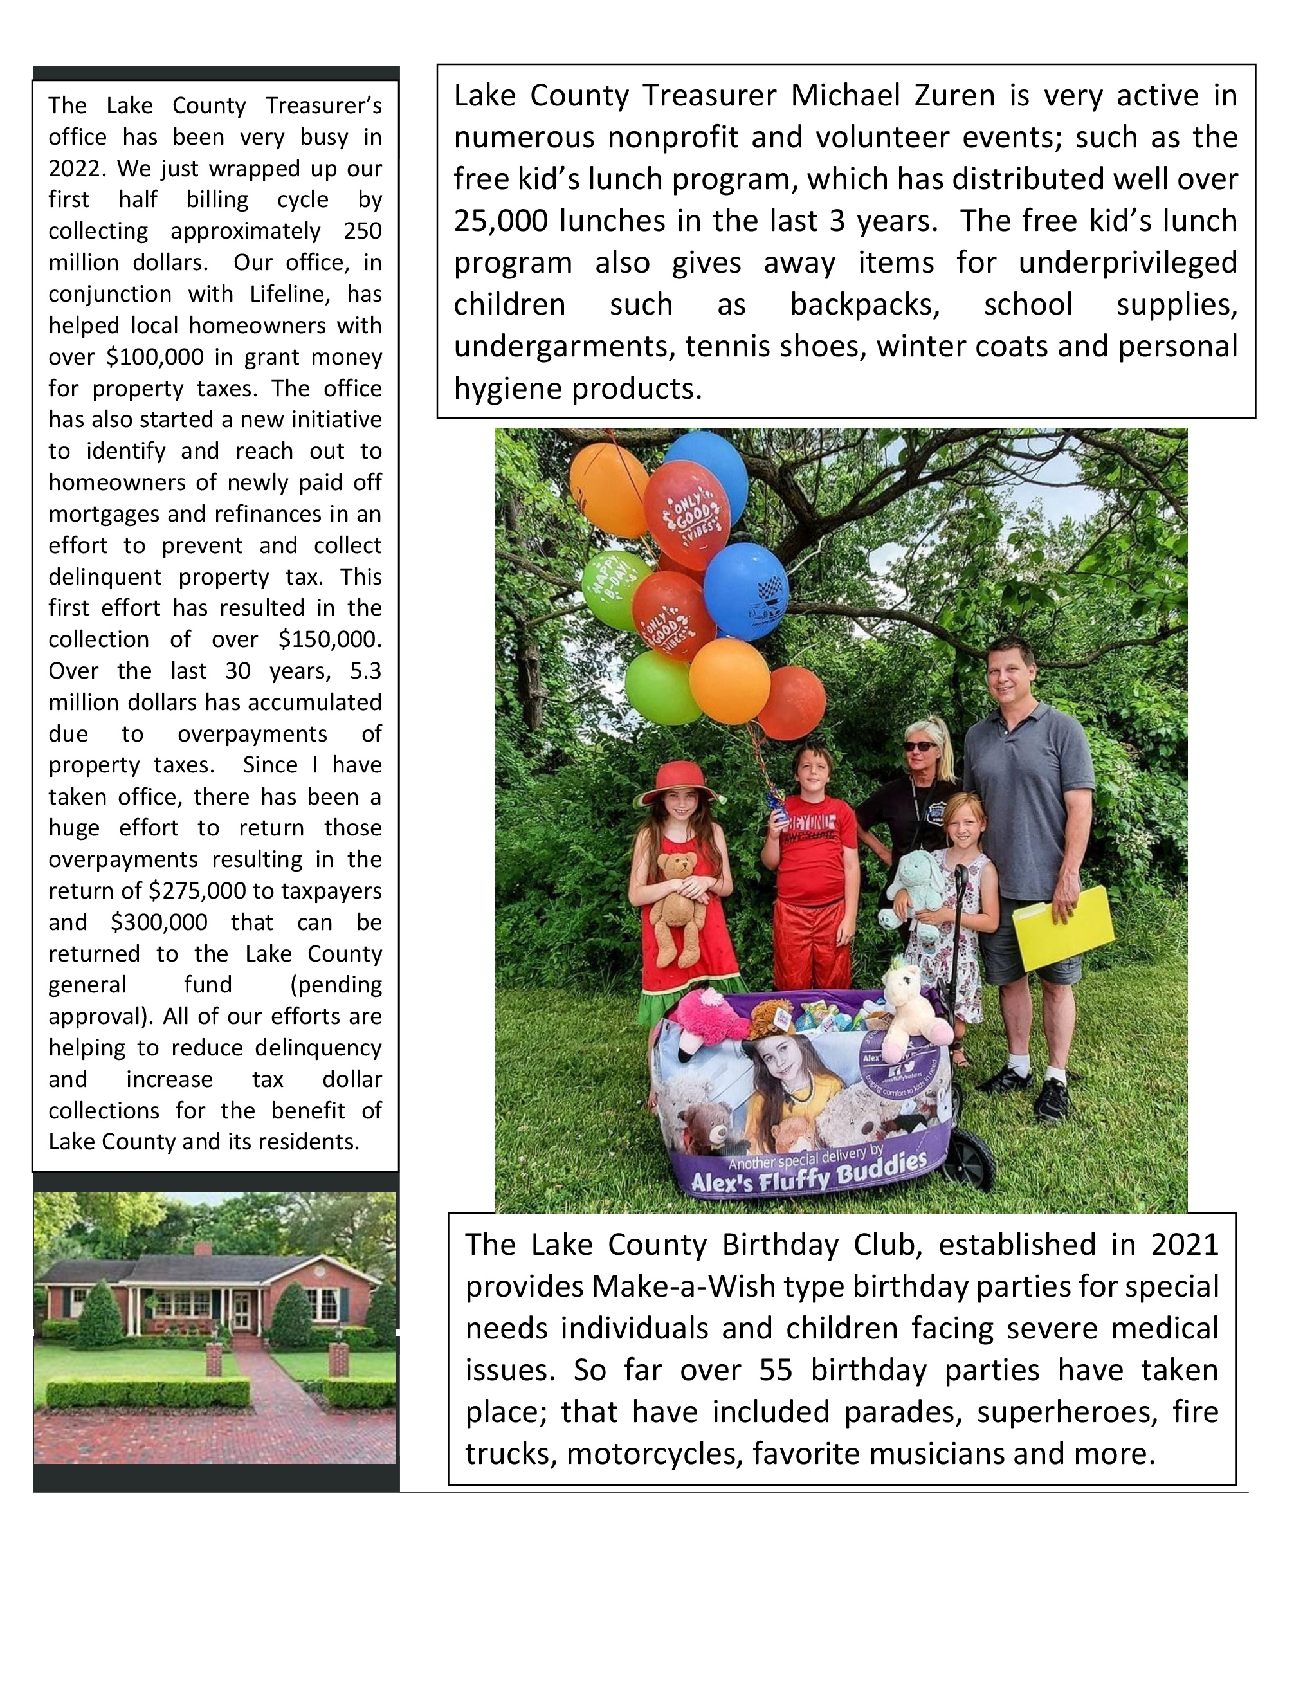

Slide 16

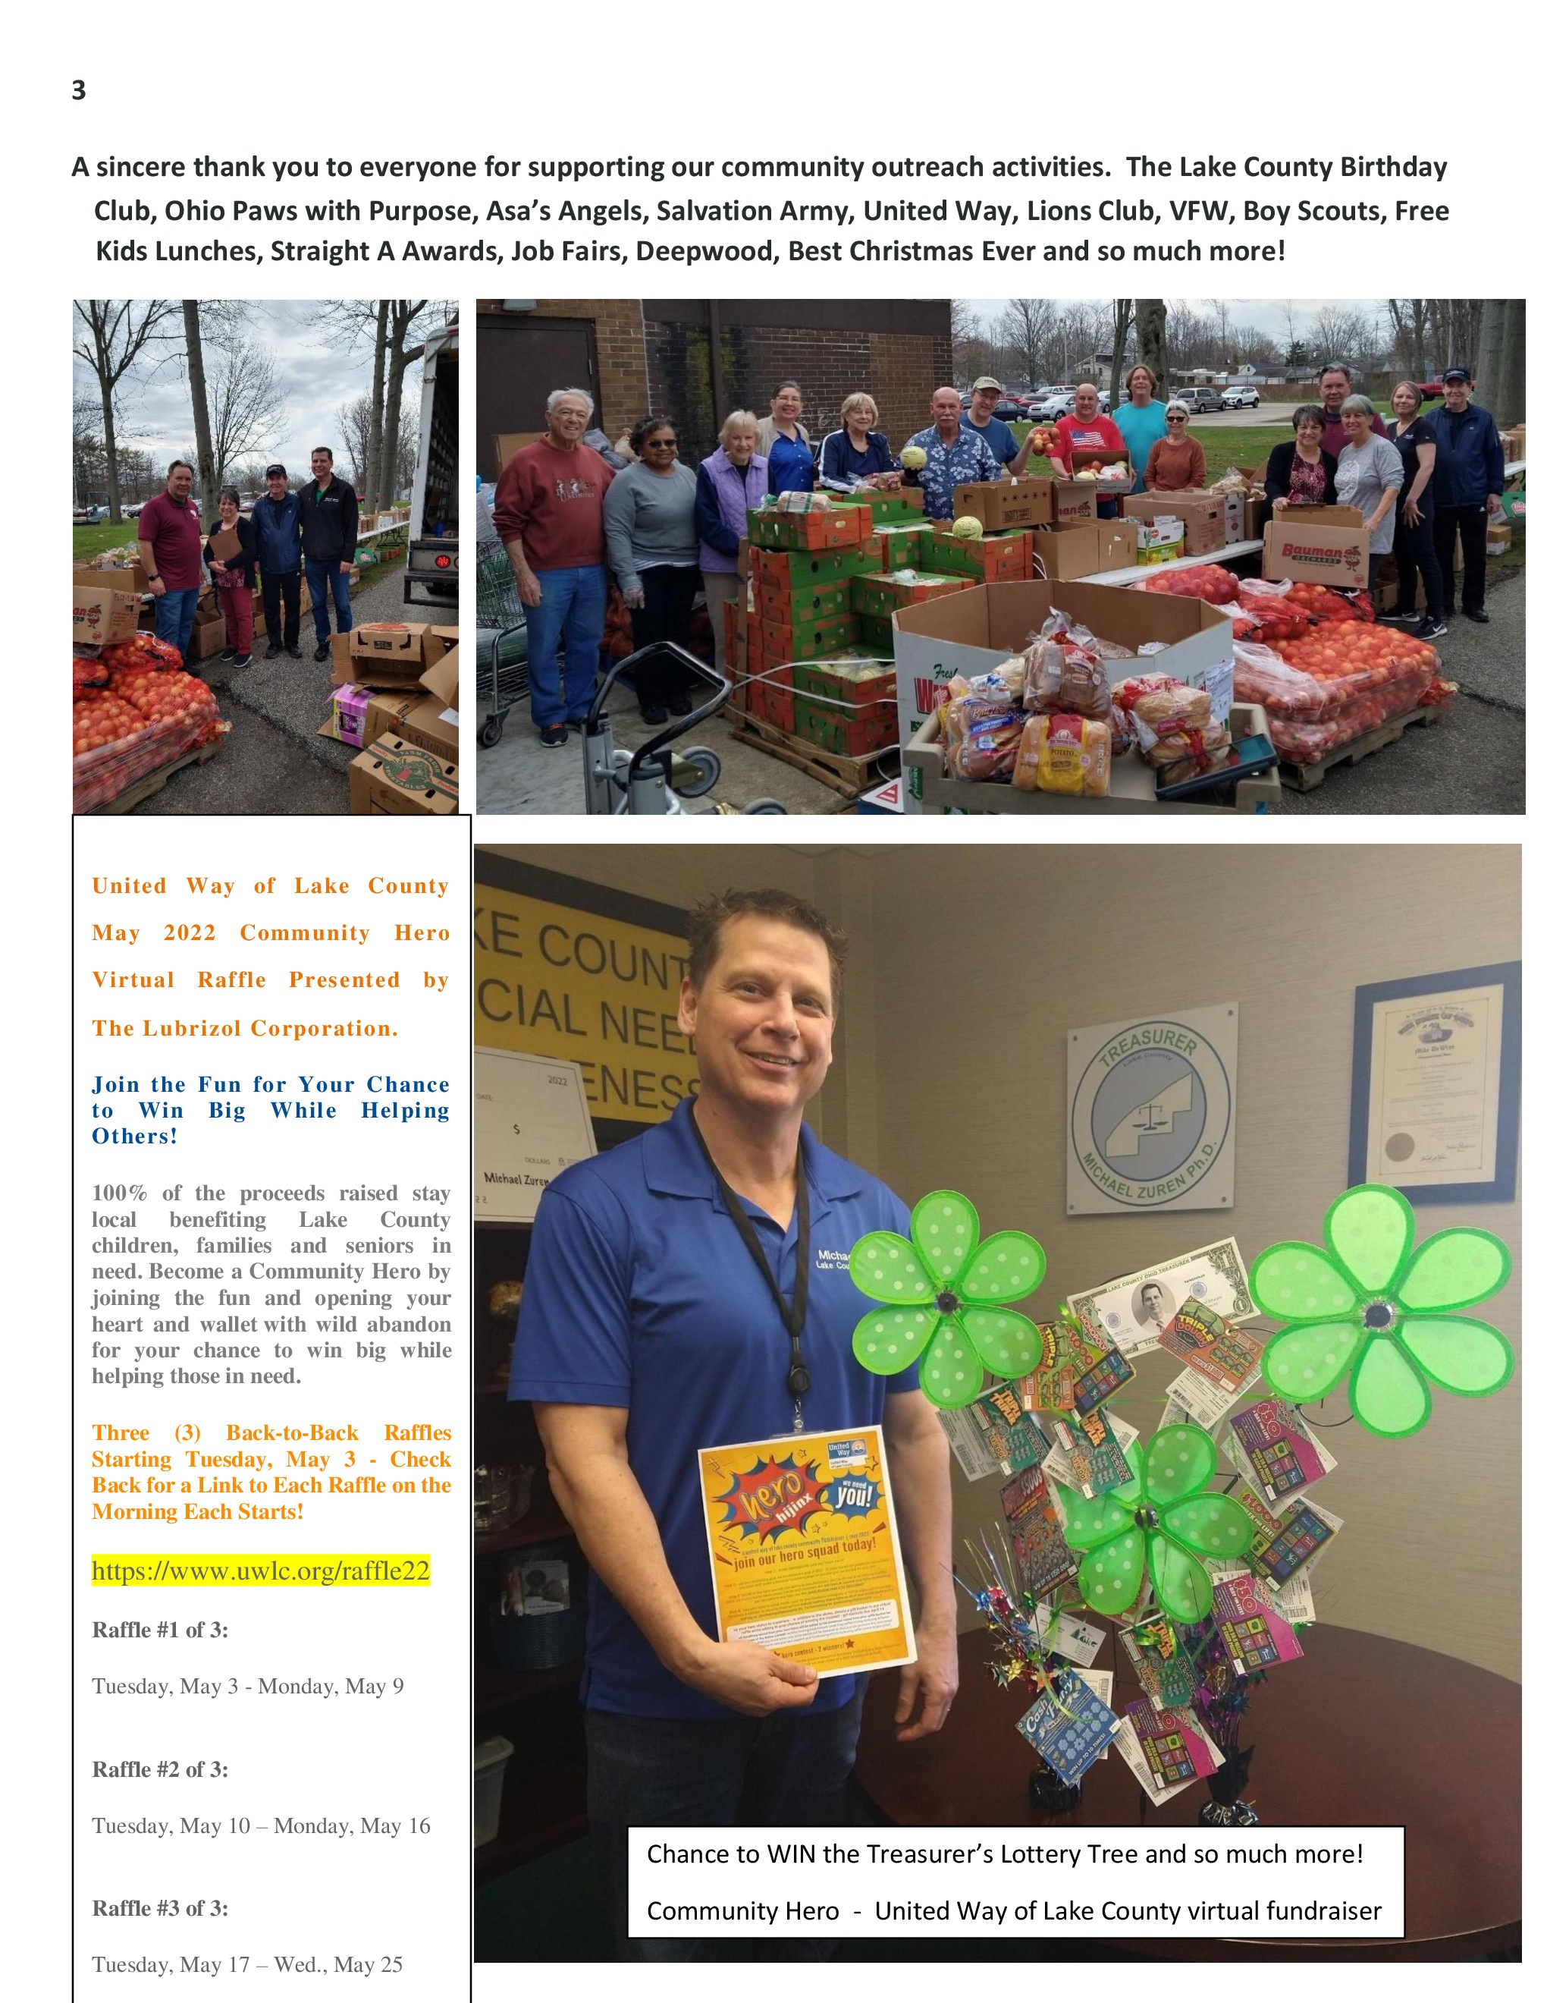

Slide 17
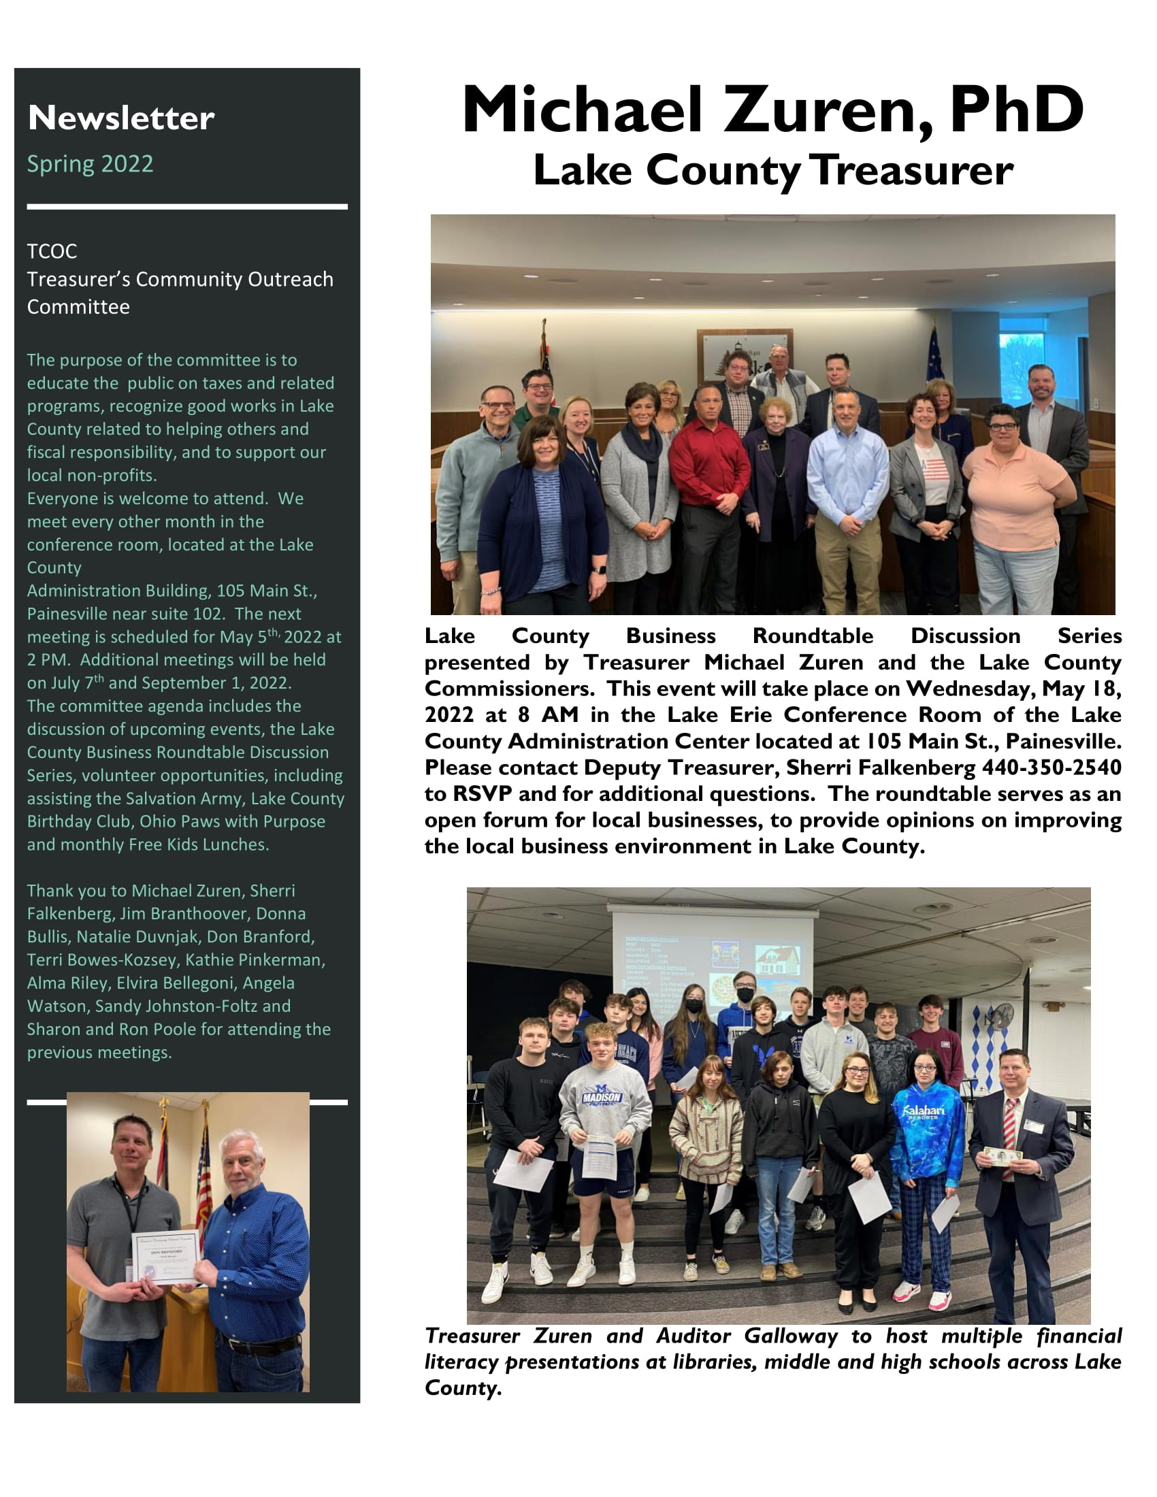
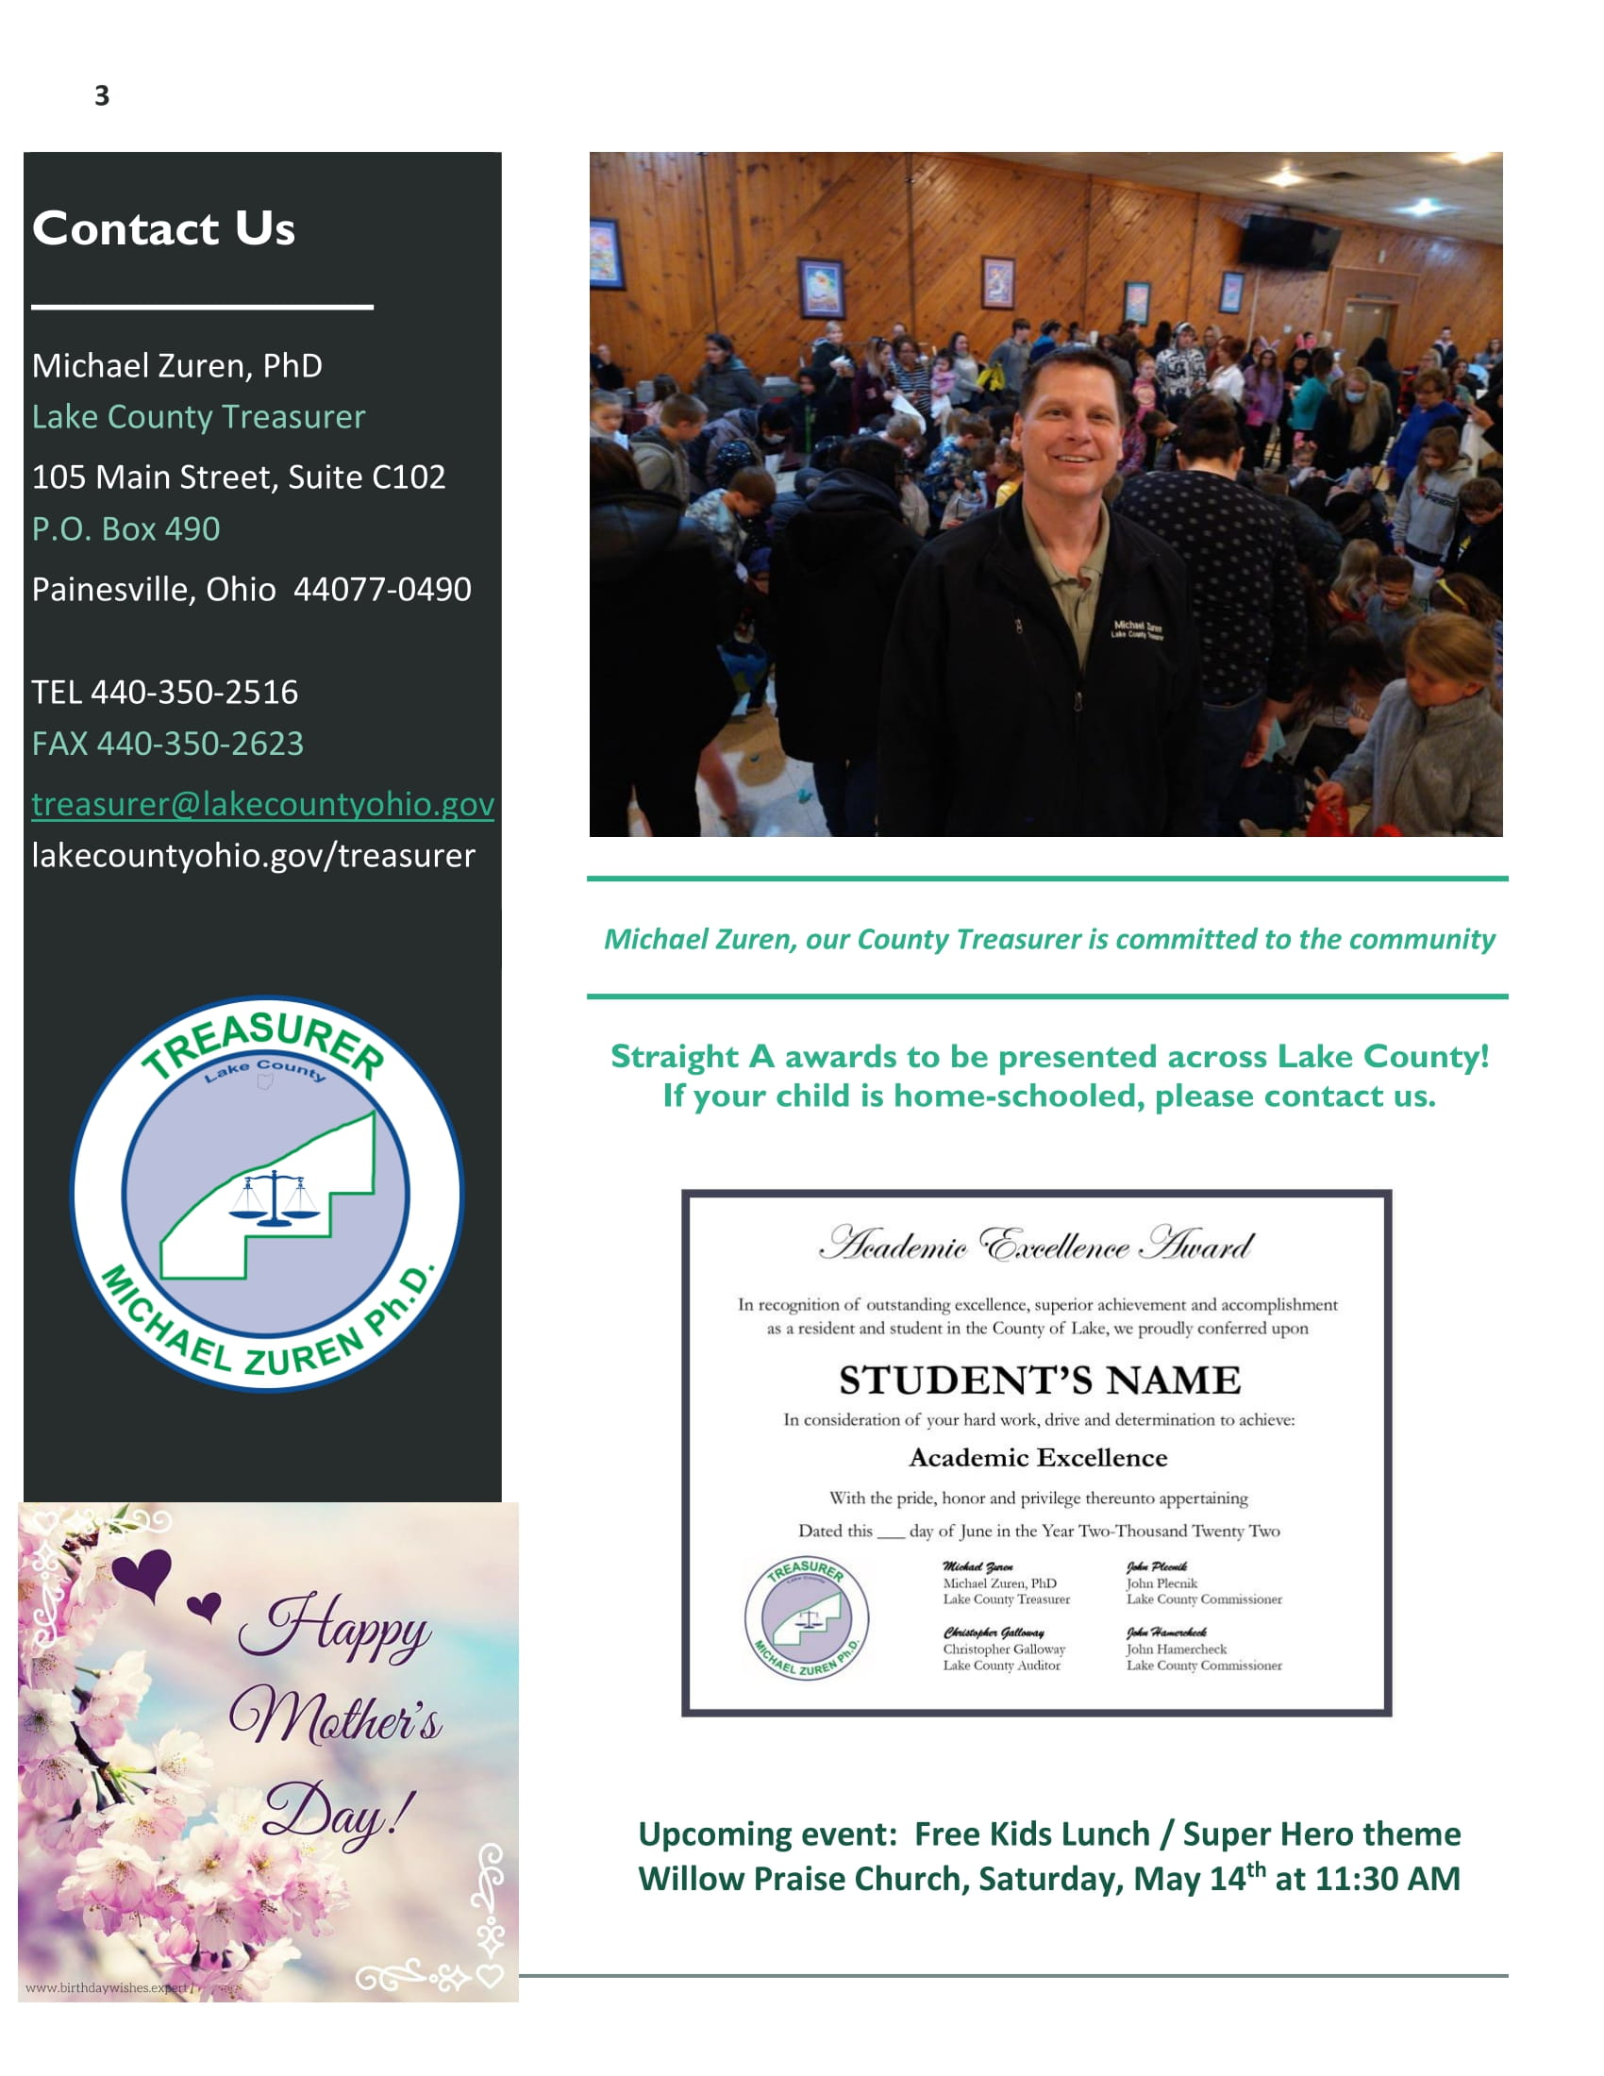

Slide 18
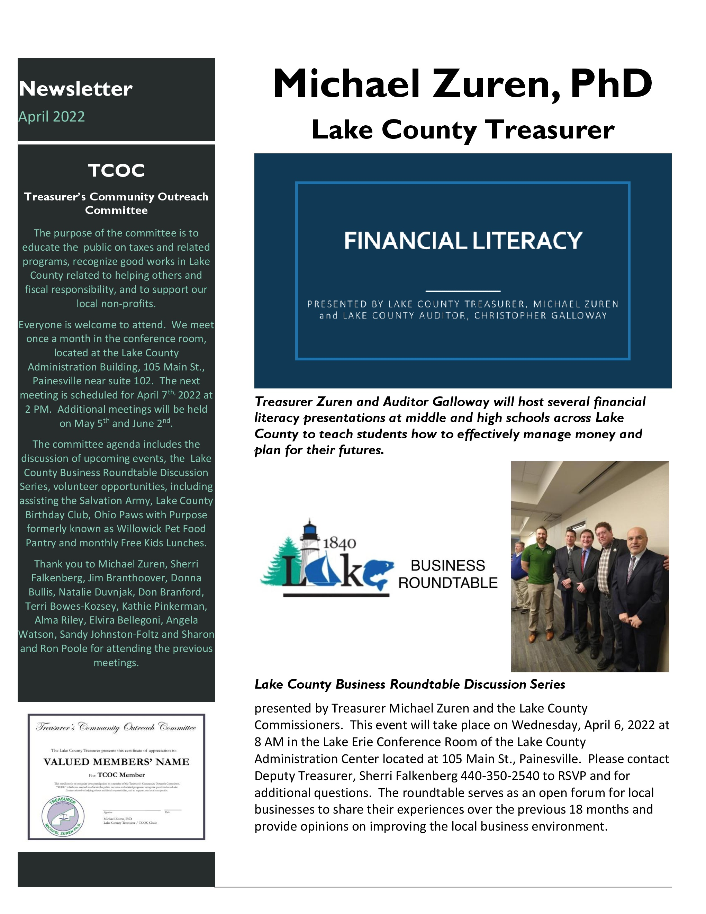
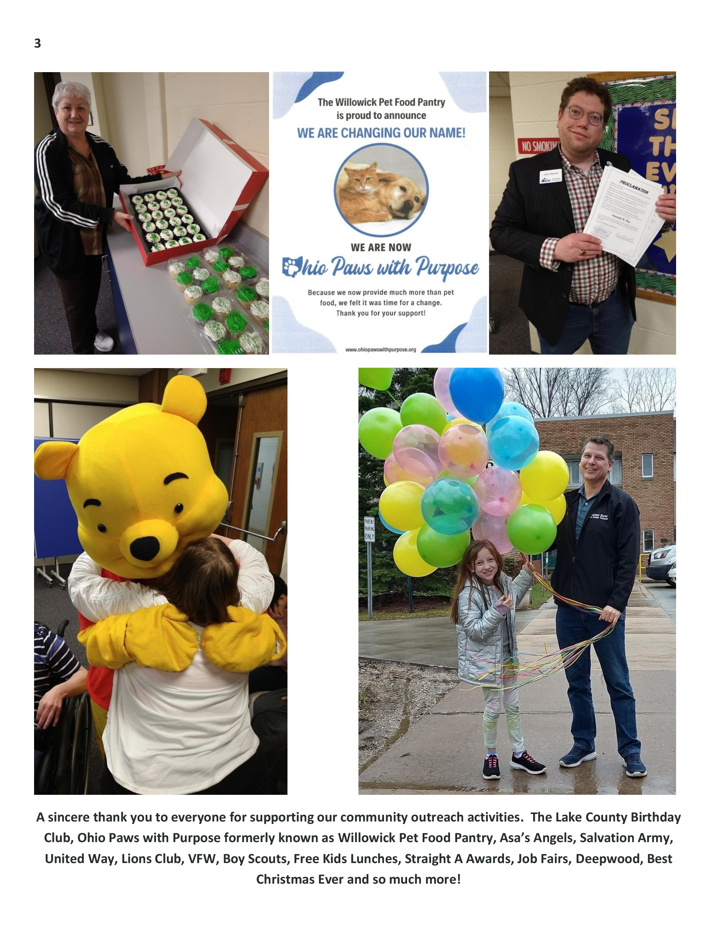

Slide 19
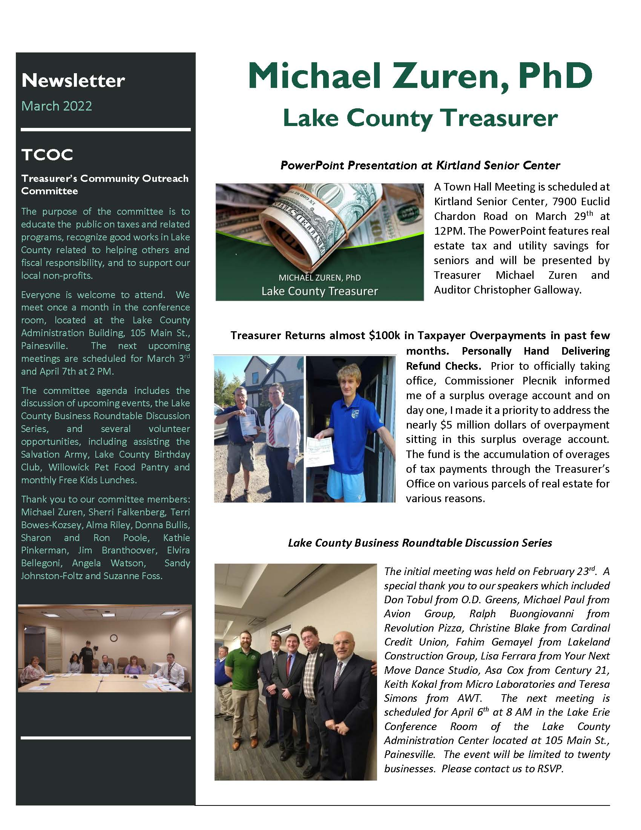
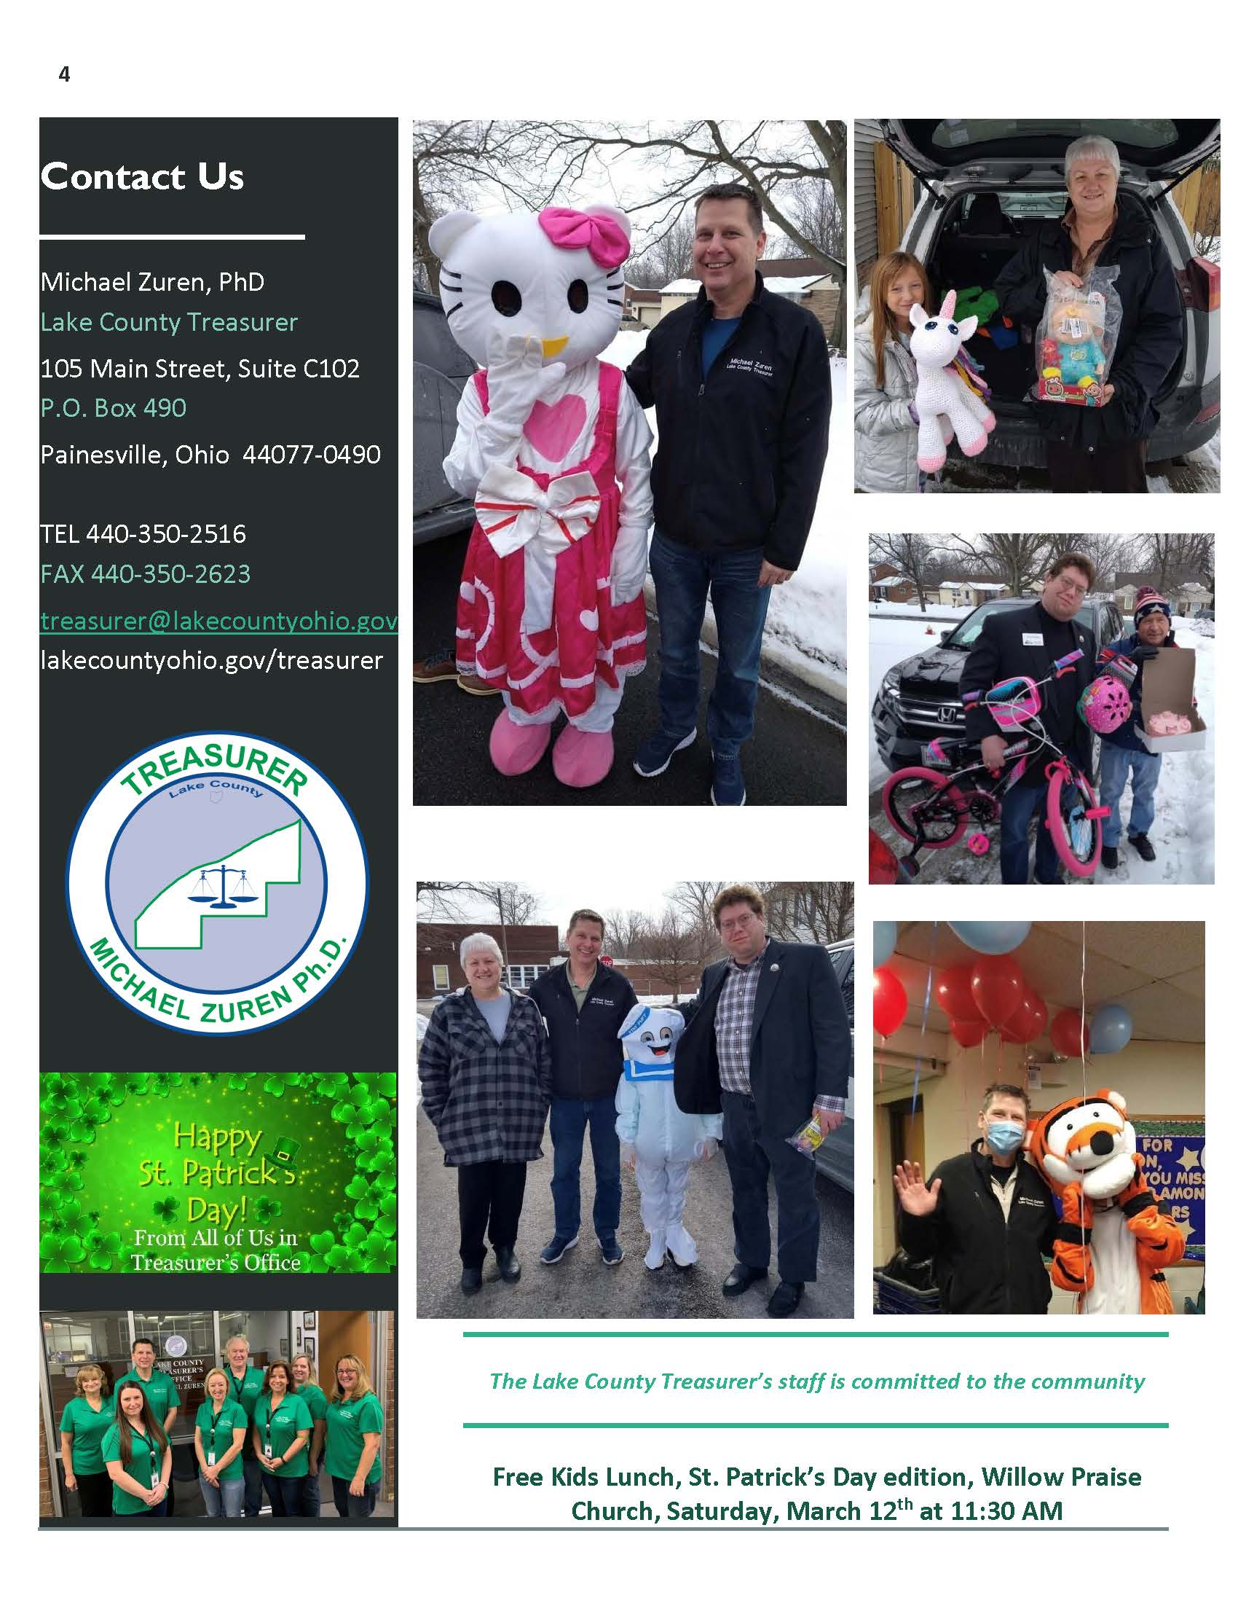

Slide 20
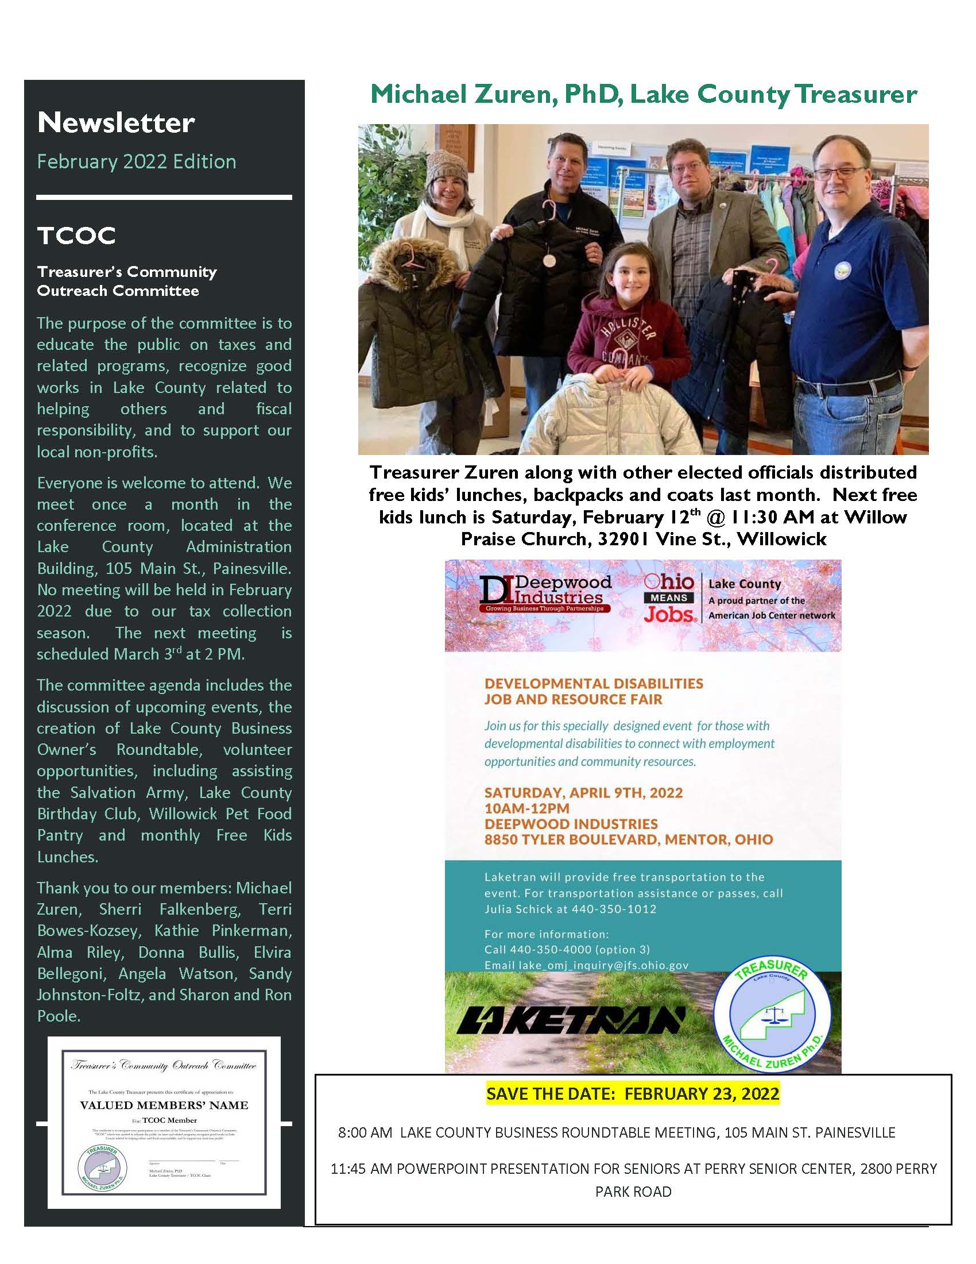
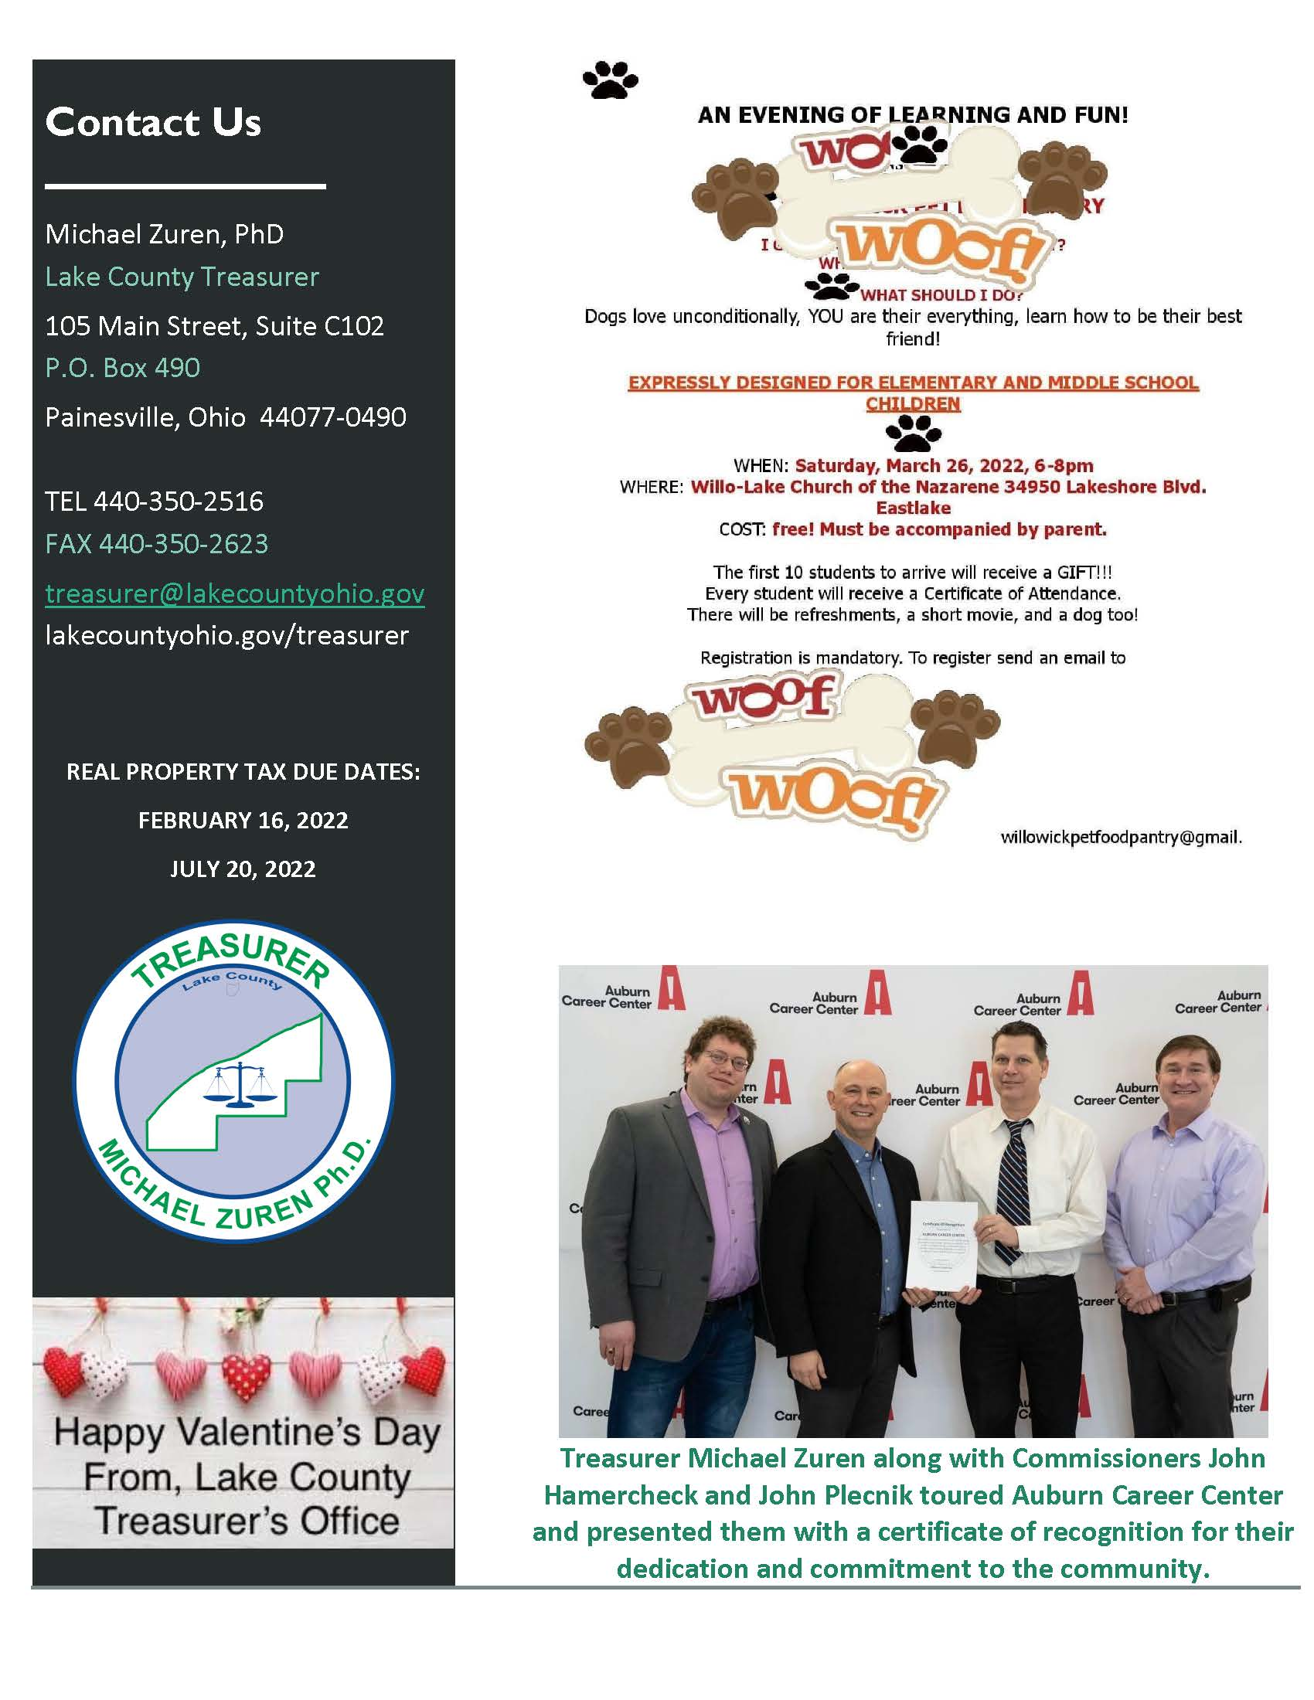

Slide 21
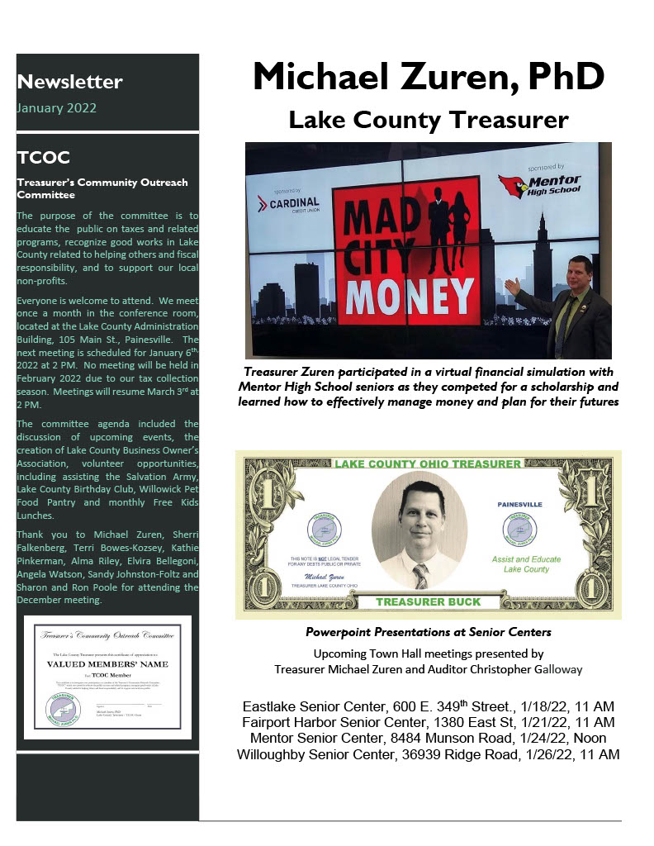
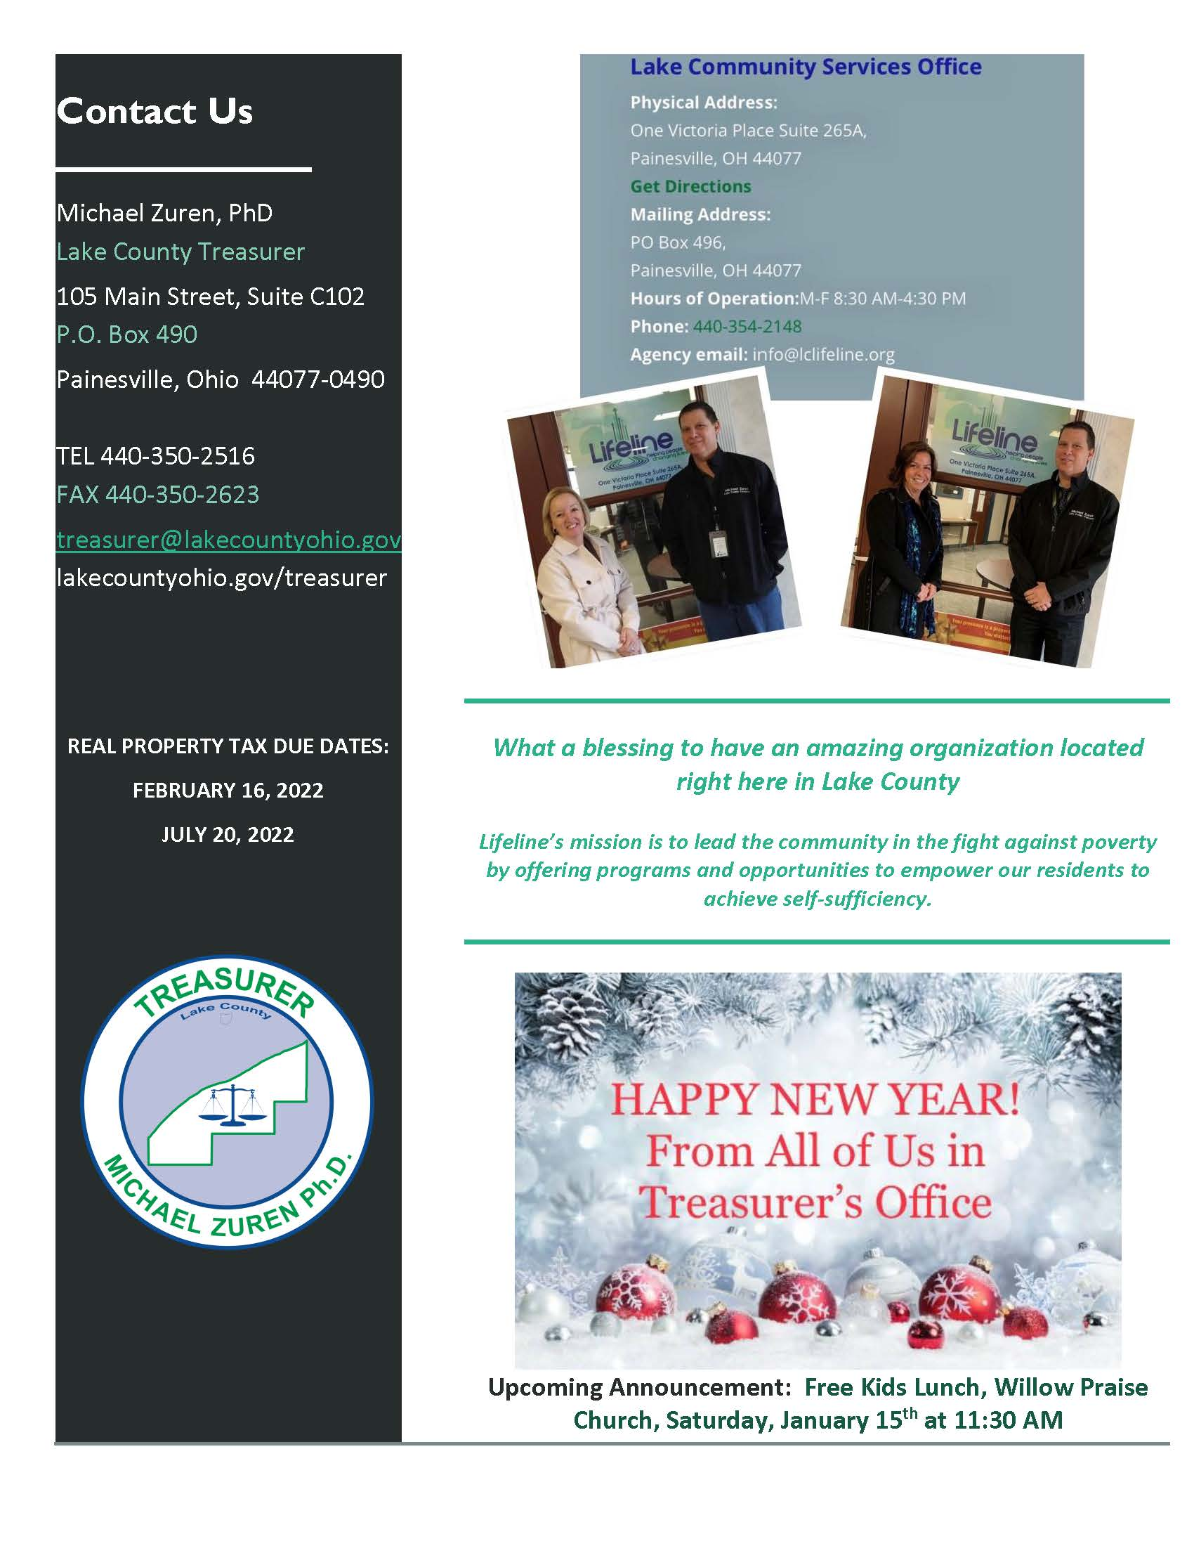

Slide 22
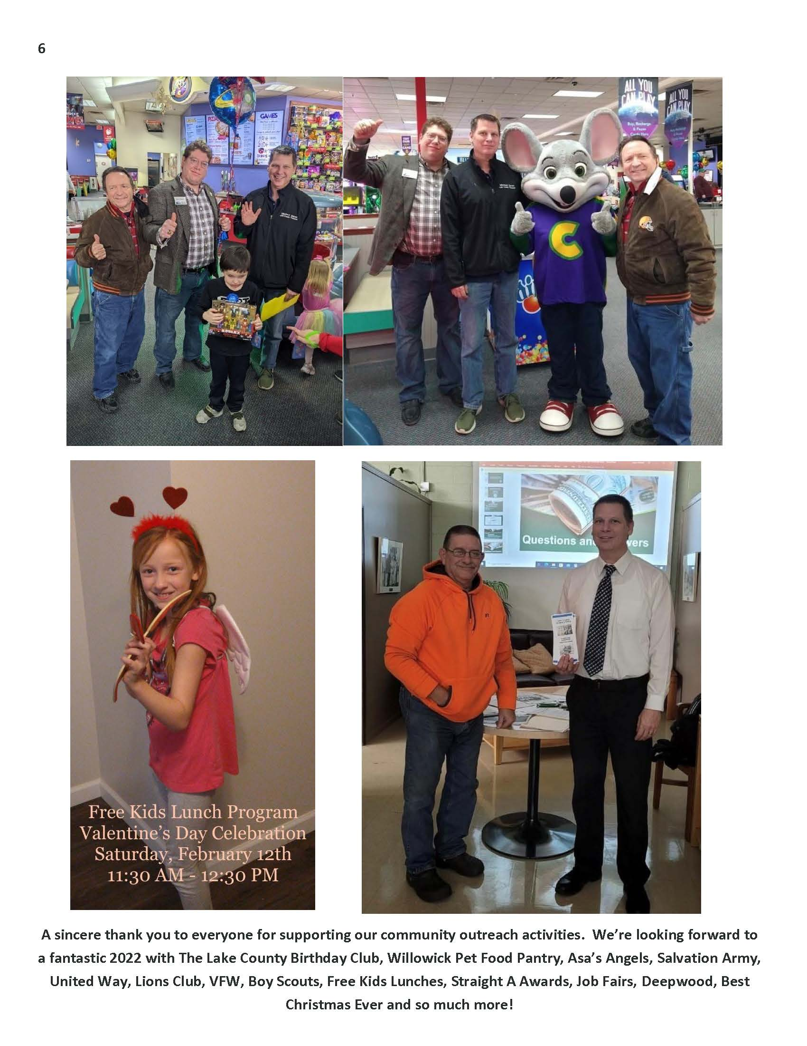
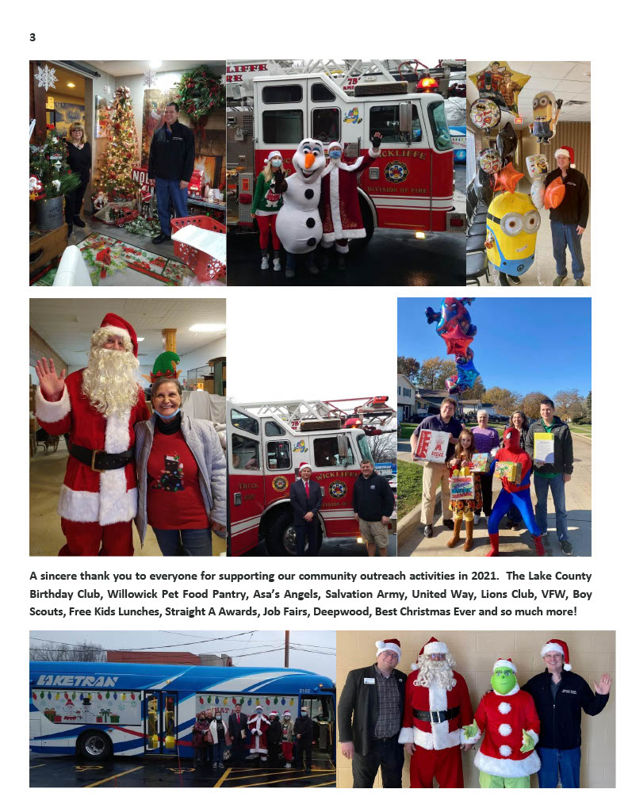

Slide 23
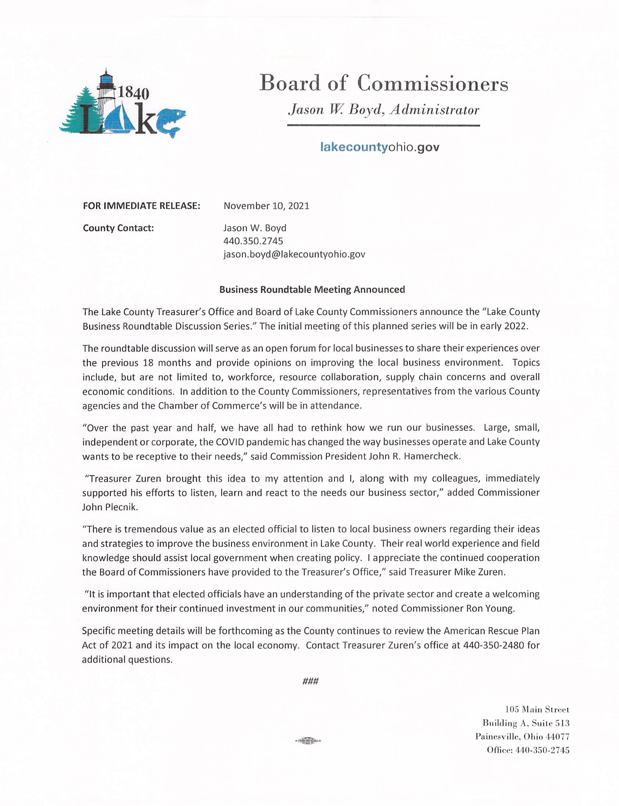
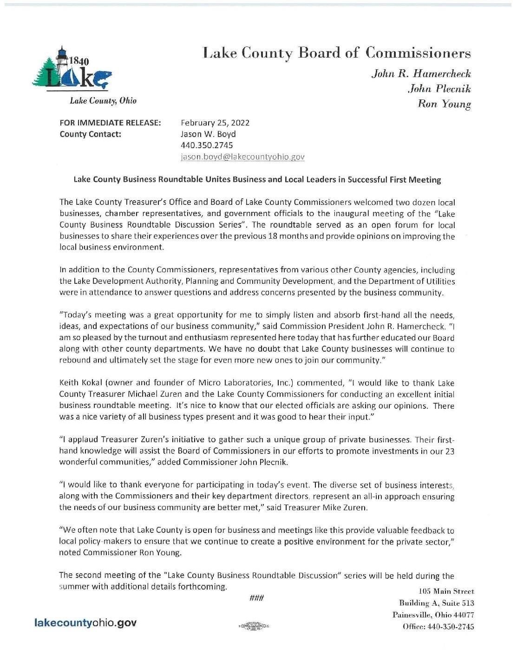

Slide 24
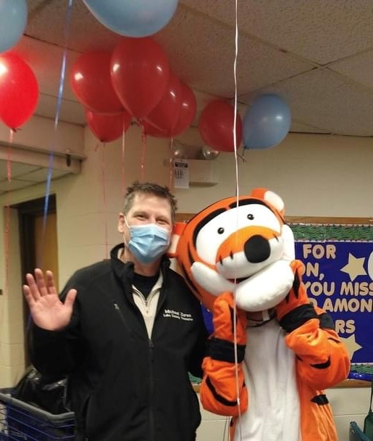
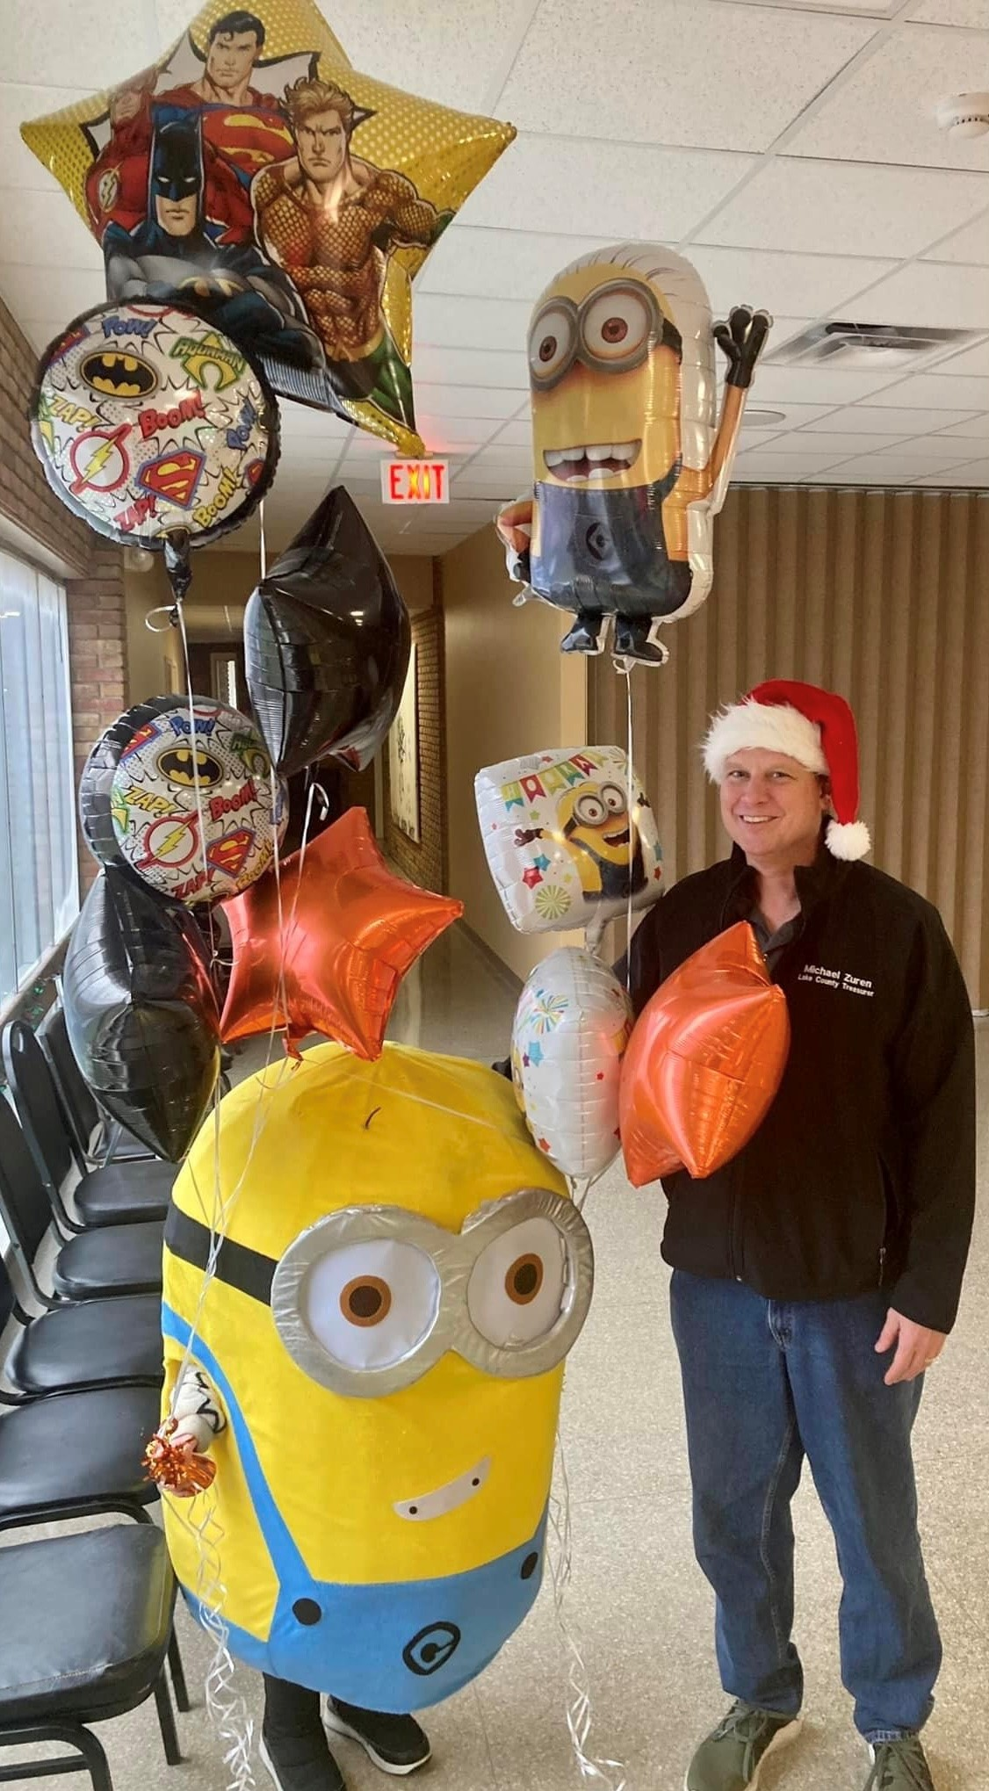
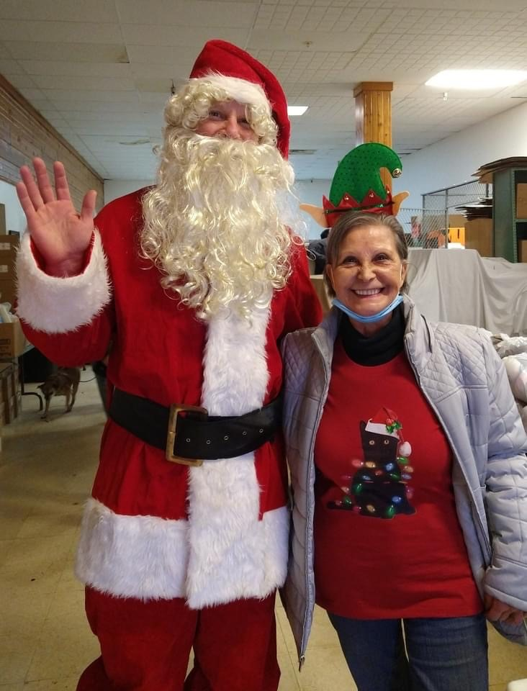
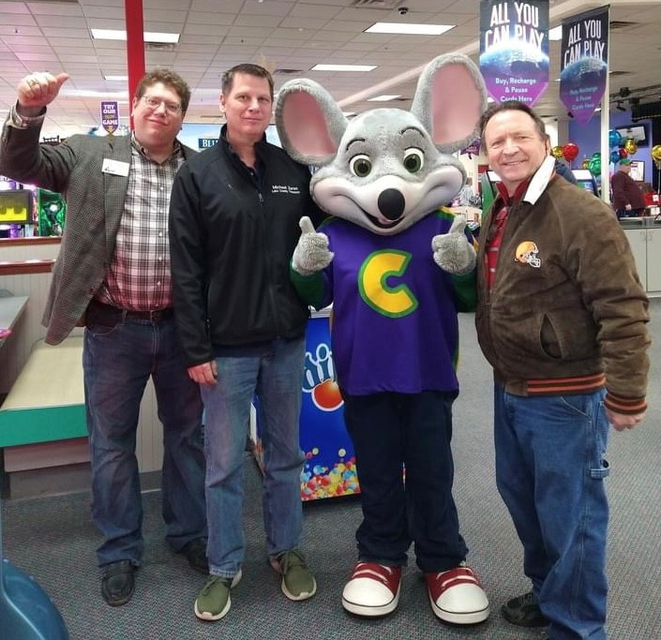
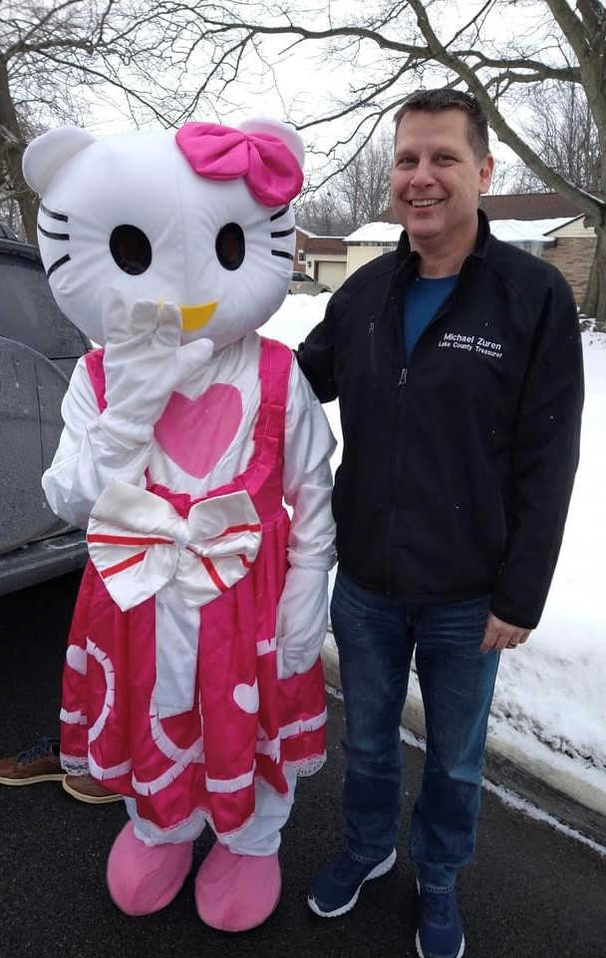
Free Kids Lunch Program
Lake County Special Needs Birthday Club
Ohio Paws with Purpose formerly Willowick Pet Food Pantry
Food Distributions at Local Schools

Slide 25

BOARDS & COMMUNITY OUTREACH
UNITED WAY
WILLOWICK PET FOOD PANTRY
WILLOW PRAISE CHURCH
SALVATION ARMY
LIONS CLUB
FORMER EASTLAKE COUNCILMAN

Slide 26

Future Career Opportunities

Slide 27
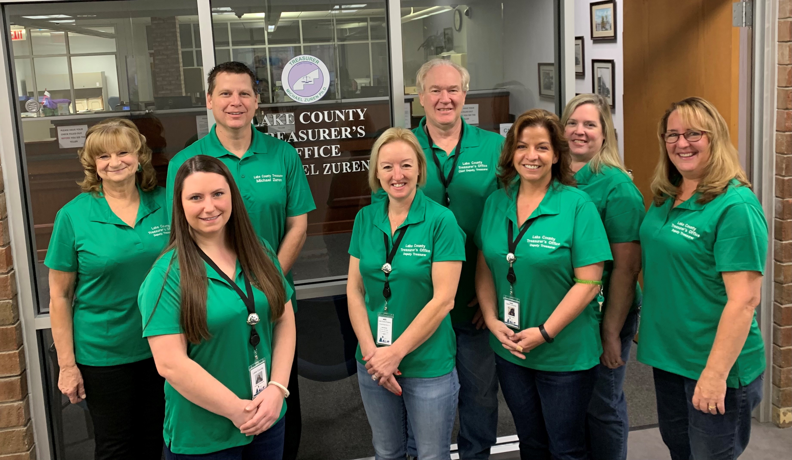
Lake County Treasurer’s Office

Slide 28
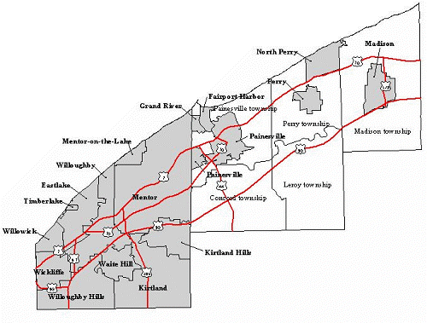
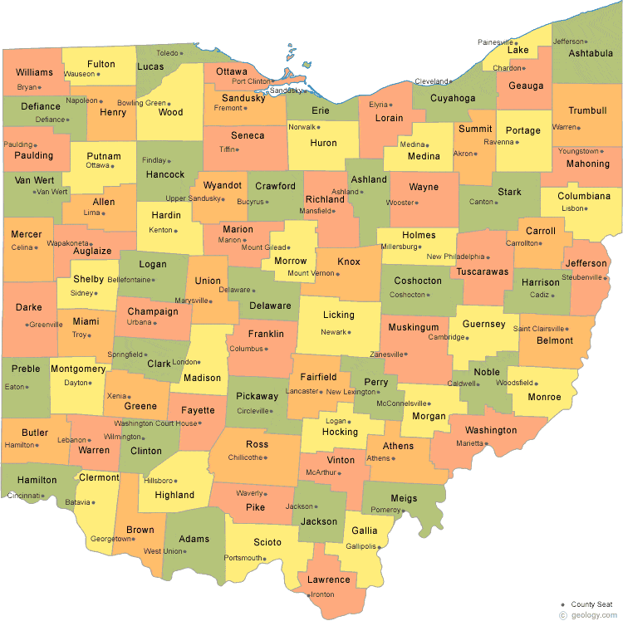
LAKE COUNTY, OHIO

Slide 29

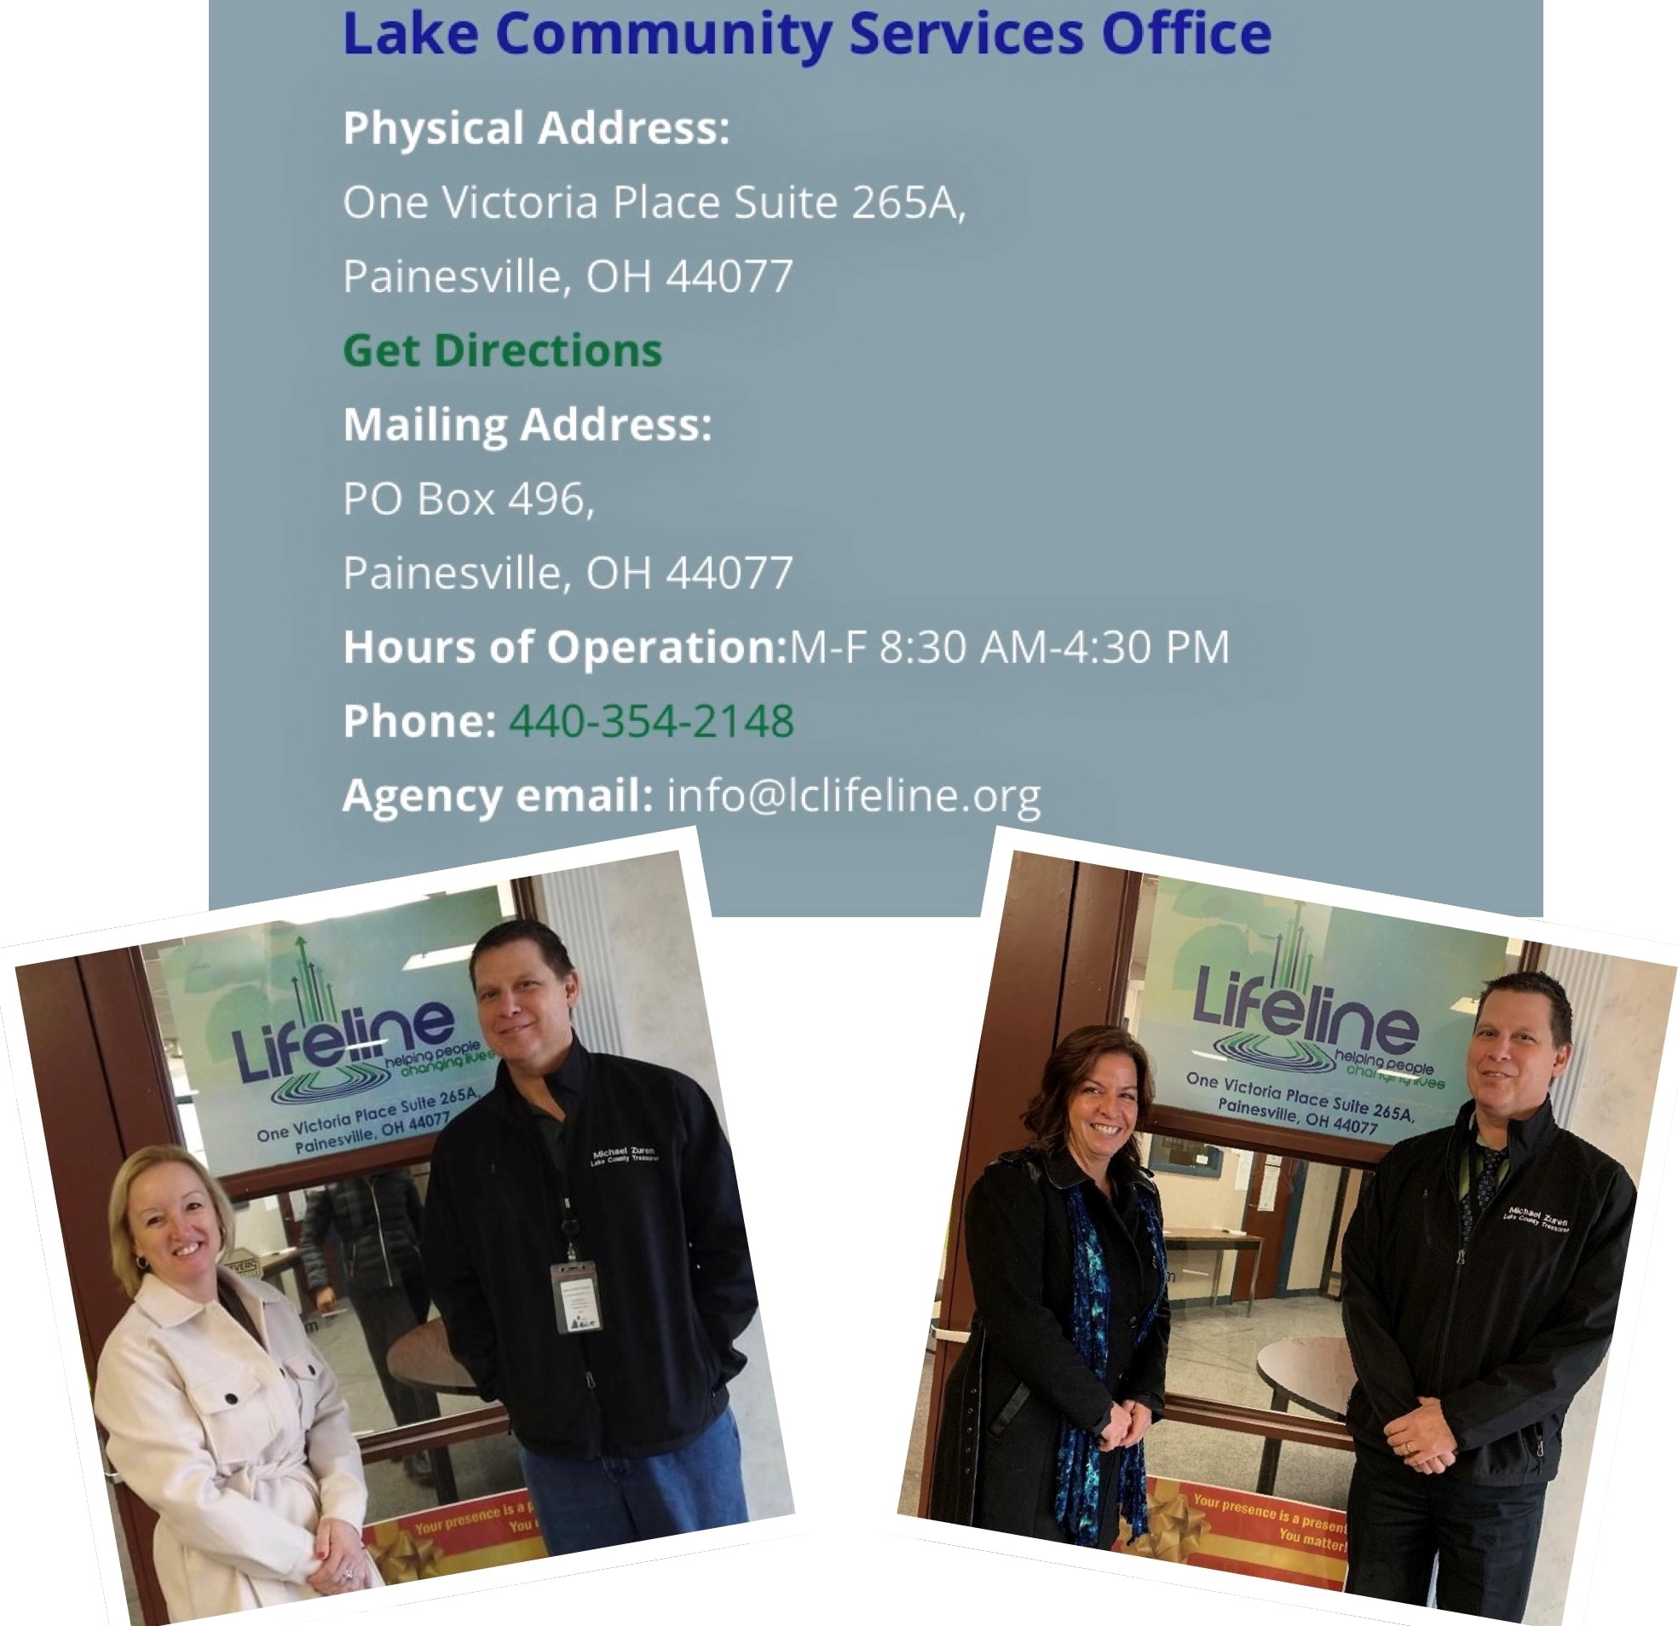
PROMOTE COMMUNITY ASSISTANCE PROGRAMS

Slide 30
Questions and Answers

Slide 31
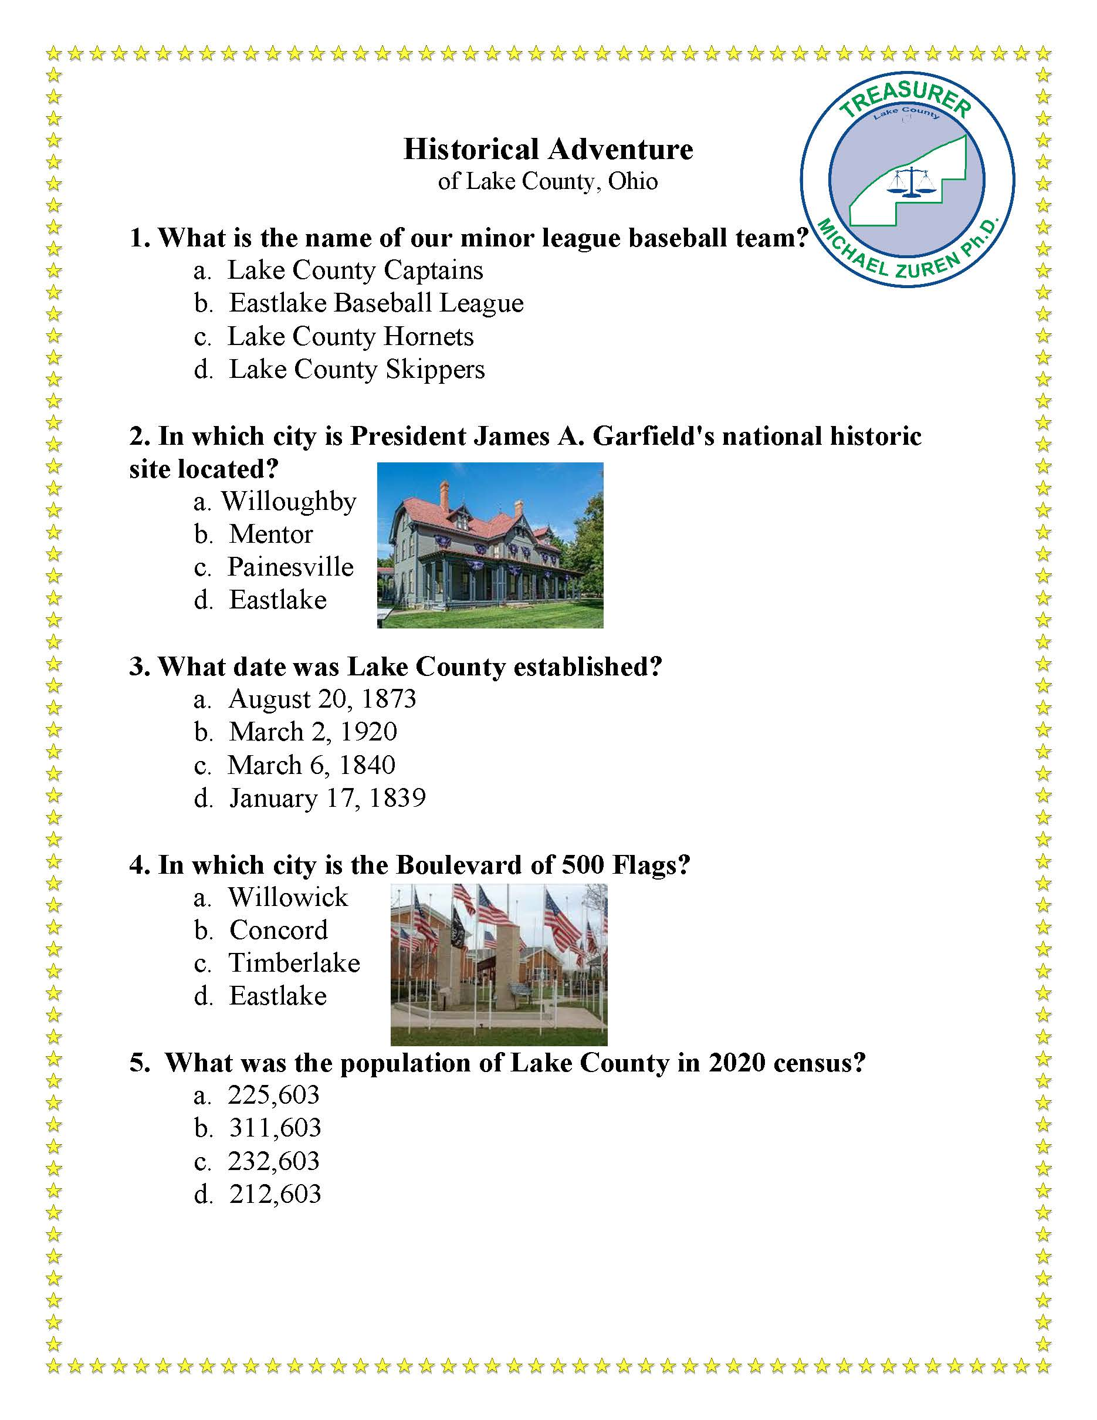
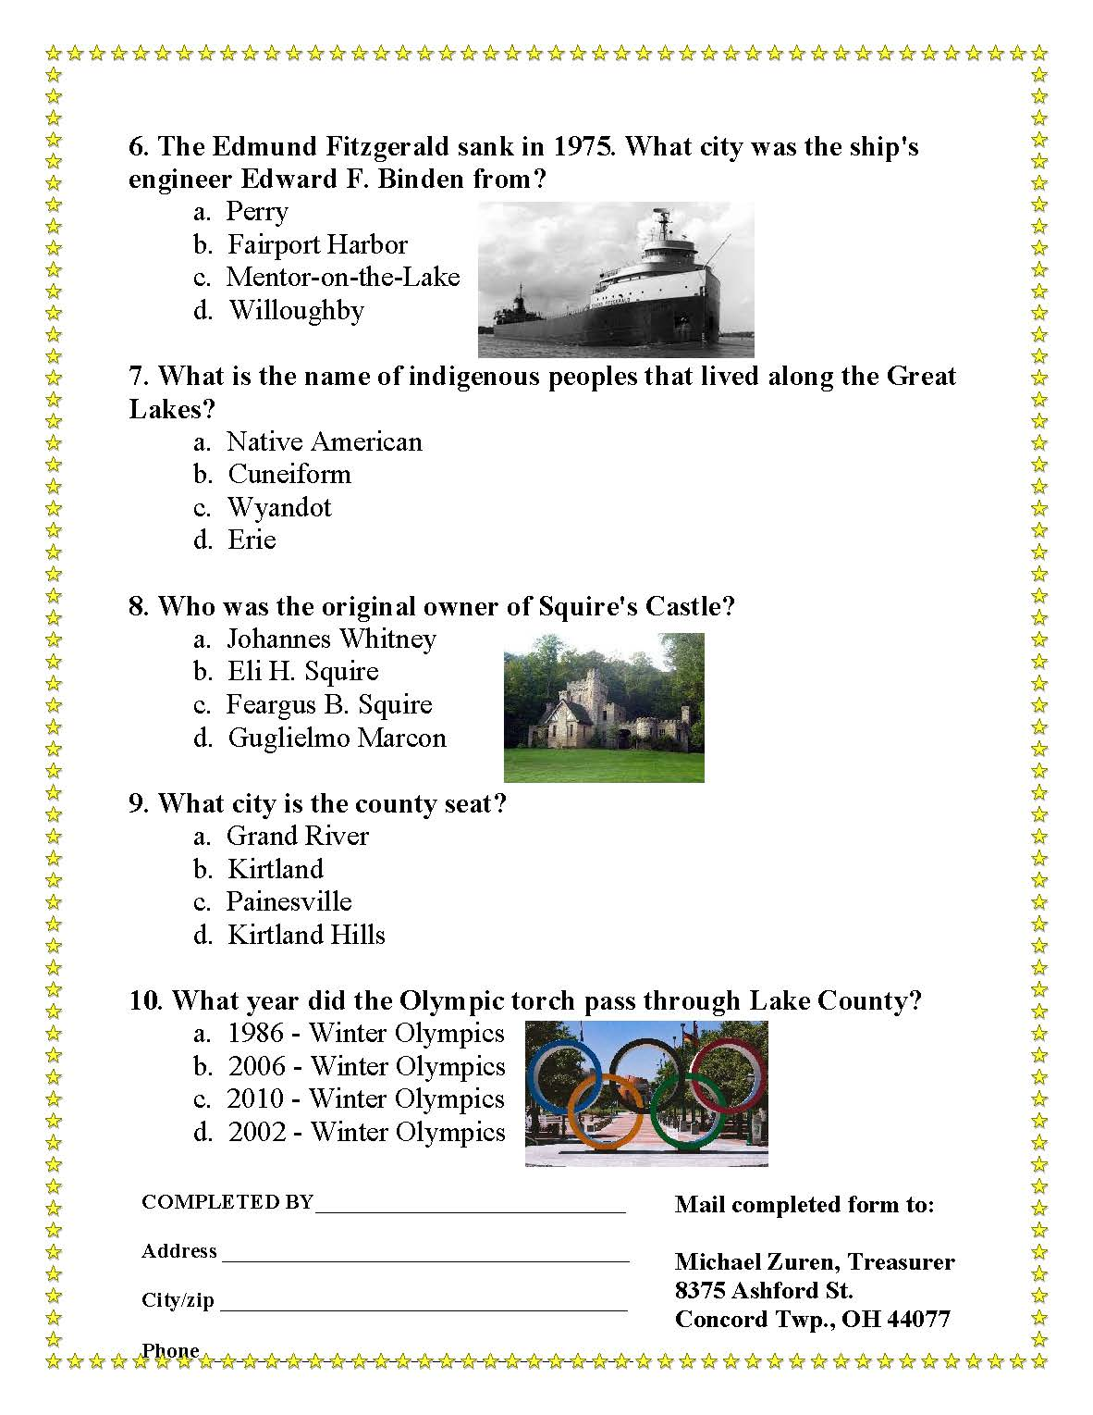

Slide 32
