Slide 1
MICHAEL ZUREN, PhD Lake County Treasurer

Slide 2
Treasurer’s Office Functions
Responsible for safeguarding all County funds
Cash Manager for all funds received and deposited
Serves as County’s Chief Investment Officer
Administrator of sophisticated delinquent tax collection programs
Maintains tax escrow and prepay accounts

Slide 3
Programs for Seniors
Homestead Exemption Qualifications
Must be 65 or older or totally disabled
You must own your home on January 1st in the year you are applying for the homestead exemption
If house is in a Trust or Life Estate, copy of trust is required
Must be your primary Residence
Income limitations $34,200 (2020) to qualify based on the Modified Adjusted Gross Income (located on line 3 of the State Income Tax Return plus line 11 of the Ohio Schedule A)
If you do not file a State Tax Return, proof of age is required with completed exemption application
If qualified, Law Exempts the first $25,000 of value

Slide 4
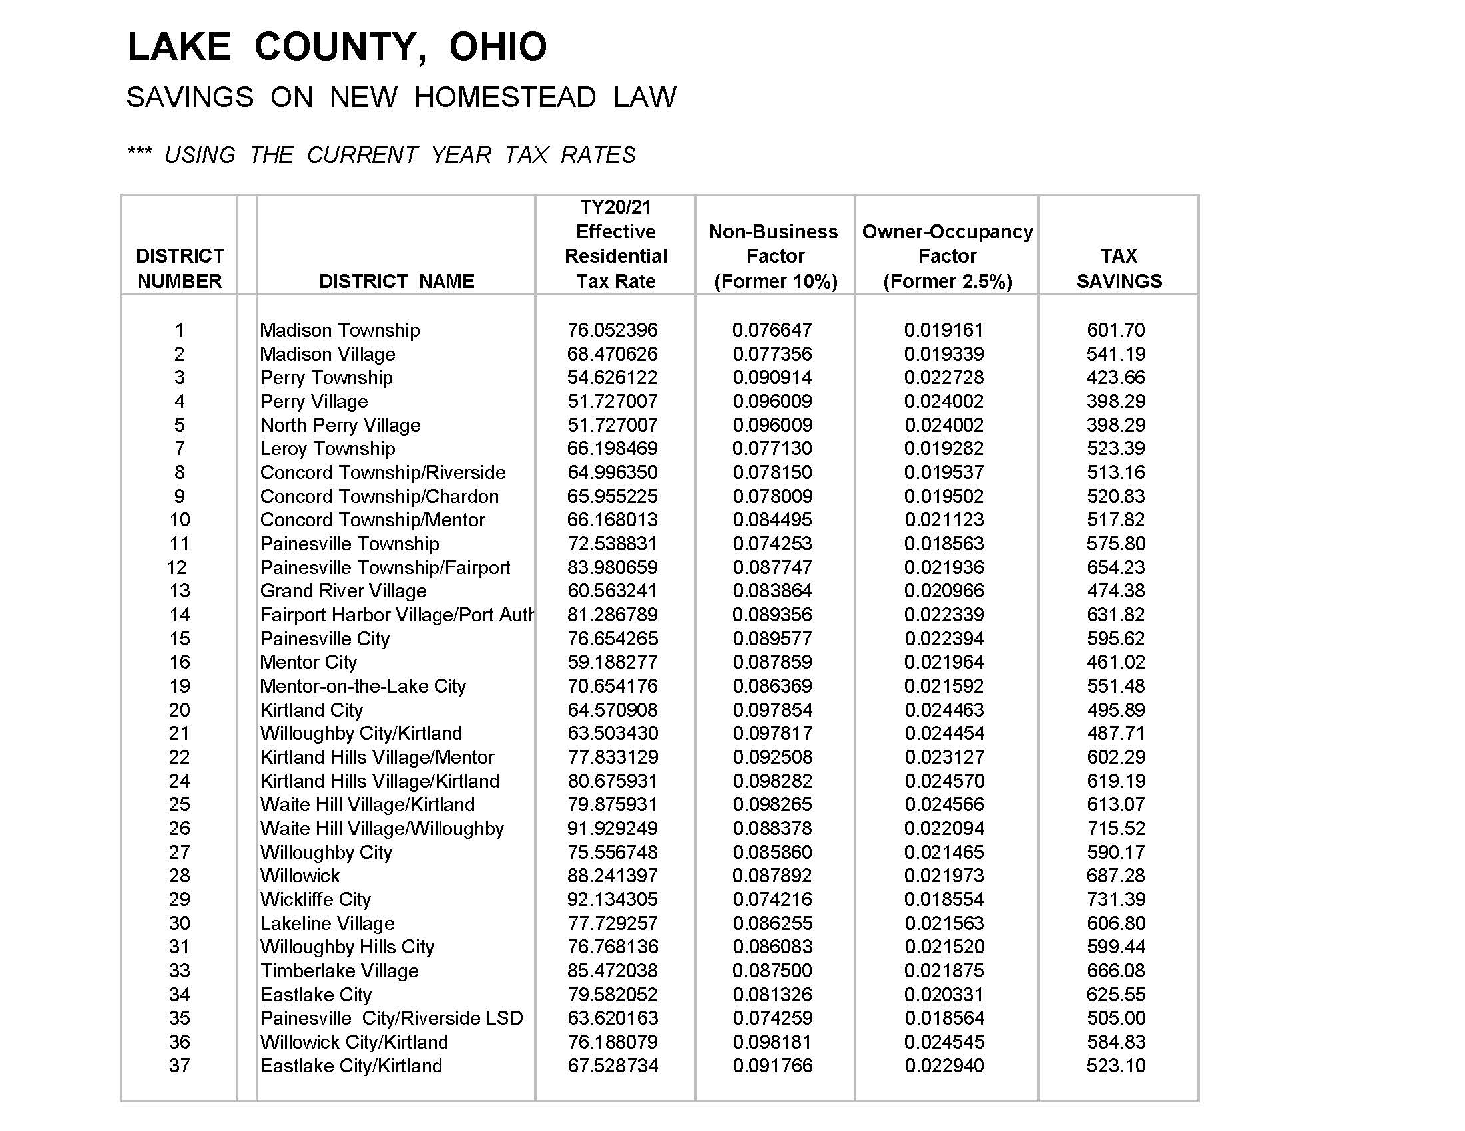
Homestead discount at current rates

Slide 5
How to obtain an application
Christopher Galloway
Lake County Auditor
105 E. Main Street
Painesville, Ohio 44077
Attn: Homestead Dept
440-918-2532 Ext. 2536 (Western Lake County)
440-350-2536 (Painesville)
440-428-4348 Ext. 2536 Madison
Form available online at Auditor’s website
https://www.lake.iviewauditor.com/

Slide 6
Programs for Veterans
Disabled Veterans and Surviving Spouses Program
Must be 100% disabled for the year applying for exemption
VA disabled Veterans do not have any income requirements
If qualified, Law Exempts the first $50,000 of value
Notes:
6

Slide 7
Other Programs of Interest
Spouses of Public Service Officers Killed in the Line of Duty
Applicant must be the surviving spouse and will be entitled to a reduction in property taxes under this exemption for the tax year in which the public service officer dies through the tax year in which the surviving spouse dies or remarries

Slide 8
Did you move or refinance in the last year?
If you do not receive a real estate tax bill by FEBRUARY 1ST and JULY 1ST of each year, please contact the Treasurer’s office

Slide 9
UPDATE OR CHANGE YOUR ADDRESS
Please send letter or E-mail, to update mailing address
Michael Zuren, PhD
Lake County Treasurer
105 Main St PO Box 490
Painesville, OH 44077
Treasurer@lakecountyohio.gov

Slide 10
PAYMENT OPTIONS
Drive Thru
FIRST HALF COLLECTION JANUARY 2022-FEBRUARY 16, 2022
SECOND HALF COLLECTION JUNE 2022- JULY 16, 2022
Auto Pay (form located on Lake County Ohio Treasurer’s website)
Credit Card (fees apply)
E-Check ($1.50 fee applies if under $10,000)
Mail (postmark accepted)
Drop Box (no cash please)
In Person

Slide 11
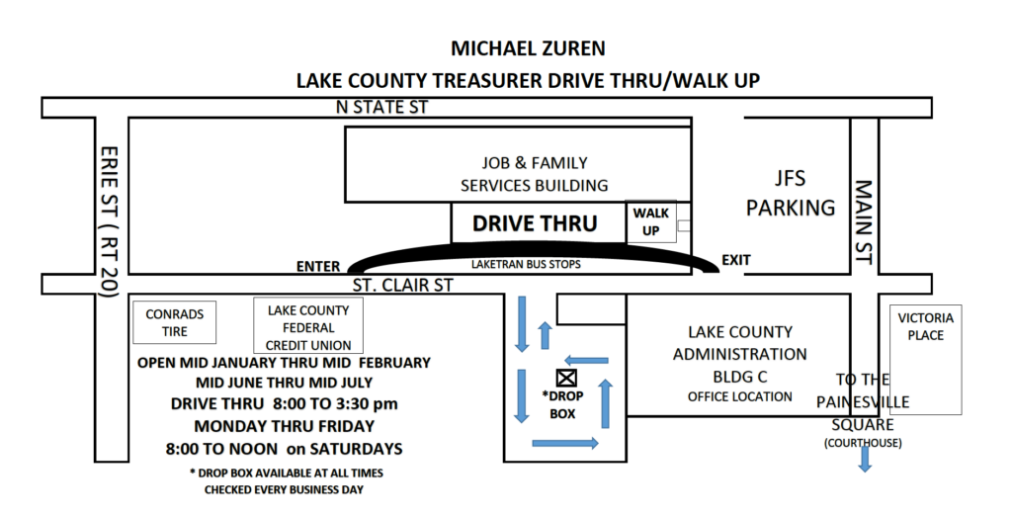

Slide 12
If you have any questions concerning the Treasurer’s Office please do not hesitate to call
from Painesville (440)350-2516,
from Madison (440)428-4348,
from West End and Cleveland (216) 918-2516;
FAX (440) 350-2623, send E-mail or visit us personally at the County Administration Building (105 Main St, Painesville, Ohio 44077)
Hours: Open Monday – Friday 8:00 AM – 4:30 PM
Extended hours during tax collection season (Open Saturdays)

Slide 13
Questions and Answers

