Slide 1
Lake County Township Trustee Association Annual Meeting
Lake County Engineer Update
April 20, 2023

Slide 2
ROADS AND BRIDGES
The County maintains 151.477 miles of roadway exclusive of SR 2.
The County maintains 102 bridges. These exist in the Townships as well as the Cities and Villages.

Slide 3
ROADS AND BRIDGES
AVERAGE MAXIMUM LIFE SPANS:
    Asphalt Roadway = 15 years
    Bridges = 50 years

Slide 4
ROADS AND BRIDGES
2019 ROADWAY COSTS/MILE:
    Chip Seal = $200,000/mile
    Asphalt = $800,000/mile
    Average = $500,000/mile

Slide 5
ROADS AND BRIDGES
2022 ROADWAY COSTS/MILE:
Costs increased by 33 1/3% for roadway projects.
    2022 Average Cost = $650,000/mile.

Slide 6
ROADS AND BRIDGES
Using a 15 year useful life & 150 miles of roads, we must do a minimum of 10 miles of roadway capital mainenance per year. This is just to stay even.
    10 miles x $650,000 = $6,500,000/year

Slide 7
ROADS AND BRIDGES
2019 AVERAGE COST TO REPLACE A BRIDGE:
    Average Cost = $1,000,000 / year

Slide 8
ROADS AND BRIDGES
2022/2023 BRIDGES/CULVERTS:
Costs increased by 50% for bridge and culvert projects.
    2022 Average Cost = $1,500,000

Slide 9
ROADS AND BRIDGES
Using a 50 year useful life & 102 bridges, we must replace a minimum of 2 bridges/culverts per year. This is just to stay even.
    2 bridges x $1,500,000 = $3,000,000/year

Slide 10
ROADS AND BRIDGES
IN SUMMARY:
Roads - $6,500,000/year
Bridges - $3,000,000/year
$9,500,000/year

Slide 11
ROADS AND BRIDGES
THIS DOES NOT INCLUDE RETAINING WALL REPAIR/REPLACEMENT, SLIDES AND OR OTHER CAPITAL IMPROVEMENT PROJECTS THAT MAY BE REQUIRED IN THE FUTURE.

Slide 12
ROADS AND BRIDGES
CAPITAL MAINTENANCE PROJECTS:
Match money for Federal/State funded projects;
Money for resurfacing roads, replacing bridges & culverts that do not qualify or receive any outside funding;
Money to replace/repair retaining walls and roadway slips;
Money for professional services which are not eligible for Federal funding, generally.

Slide 13
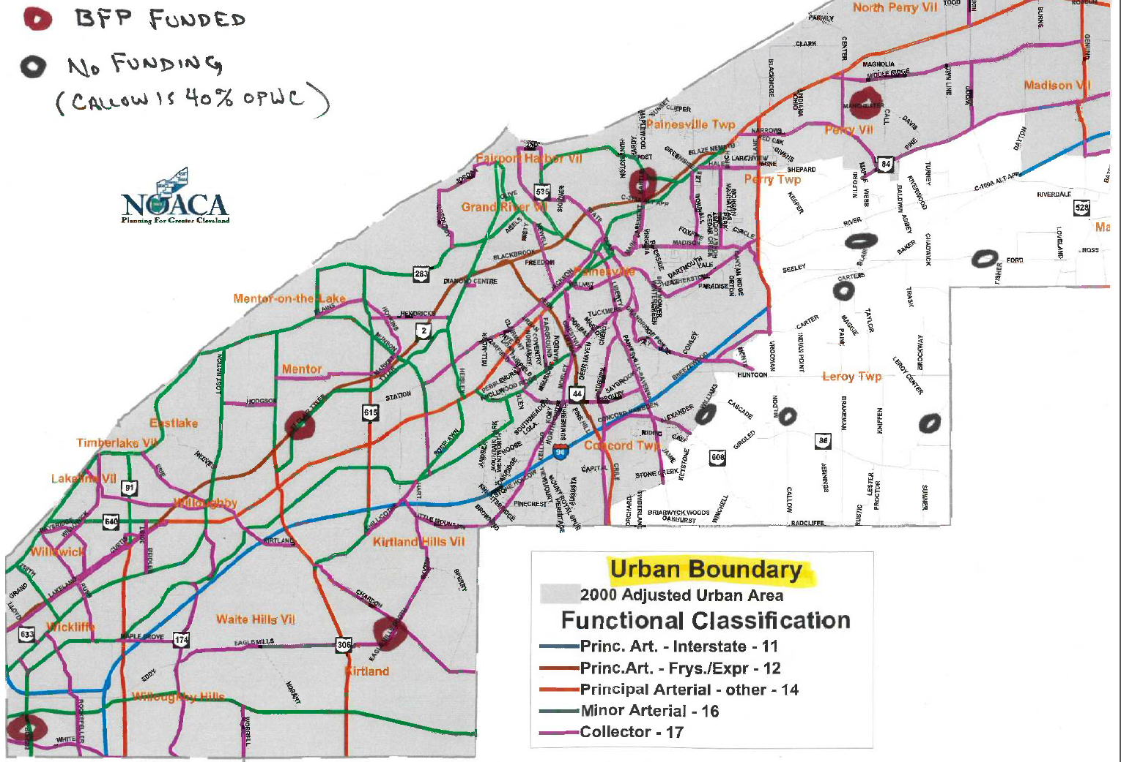

Slide 14
ENGINEER OFFICE FUNDS
Workable Income $9,500,000.00
Labor ($5,000,000.00)
SR2 ($1,000,000.00)
Snow Removal ($ 800,000.00) Present Debt
Service ($ 300,000.00)
Other Maintenance ($1,200,000.00)
NOACA Fee ($ 44,000.00)
GIS Contribution ($ 100,000.00)
Capital Maintenance $1,036,000.00
Balance
How are funds spent in a year?

Slide 15
COUNTY ROADS & BRIDGES
No. 1 Priority: Closed Roads
  • Paine Road Retaining Wall & Culvert
  • Ford Road Bridge
  • Williams Road Slope Failure
Total Cost - $5,370,000
No. 2 Priority: Pending Closures
  • Blair Road Retaining Wall
  • St. Clair Road Bridge Deck Repair
Total Cost - $3,362,300
Balance:
  • Manchester Road Bridge
  • Tyler Blvd. Bridge
  • Leroy Thompson Road Bridge Repair
  • Hopkins Road Bridge Repair
  • Numerous County Roads
What are the needs?

